Slide 1

(Continued) KEGG Mapper Analyses for selected pathways of Xanthomonas euvesicatoria pv. perforans as mapped onto the LH3 genome on KEGG (https://www.genome.jp/kegg/mapper/color.html ) at 0-1 hr and 1-4 hr following exposure to carvacrol.
For all figures, all significantly differentially expressed genes are shown in red or black color with a colored background, except that genes in black with green background indicates that the gene was not differentially expressed. Genes for which no homologue exist in this study are in black with white background. Gene expression is from -1 (red, most downregulated) to +1 (blue, most upregulated)
Gene expression key

Slide 2
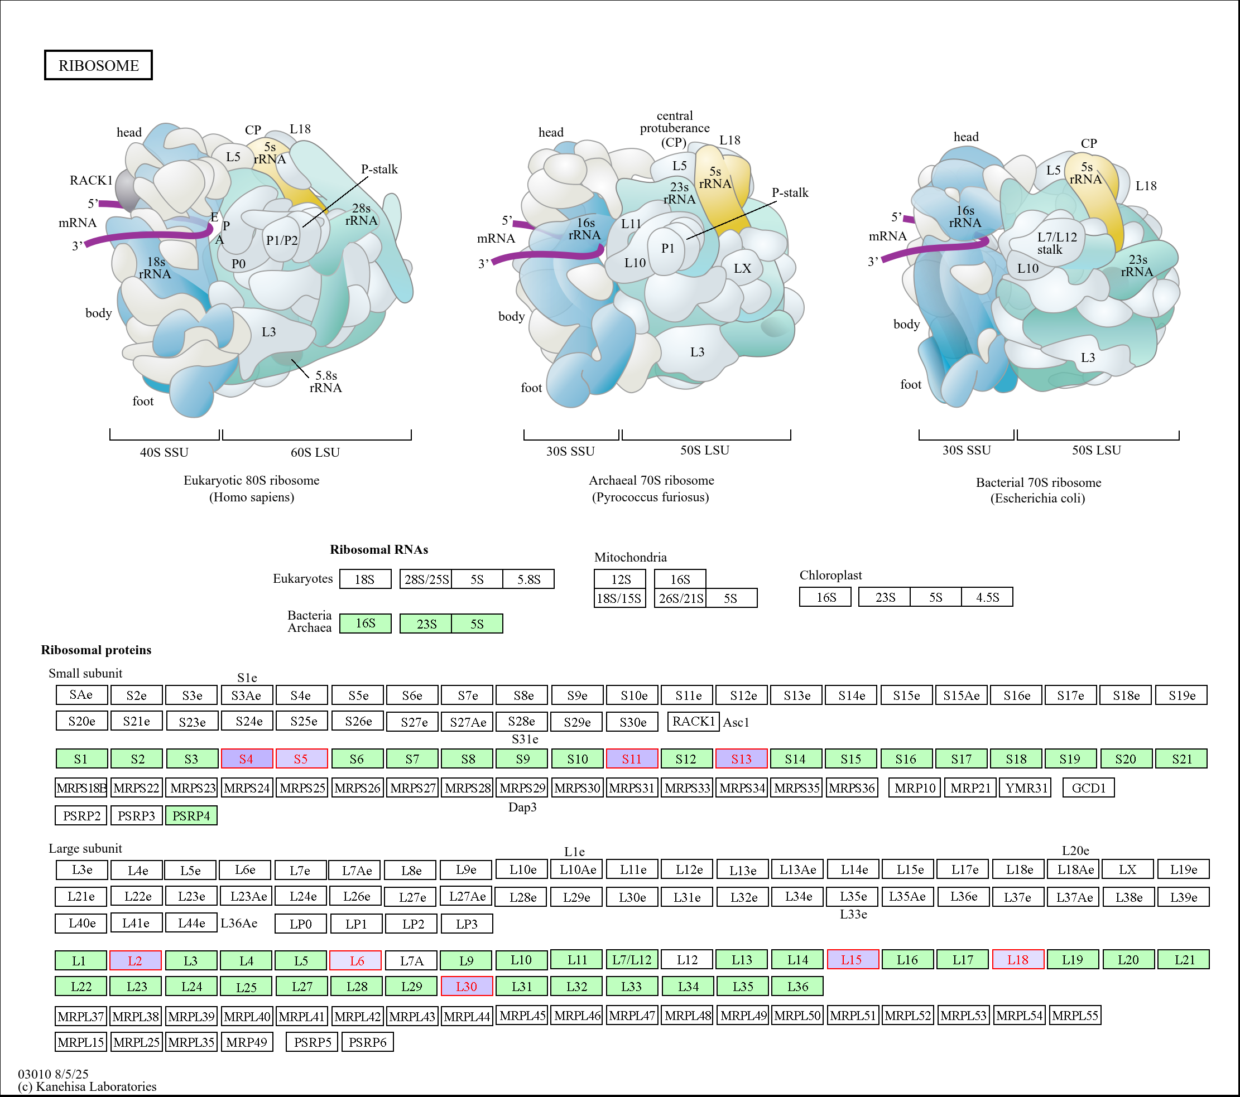
Figure S8a. Regulation of genes in the ribosome complex following treatment of Xanthomonas euvesicatoria pv. perforans with carvacrol at 0-1 hr.
All significantly differentially expressed genes are shown in red or black color with a colored background. Genes for which no homologue exist in this study are in black with white background. Genes in black with green background indicates that the gene was not differentially expressed. Gene expression is from -1 (red, most downregulated) to +1 (blue, most upregulated)

Slide 3
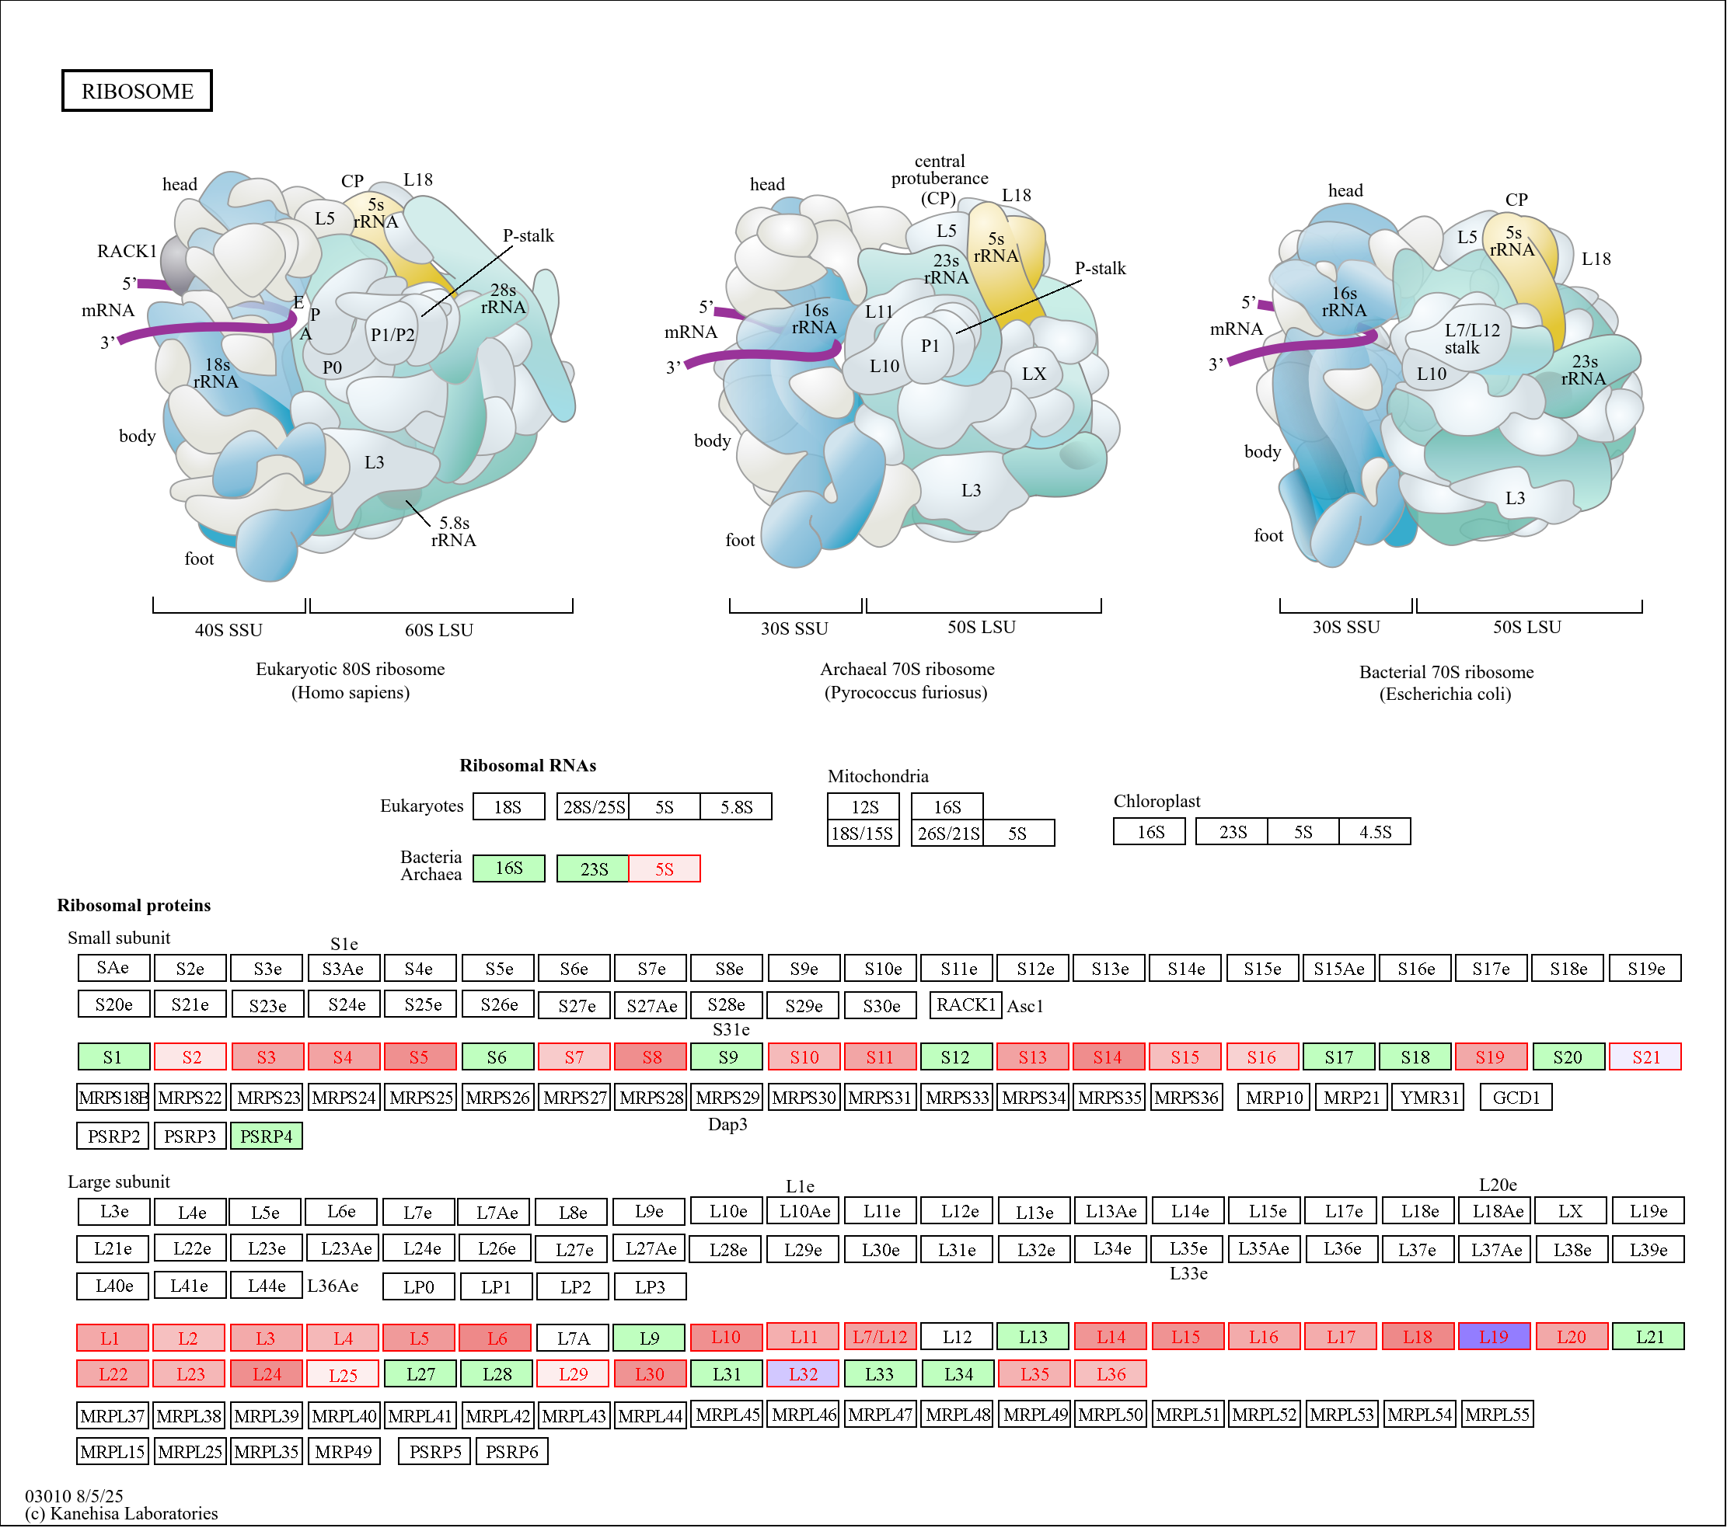
Figure S8b. Regulation of genes in the ribosome complex following treatment of Xanthomonas euvesicatoria pv. perforans with carvacrol at 1-4 hr.
All significantly differentially expressed genes are shown in red or black color with a colored background. Genes for which no homologue exist in this study are in black with white background. Genes in black with green background indicates that the gene was not differentially expressed. Gene expression is from -1 (red, most downregulated) to +1 (blue, most upregulated)
1-4 hr

Slide 4
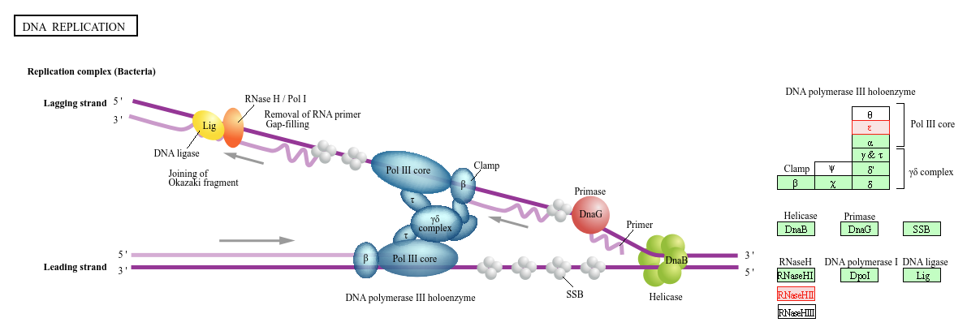
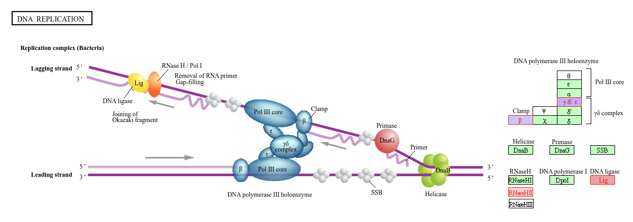
Figure S9a. Regulation of genes in the DNA replication complex following treatment of Xanthomonas euvesicatoria pv. perforans with carvacrol at 0-1hr and 1-4hr.
All significantly differentially expressed genes are shown in red or black color with a colored background. Genes for which no homologue exist in this study are in black with white background. Genes in black with green background indicates that the gene was not differentially expressed. Gene expression is from -1 (red, most downregulated) to +1 (blue, most upregulated)
0-1 h
1-4 h

Slide 5
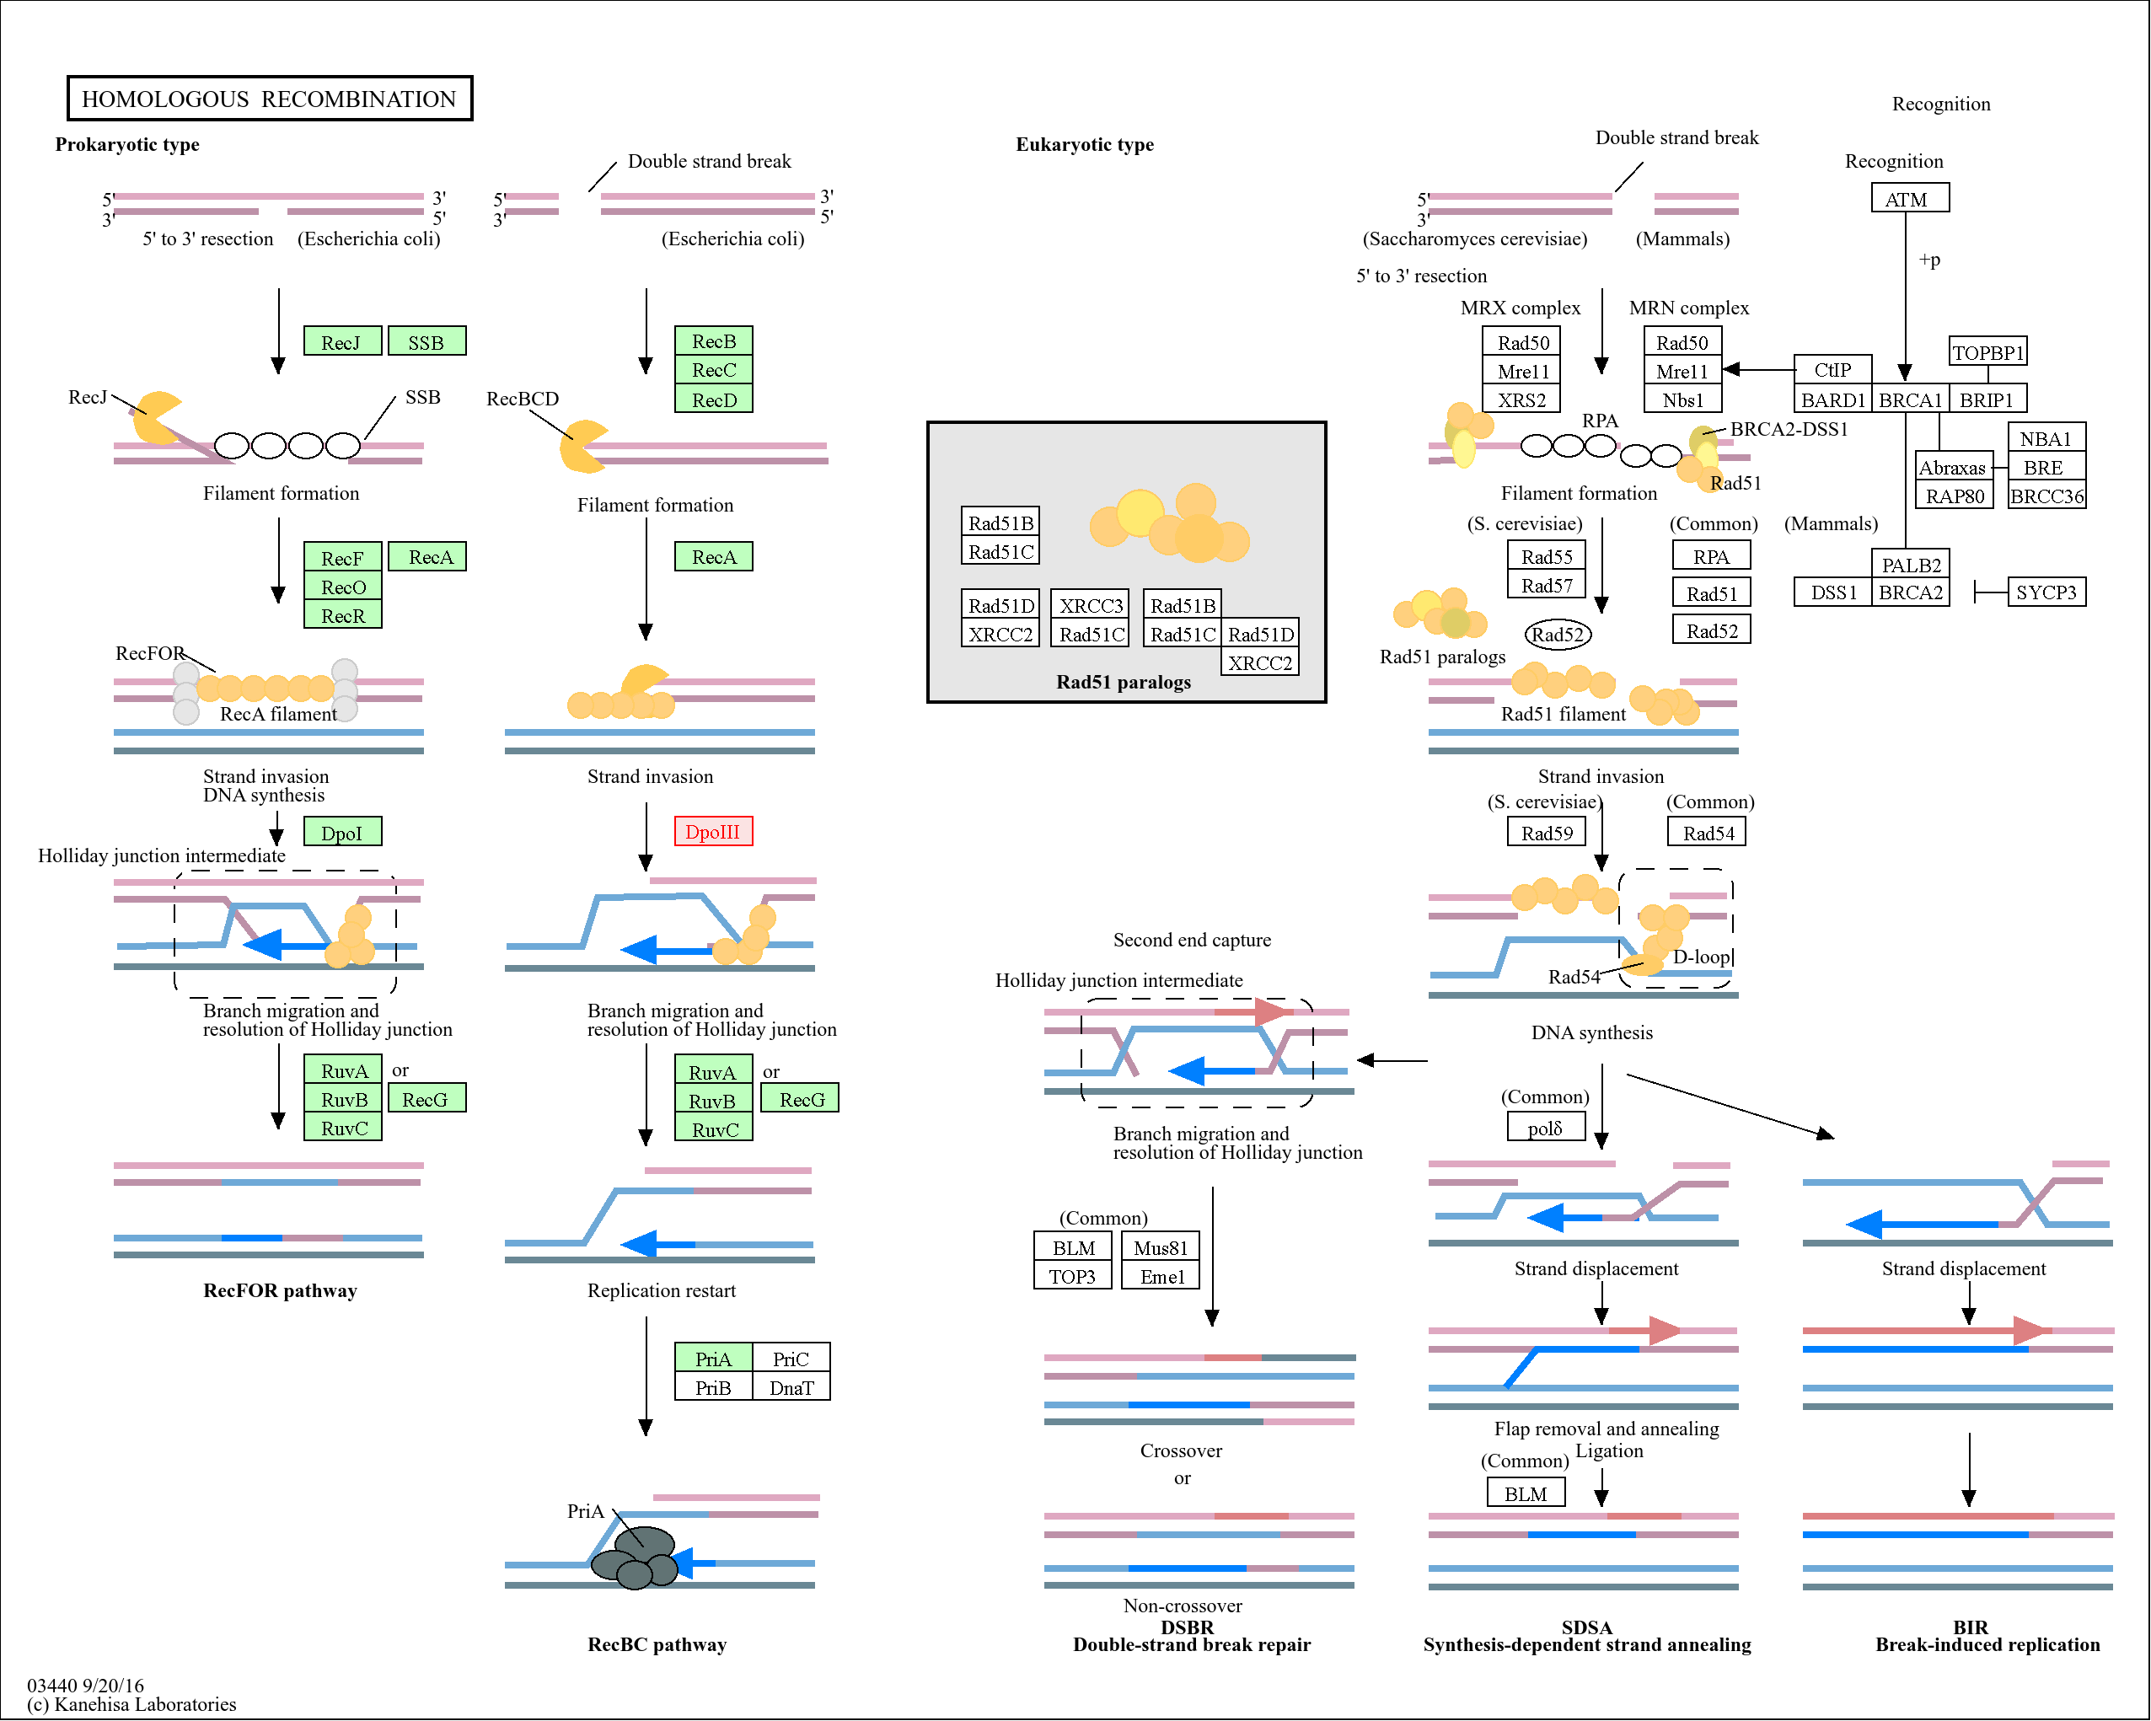
Figure S9b(i). Regulation of genes in the homologous recombination complex following treatment of Xanthomonas euvesicatoria pv. perforans with carvacrol at 0-1hr.
All significantly differentially expressed genes are shown in red or black color with a colored background. Genes for which no homologue exist in this study are in black with white background. Genes in black with green background indicates that the gene was not differentially expressed. Gene expression is from -1 (red, most downregulated) to +1 (blue, most upregulated)
0-1 h

Slide 6
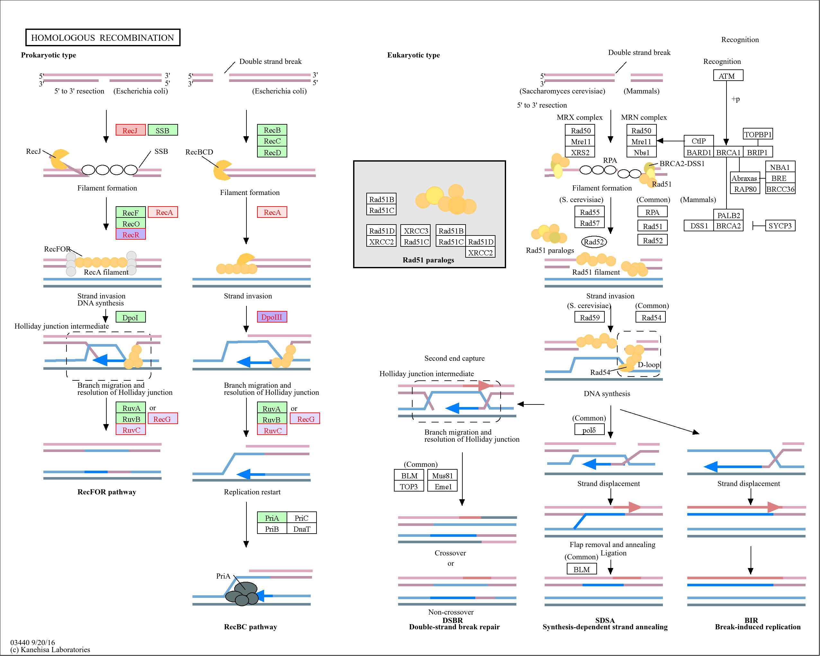
Figure S9b(ii). Regulation of genes in the homologous recombination complex following treatment of Xanthomonas euvesicatoria pv. perforans with carvacrol at 1-4hr.
All significantly differentially expressed genes are shown in red or black color with a colored background. Genes for which no homologue exist in this study are in black with white background. Genes in black with green background indicates that the gene was not differentially expressed. Gene expression is from -1 (red, most downregulated) to +1 (blue, most upregulated)
1-4 hr

Slide 7
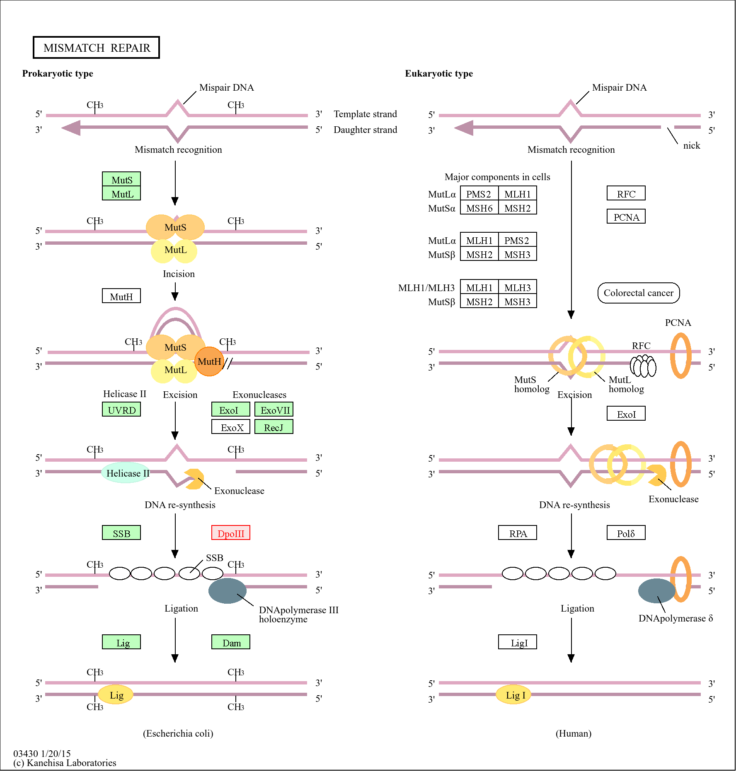
Figure S9c(i). Regulation of genes in the mismatch repair complex following treatment of Xanthomonas euvesicatoria pv. perforans with carvacrol at 0-1hr.
All significantly differentially expressed genes are shown in red or black color with a colored background. Genes for which no homologue exist in this study are in black with white background. Genes in black with green background indicates that the gene was not differentially expressed. Gene expression is from -1 (red, most downregulated) to +1 (blue, most upregulated)
0-1h

Slide 8
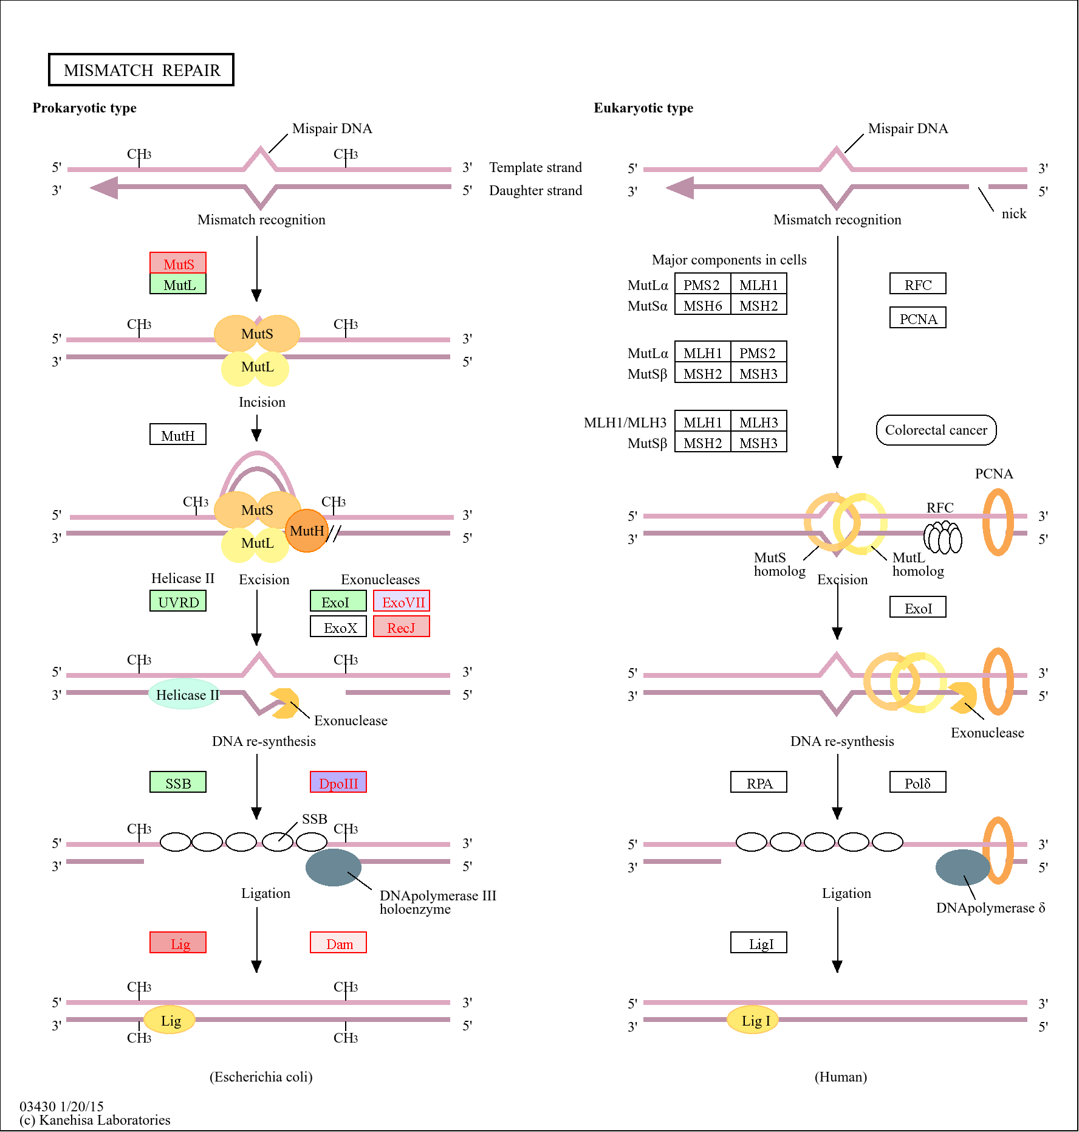
Figure S9c(ii). Regulation of genes in the mismatch repair complex following treatment of Xanthomonas euvesicatoria pv. perforans with carvacrol at 1-4hr.
All significantly differentially expressed genes are shown in red or black color with a colored background. Genes for which no homologue exist in this study are in black with white background. Genes in black with green background indicates that the gene was not differentially expressed. Gene expression is from -1 (red, most downregulated) to +1 (blue, most upregulated)
1-4 hr

Slide 9
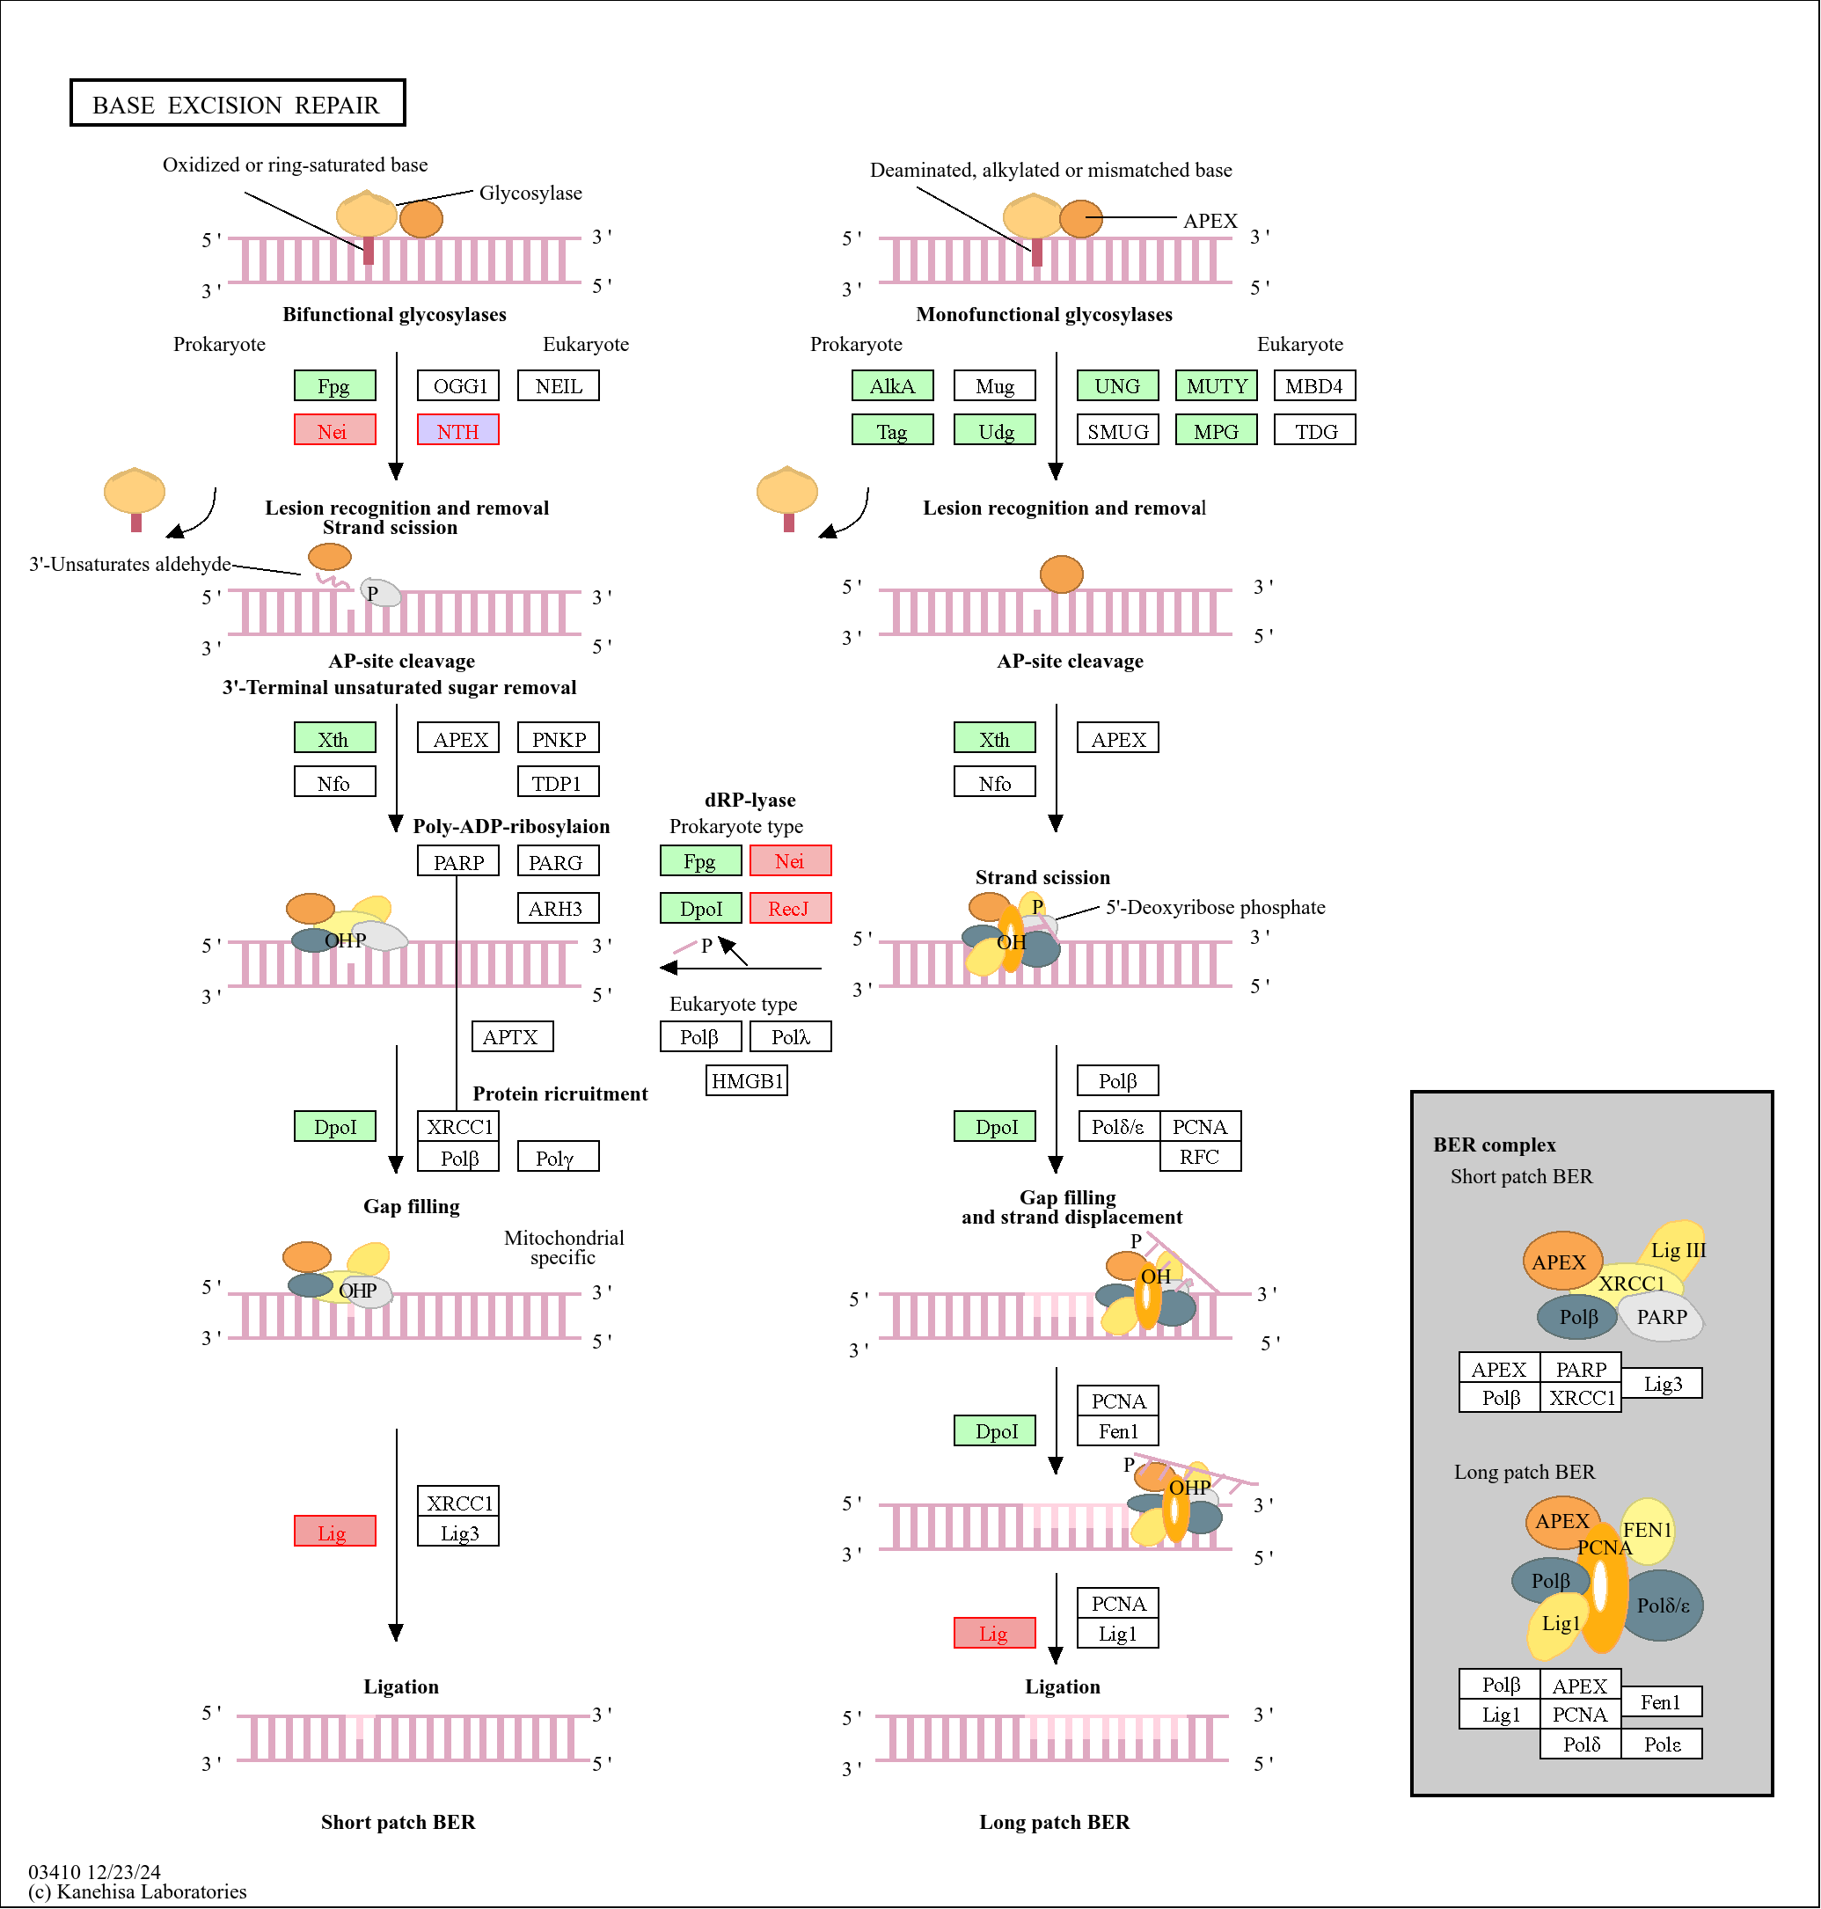
Figure S9d. Regulation of genes in the base excision repair complex following treatment of Xanthomonas euvesicatoria pv. perforans with carvacrol at 1-4hr.
All significantly differentially expressed genes are shown in red or black color with a colored background. Genes for which no homologue exist in this study are in black with white background. Genes in black with green background indicates that the gene was not differentially expressed. Gene expression is from -1 (red, most downregulated) to +1 (blue, most upregulated)
1-4 hr

