Slide 1

KEGG Mapper Analyses for selected pathways of Xanthomonas euvesicatoria pv. perforans as mapped onto the LH3 genome on KEGG (https://www.genome.jp/kegg/mapper/color.html ) at 0-1 hr and 1-4 hr following exposure to carvacrol.
For all figures, all significantly differentially expressed genes are shown in red or black color with a colored background, except that genes in black with green background indicates that the gene was not differentially expressed. Genes for which no homologue exist in this study are in black with white background. Gene expression is from -1 (red, most downregulated) to +1 (blue, most upregulated)
Gene expression key

Slide 2
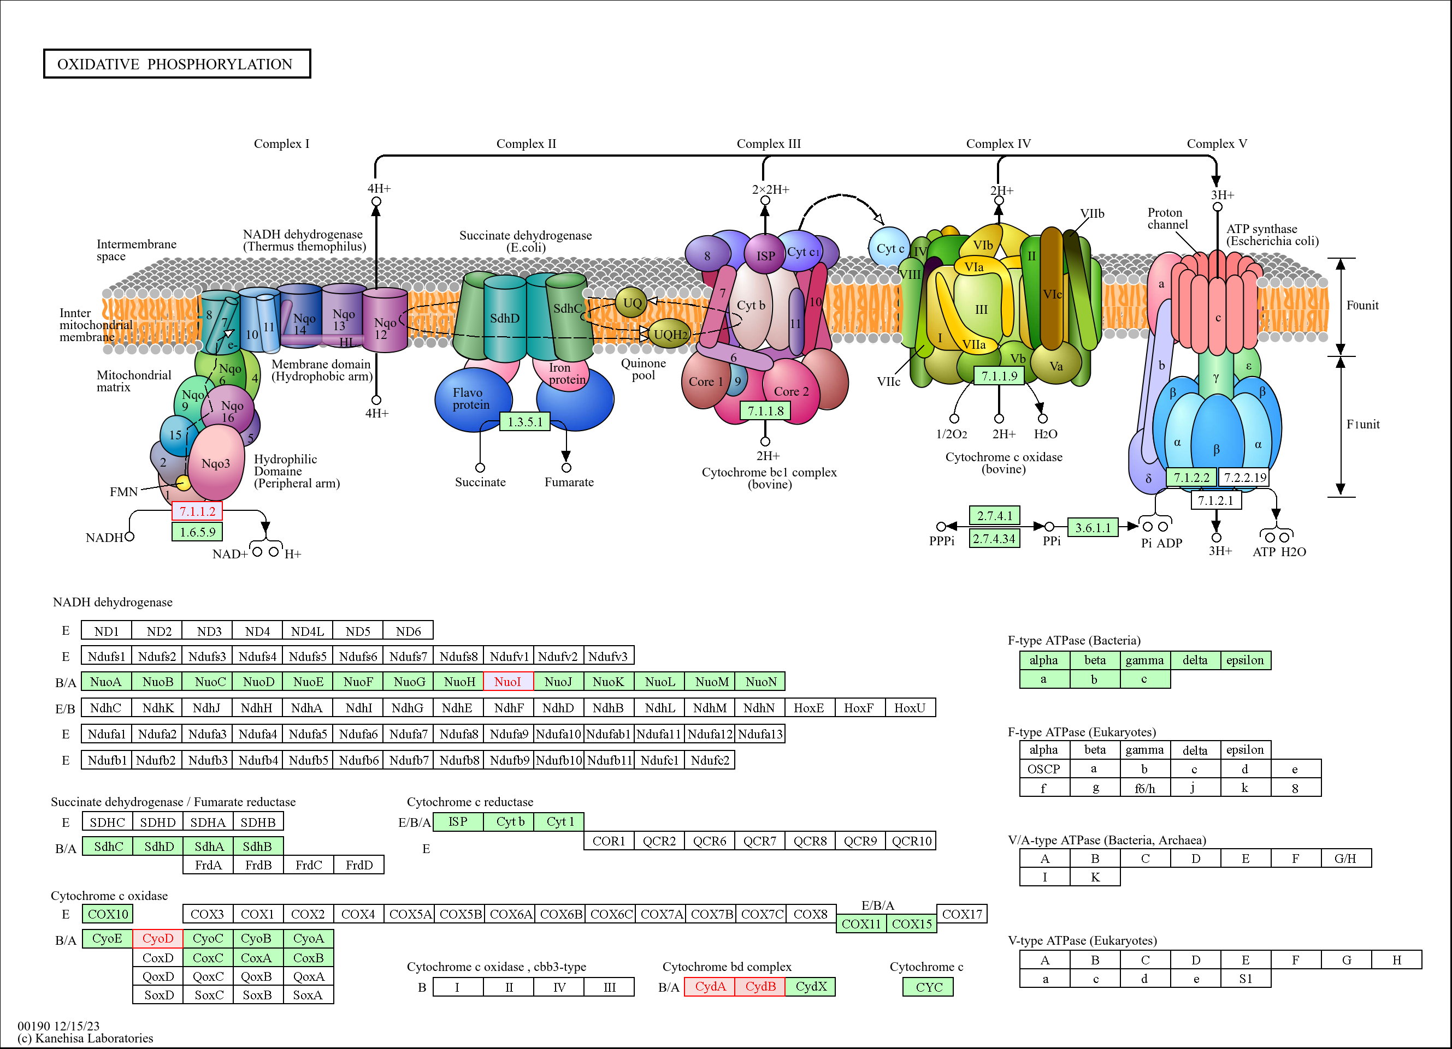

Figure S2a. Gene expression in the five complexes of the energy synthesizing oxidative phosphorylation pathway following treatment of Xanthomonas euvesicatoria pv. perforans with carvacrol at 0-1hr.
All significantly differentially expressed genes are shown in red or black color with a colored background. Genes for which no homologue exist in this study are in black with white background. Genes in black with green background indicates that the gene was not differentially expressed. Gene expression is from -1 (red, most downregulated) to +1 (blue, most upregulated)

Slide 3

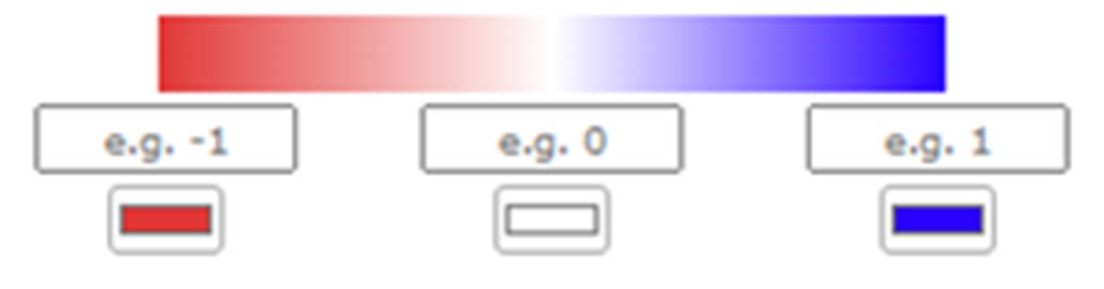
Figure S2b. Gene expression in the five complexes of the energy synthesizing oxidative phosphorylation pathway following treatment of Xanthomonas euvesicatoria pv. perforans with carvacrol at 4 hr. All significantly differentially expressed genes are shown in red or black color with a colored background, except that genes in black with green background indicates that the gene was not differentially expressed. Genes for which no homologue exist in this study are in black with white background. Gene expression is from -1 (red, most downregulated) to +1 (blue, most upregulated).

Slide 4
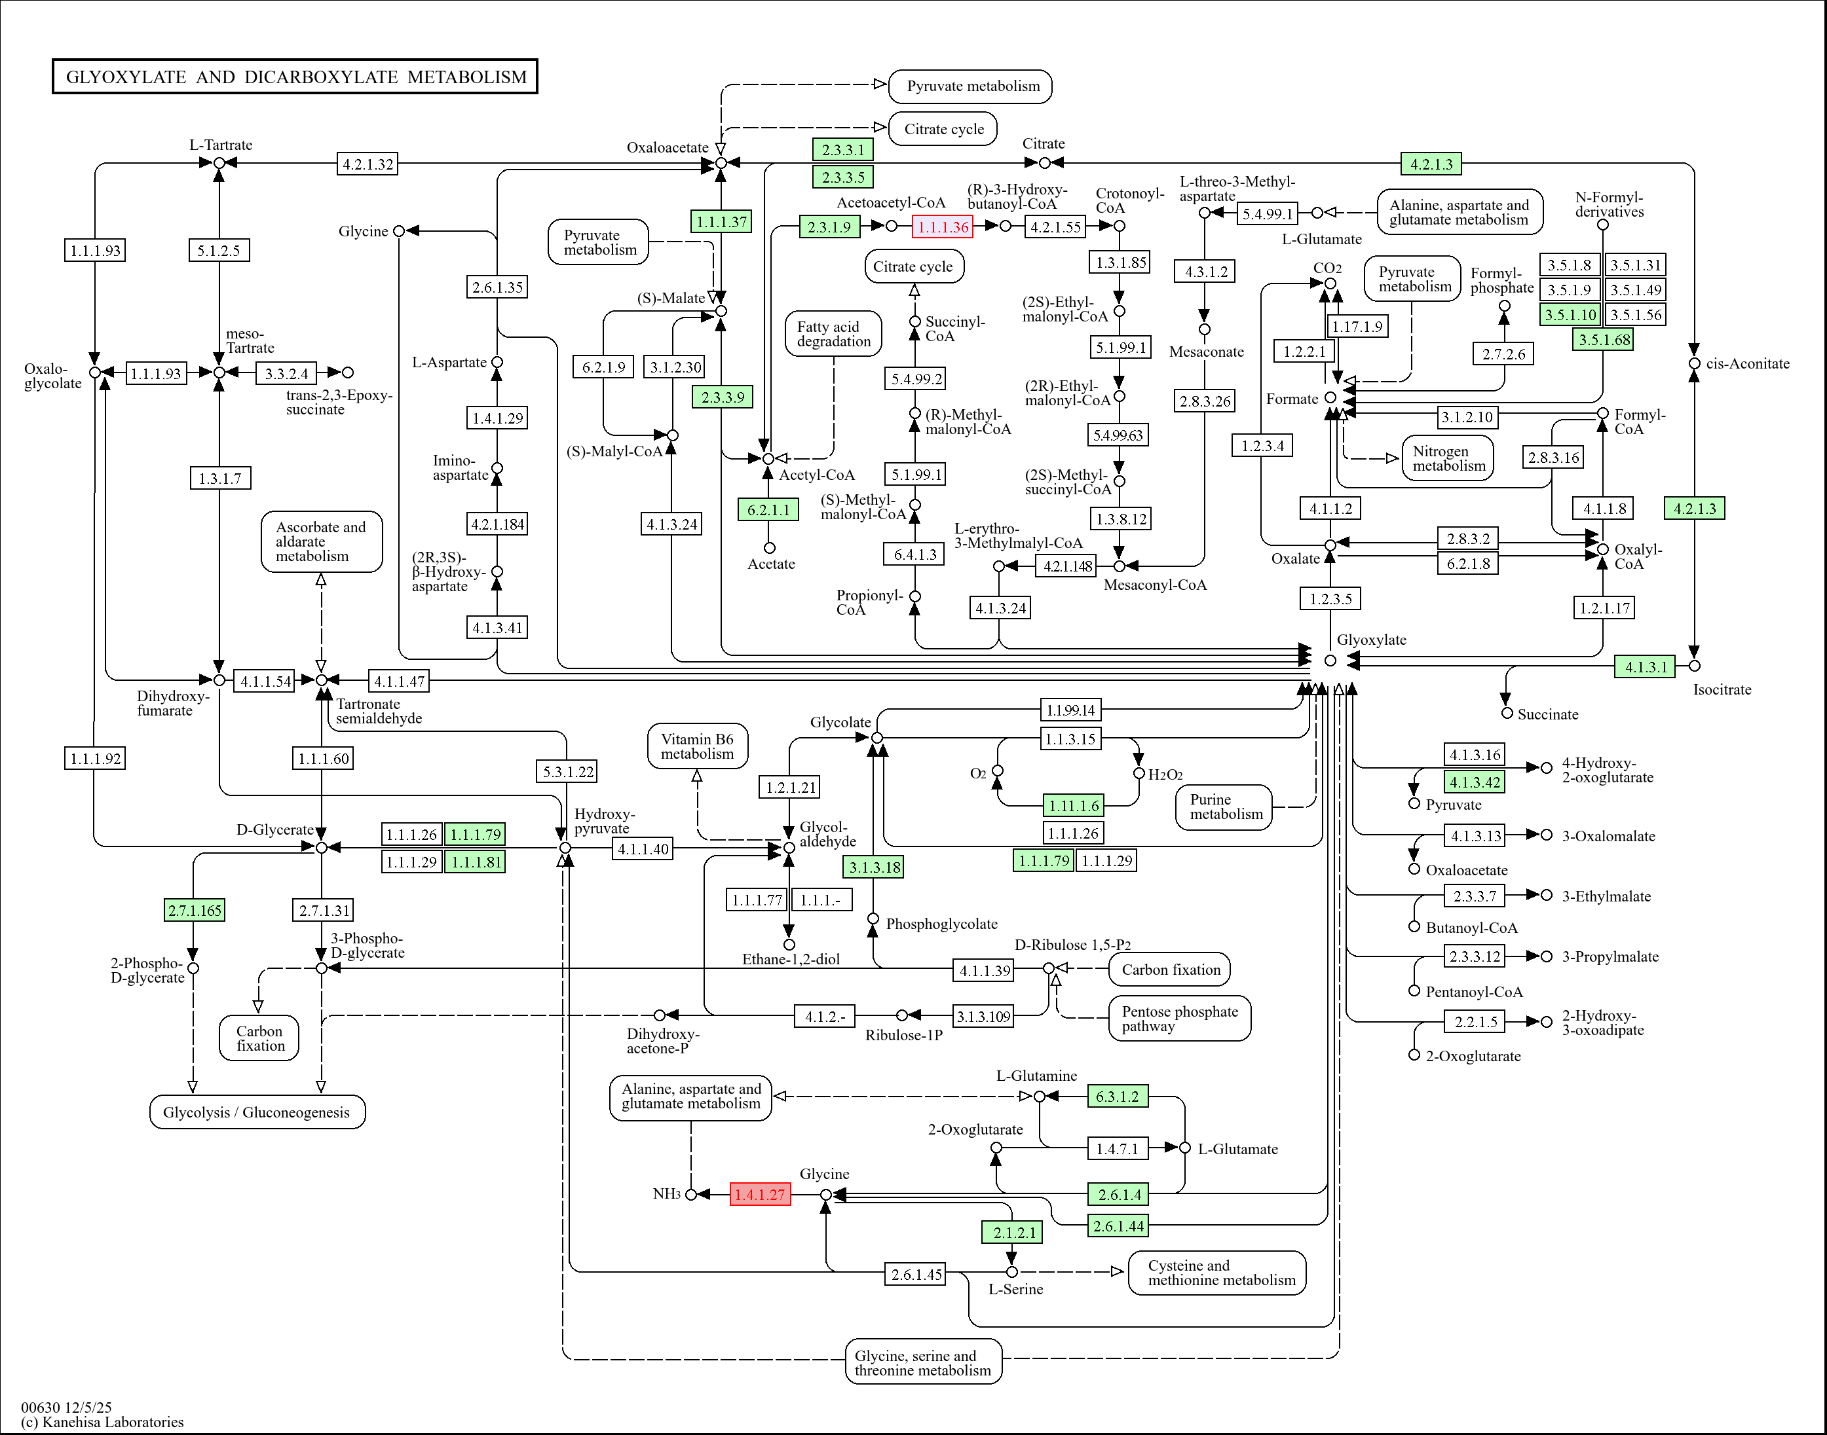

C4-dicarboxylate transport
Figure S3a. Gene expression in the glyoxylate and dicarboxylate metabolism pathway following treatment of Xanthomonas euvesicatoria pv. perforans with carvacrol at 0-1hr.
All significantly differentially expressed genes are shown in red or black color with a colored background. Genes for which no homologue exist in this study are in black with white background. Genes in black with green background indicates that the gene was not differentially expressed. Gene expression is from -1 (red, most downregulated) to +1 (blue, most upregulated)

Slide 5
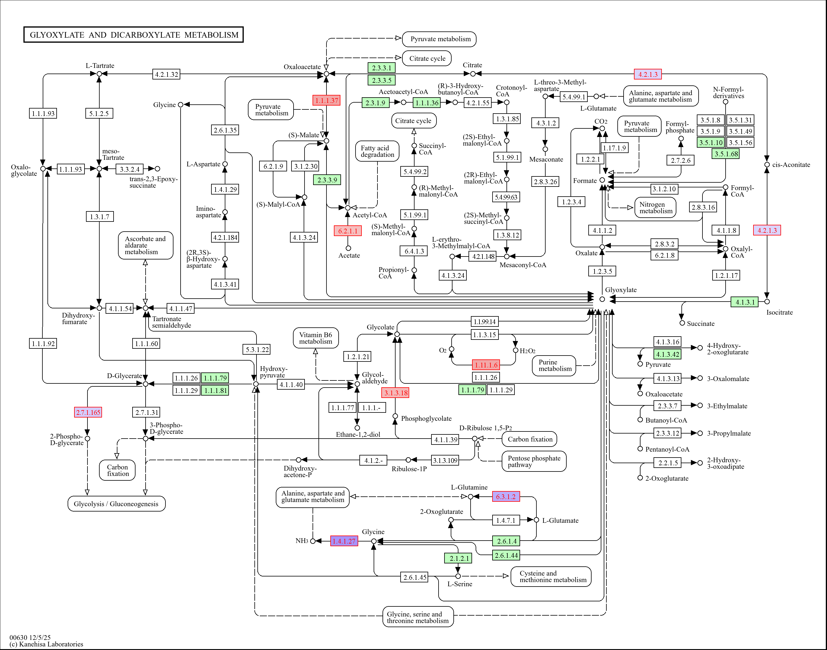

C4-dicarboxylate transport
Figure S3b. Gene expression in the glyoxylate and dicarboxylate metabolism pathway following treatment of Xanthomonas euvesicatoria pv. perforans with carvacrol at 1-4 hr.
All significantly differentially expressed genes are shown in red or black color with a colored background. Genes for which no homologue exist in this study are in black with white background. Genes in black with green background indicates that the gene was not differentially expressed. Gene expression is from -1 (red, most downregulated) to +1 (blue, most upregulated)

Slide 6
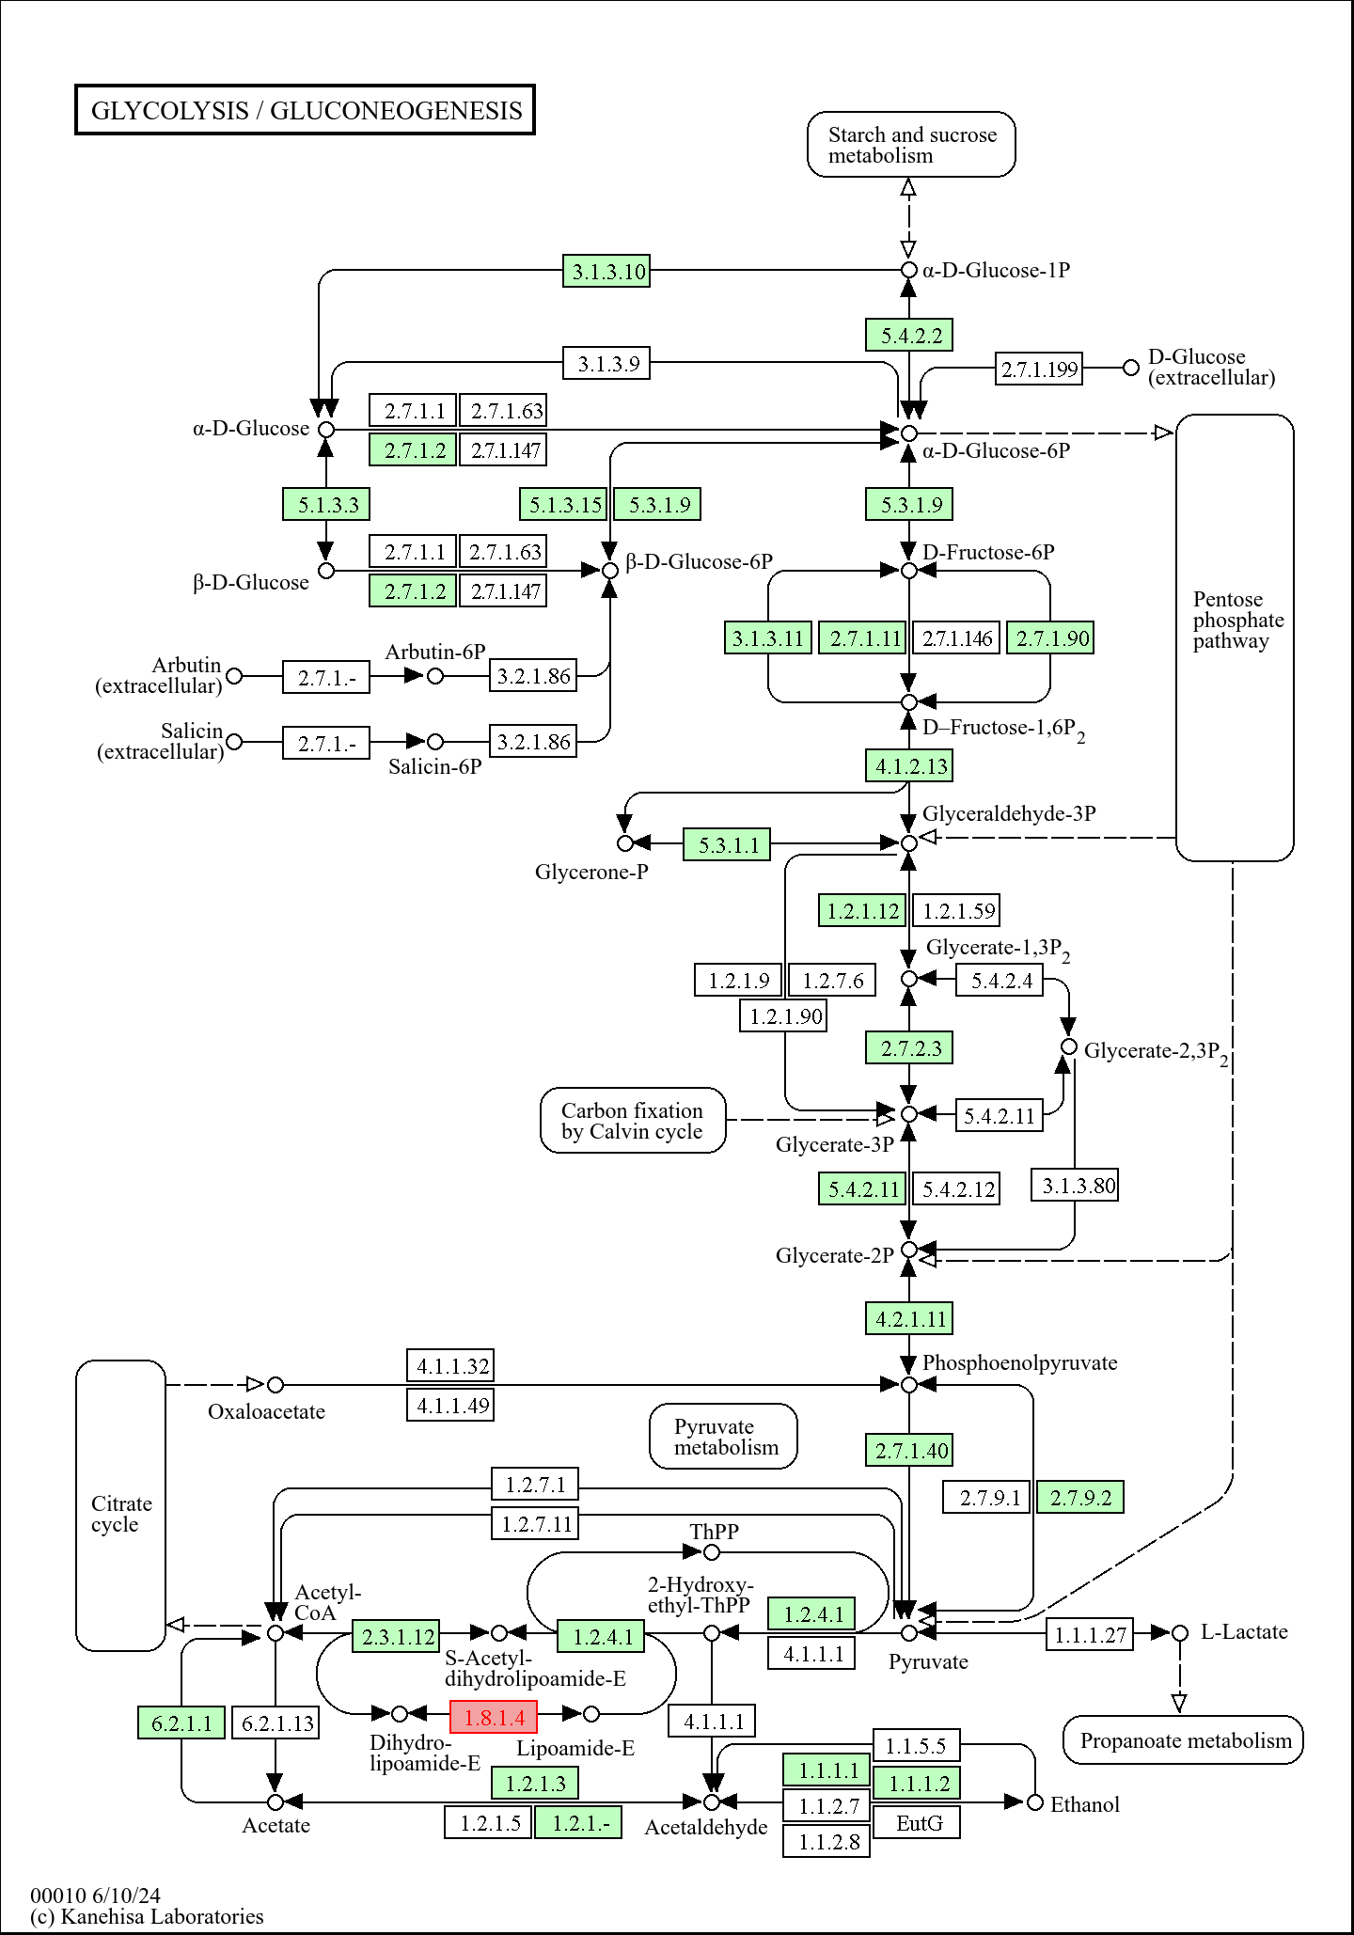
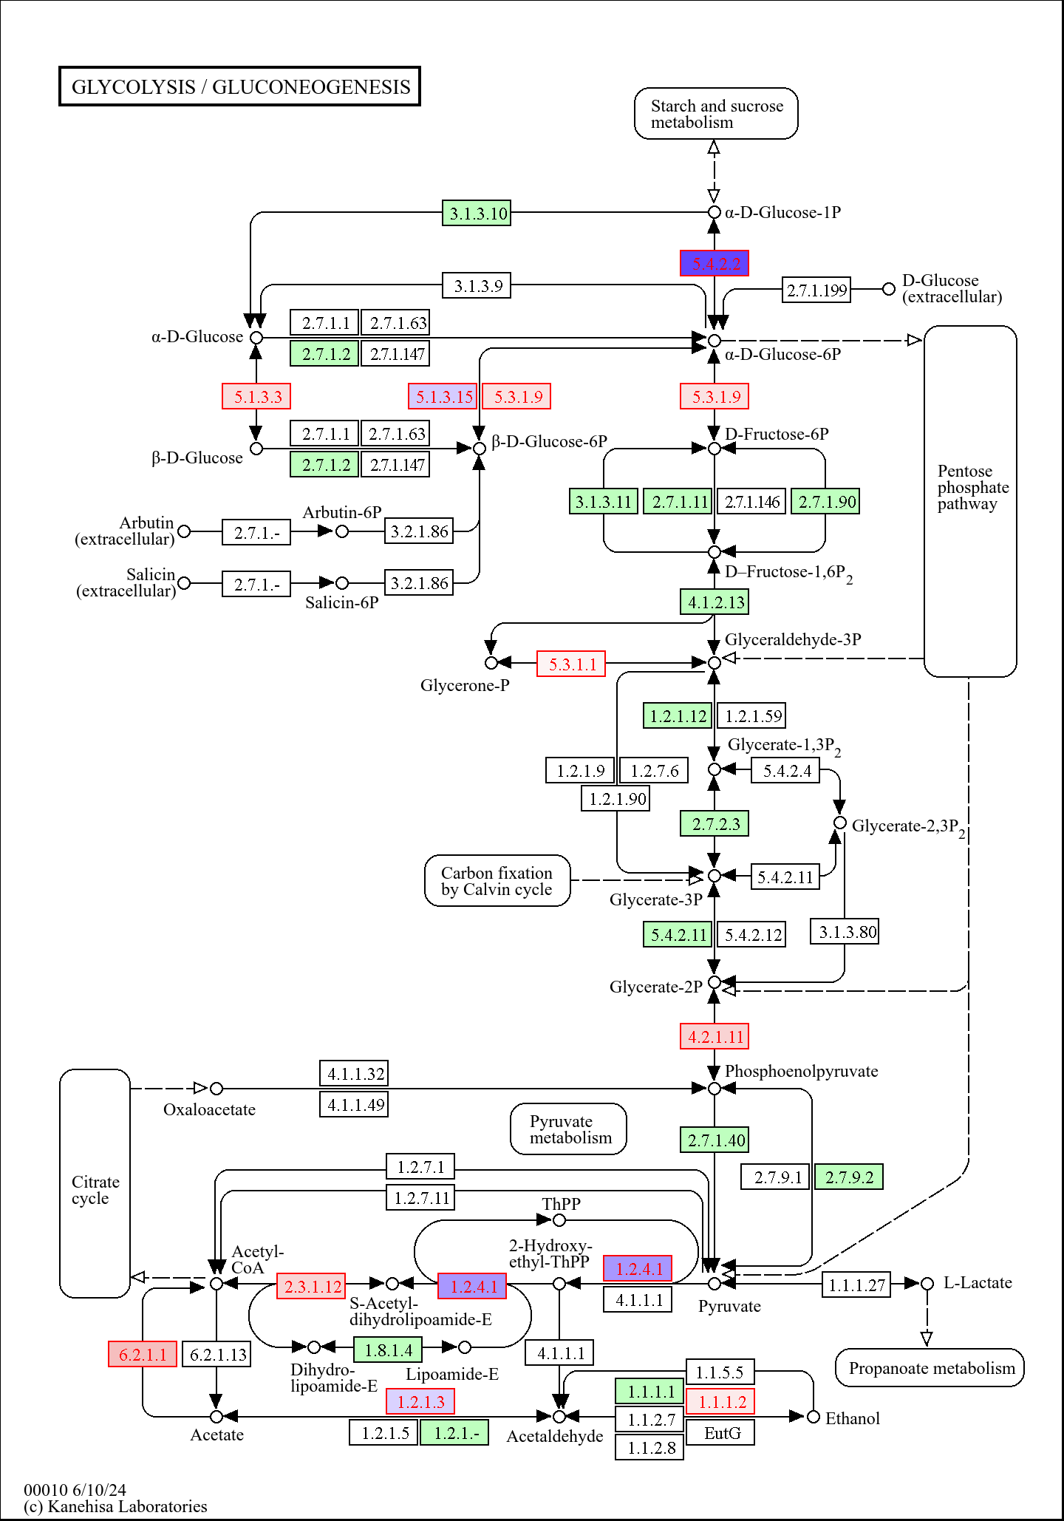
a. 0-1 hr
b. 1-4 hr
Figure S4. Gene expression in the glycolysis/gluconeogenesis pathway following treatment of Xanthomonas euvesicatoria pv. perforans with carvacrol at (a) 0-1 hr and (b)1-4 hr.
All significantly differentially expressed genes are shown in red or black color with a colored background. Genes for which no homologue exist in this study are in black with white background. Genes in black with green background indicates that the gene was not differentially expressed. Gene expression is from -1 (red, most downregulated) to +1 (blue, most upregulated)

Slide 7
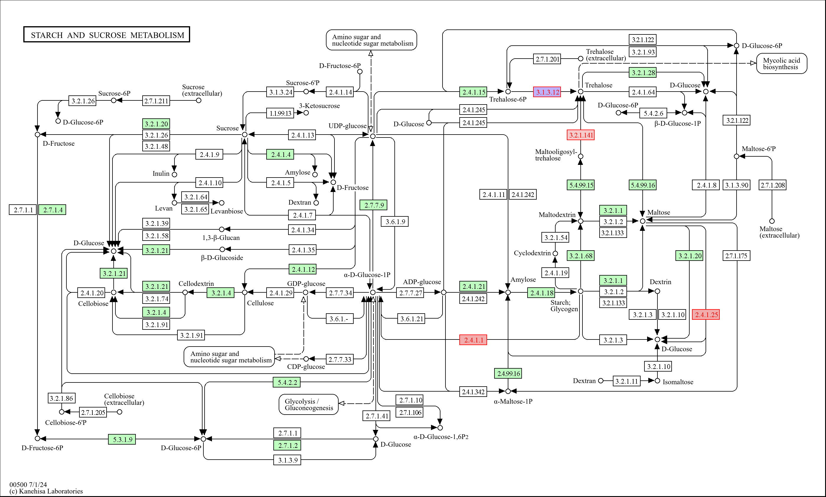
Figure S5a. Gene expression in the starch and sucrose metabolism pathway following treatment of Xanthomonas euvesicatoria pv. perforans with carvacrol at 0-1 hr. All significantly differentially expressed genes are shown in red or black color with a colored background. Genes for which no homologue exist in this study are in black with white background. Genes in black with green background indicates that the gene was not differentially expressed. Gene expression is from -1 (red, most downregulated) to +1 (blue, most upregulated)

Slide 8
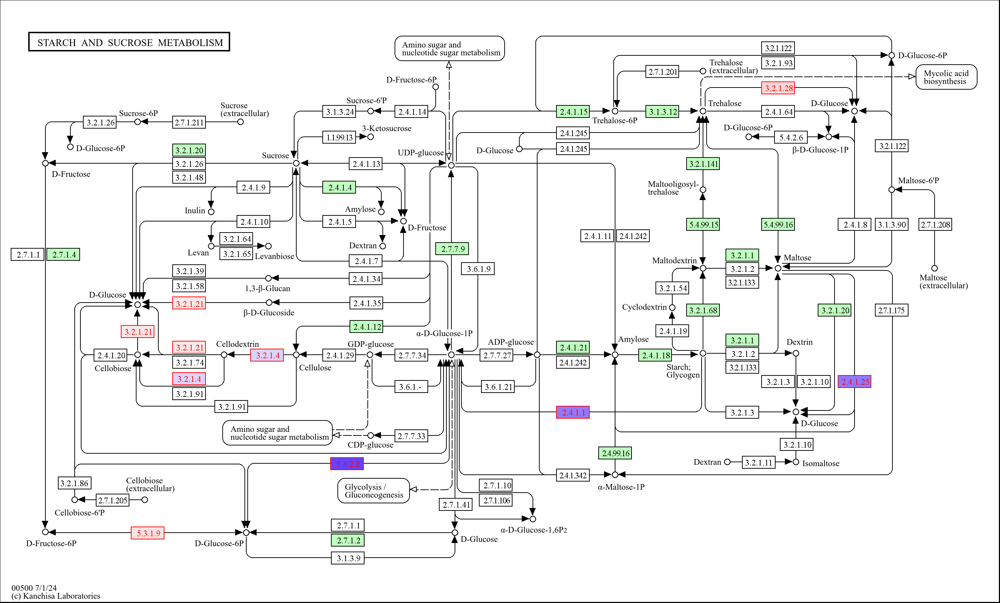
Figure S5b. Gene expression in the starch and sucrose metabolism pathway following treatment of Xanthomonas euvesicatoria pv. perforans with carvacrol at 1-4 hr. All significantly differentially expressed genes are shown in red or black color with a colored background. Genes for which no homologue exist in this study are in black with white background. Genes in black with green background indicates that the gene was not differentially expressed. Gene expression is from -1 (red, most downregulated) to +1 (blue, most upregulated)

Slide 9
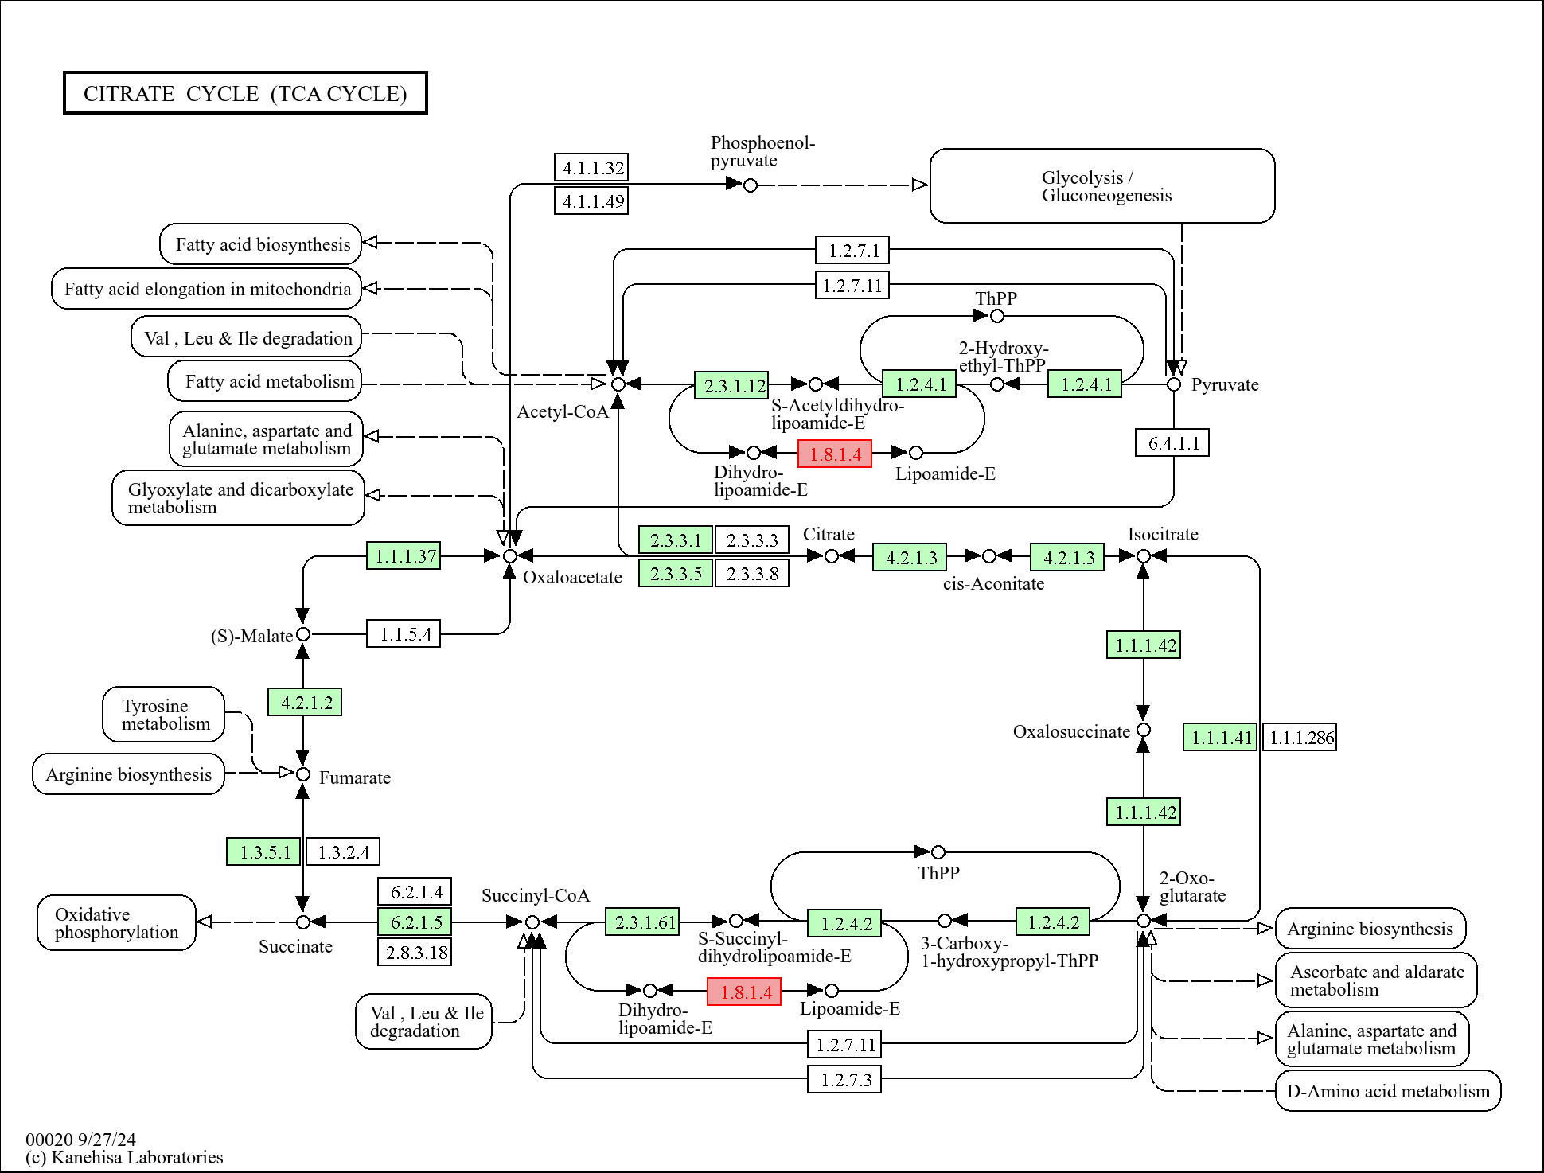
Figure S6a. Gene expression in the TCA Cycle pathway following treatment of Xanthomonas euvesicatoria pv. perforans with carvacrol at 0-1 hr.
All significantly differentially expressed genes are shown in red or black color with a colored background. Genes for which no homologue exist in this study are in black with white background. Genes in black with green background indicates that the gene was not differentially expressed. Gene expression is from -1 (red, most downregulated) to +1 (blue, most upregulated)

Slide 10
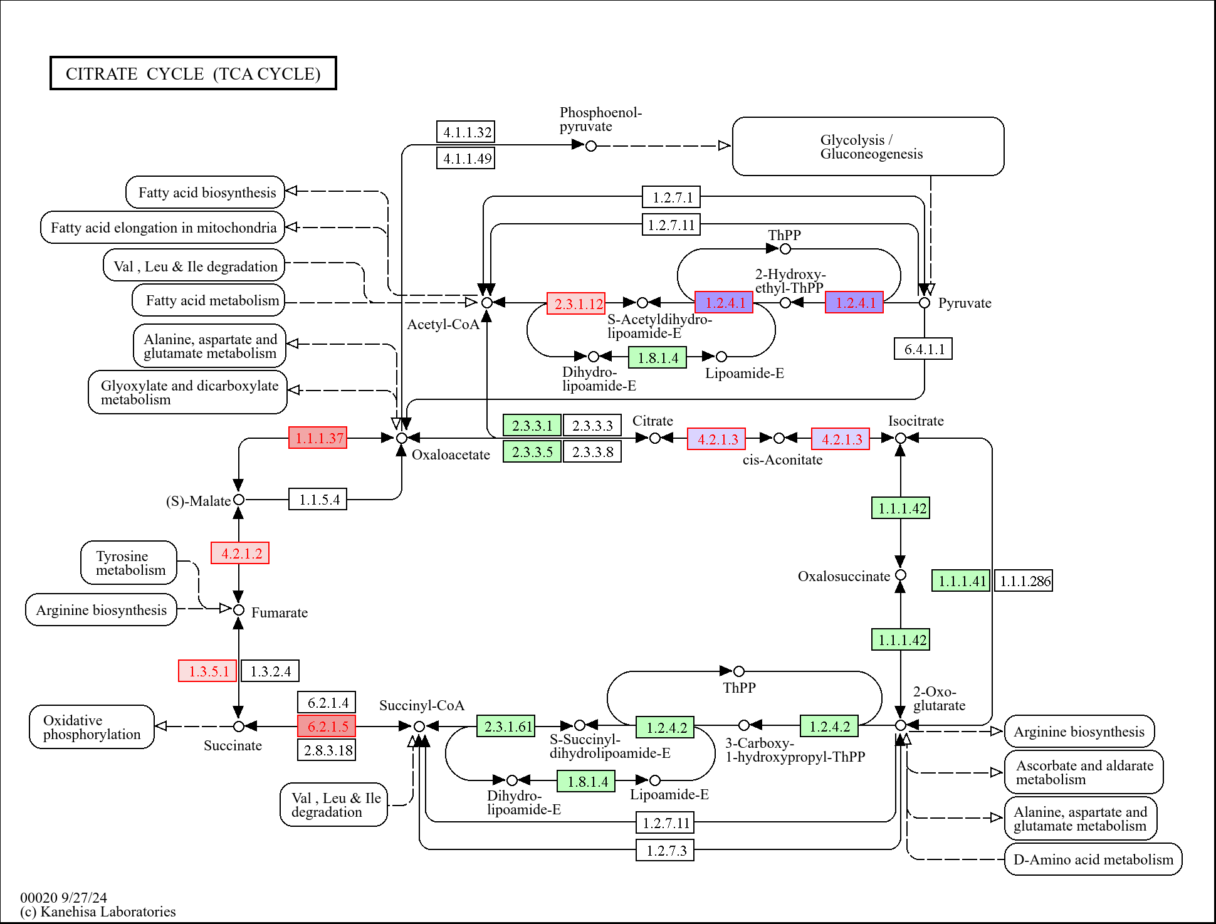
Figure S6b. Gene expression in the TCA Cycle pathway following treatment of Xanthomonas euvesicatoria pv. perforans with carvacrol at 1-4 hr. All significantly differentially expressed genes are shown in red or black color with a colored background. Genes for which no homologue exist in this study are in black with white background. Genes in black with green background indicates that the gene was not differentially expressed. Gene expression is from -1 (red, most downregulated) to +1 (blue, most upregulated)

Slide 11
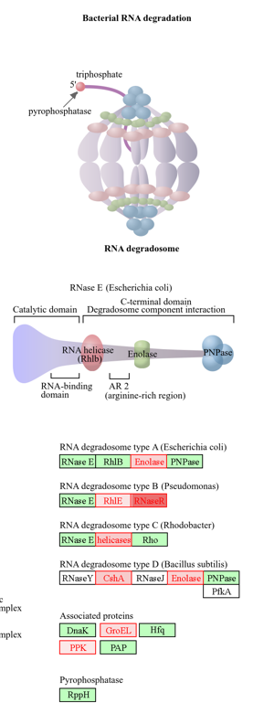
Fig. S7. Regulation of RNA degradation genes following treatment of Xanthomonas euvesicatoria pv. perforans with carvacrol at 4hr. Please see Table 2 for additional details. All DEGs are shown in red or black color with a colored background. Genes for which no homologue exist in this study are in black with white background.

