Slide 1
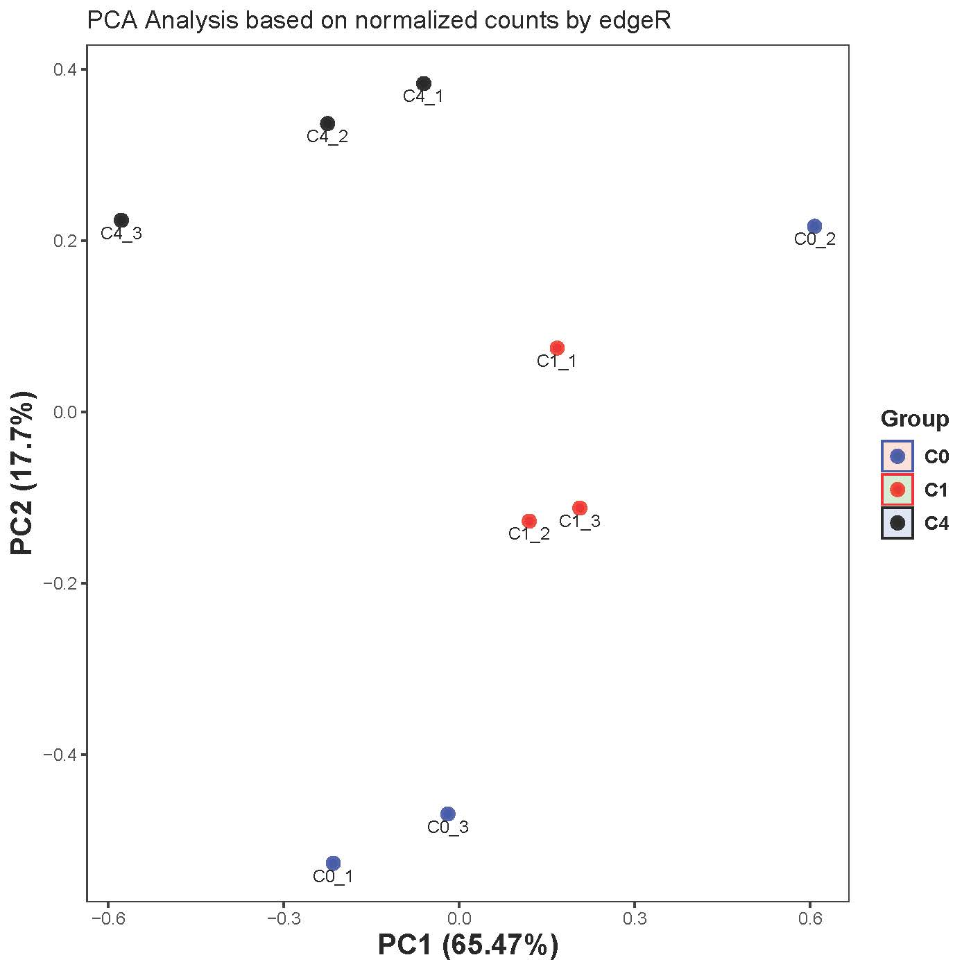
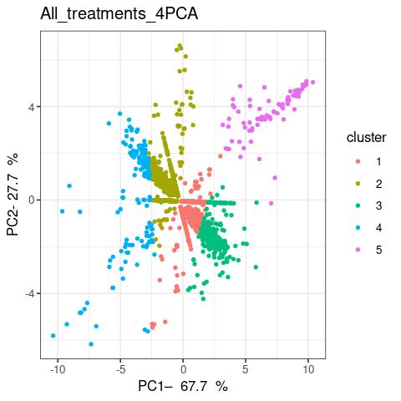
Figure S1a. Principal component analyses of clustering of all significant differentially expressed genes (DEGs) in Xanthomonas euvesicatoria pv. perforans GEV485 following treatment with carvacrol for all time points as mapped onto Xep LH3 genome. C0=Control, C1=treatment at 1 hr and C4=treatment at 4 hr.
Fig S1b. Principal component analyses showing hierarchical clustering of all significant DEGs in Xanthomonas euvesicatoria pv. perforans GEV485 following treatment with carvacrol for changes between 0-1 hr and 1-4 hr as mapped onto Xep LH3 genome. All significant DEGs clusters into five major clusters.

