Slide 1

(Continued) KEGG Mapper Analyses for selected pathways of Xanthomonas euvesicatoria pv. perforans as mapped onto the LH3 genome on KEGG (https://www.genome.jp/kegg/mapper/color.html ) at 0-1 hr and 1-4 hr following exposure to carvacrol.
For all figures, all significantly differentially expressed genes are shown in red or black color with a colored background, except that genes in black with green background indicates that the gene was not differentially expressed. Genes for which no homologue exist in this study are in black with white background. Gene expression is from -1 (red, most downregulated) to +1 (blue, most upregulated)
Gene expression key

Slide 2
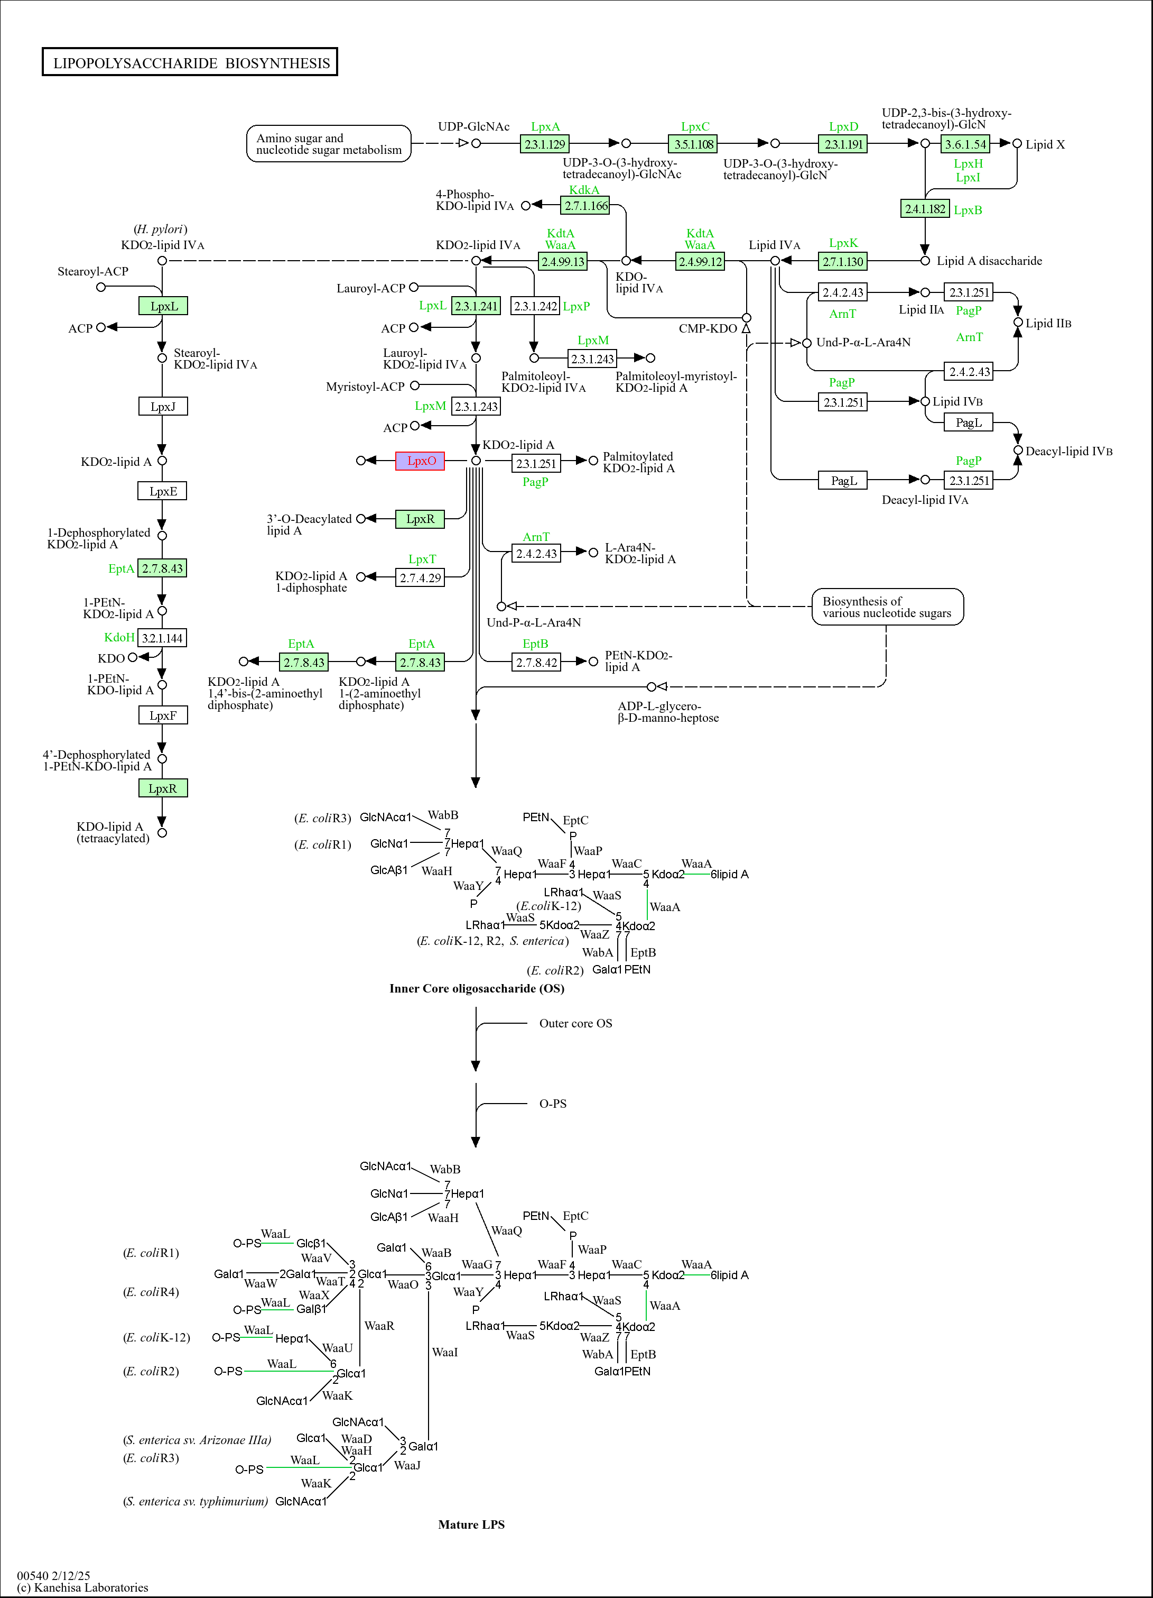
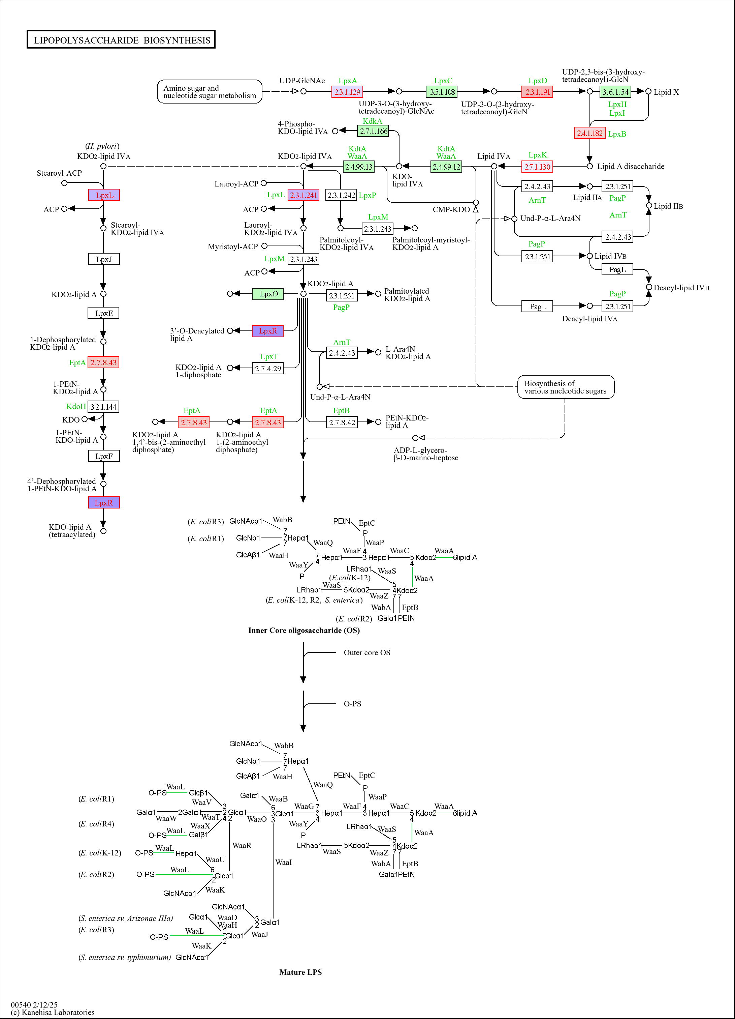
a.
b.
Figure S10. Regulation of genes in the lipopolysaccharide biosynthesis pathway following treatment of Xanthomonas euvesicatoria pv. perforans with carvacrol at (a) 0-1hr and (b) 1-4hr.
All significantly differentially expressed genes are shown in red or black color with a colored background. Genes for which no homologue exist in this study are in black with white background. Genes in black with green background indicates that the gene was not differentially expressed. Gene expression is from -1 (red, most downregulated) to +1 (blue, most upregulated)

Slide 3
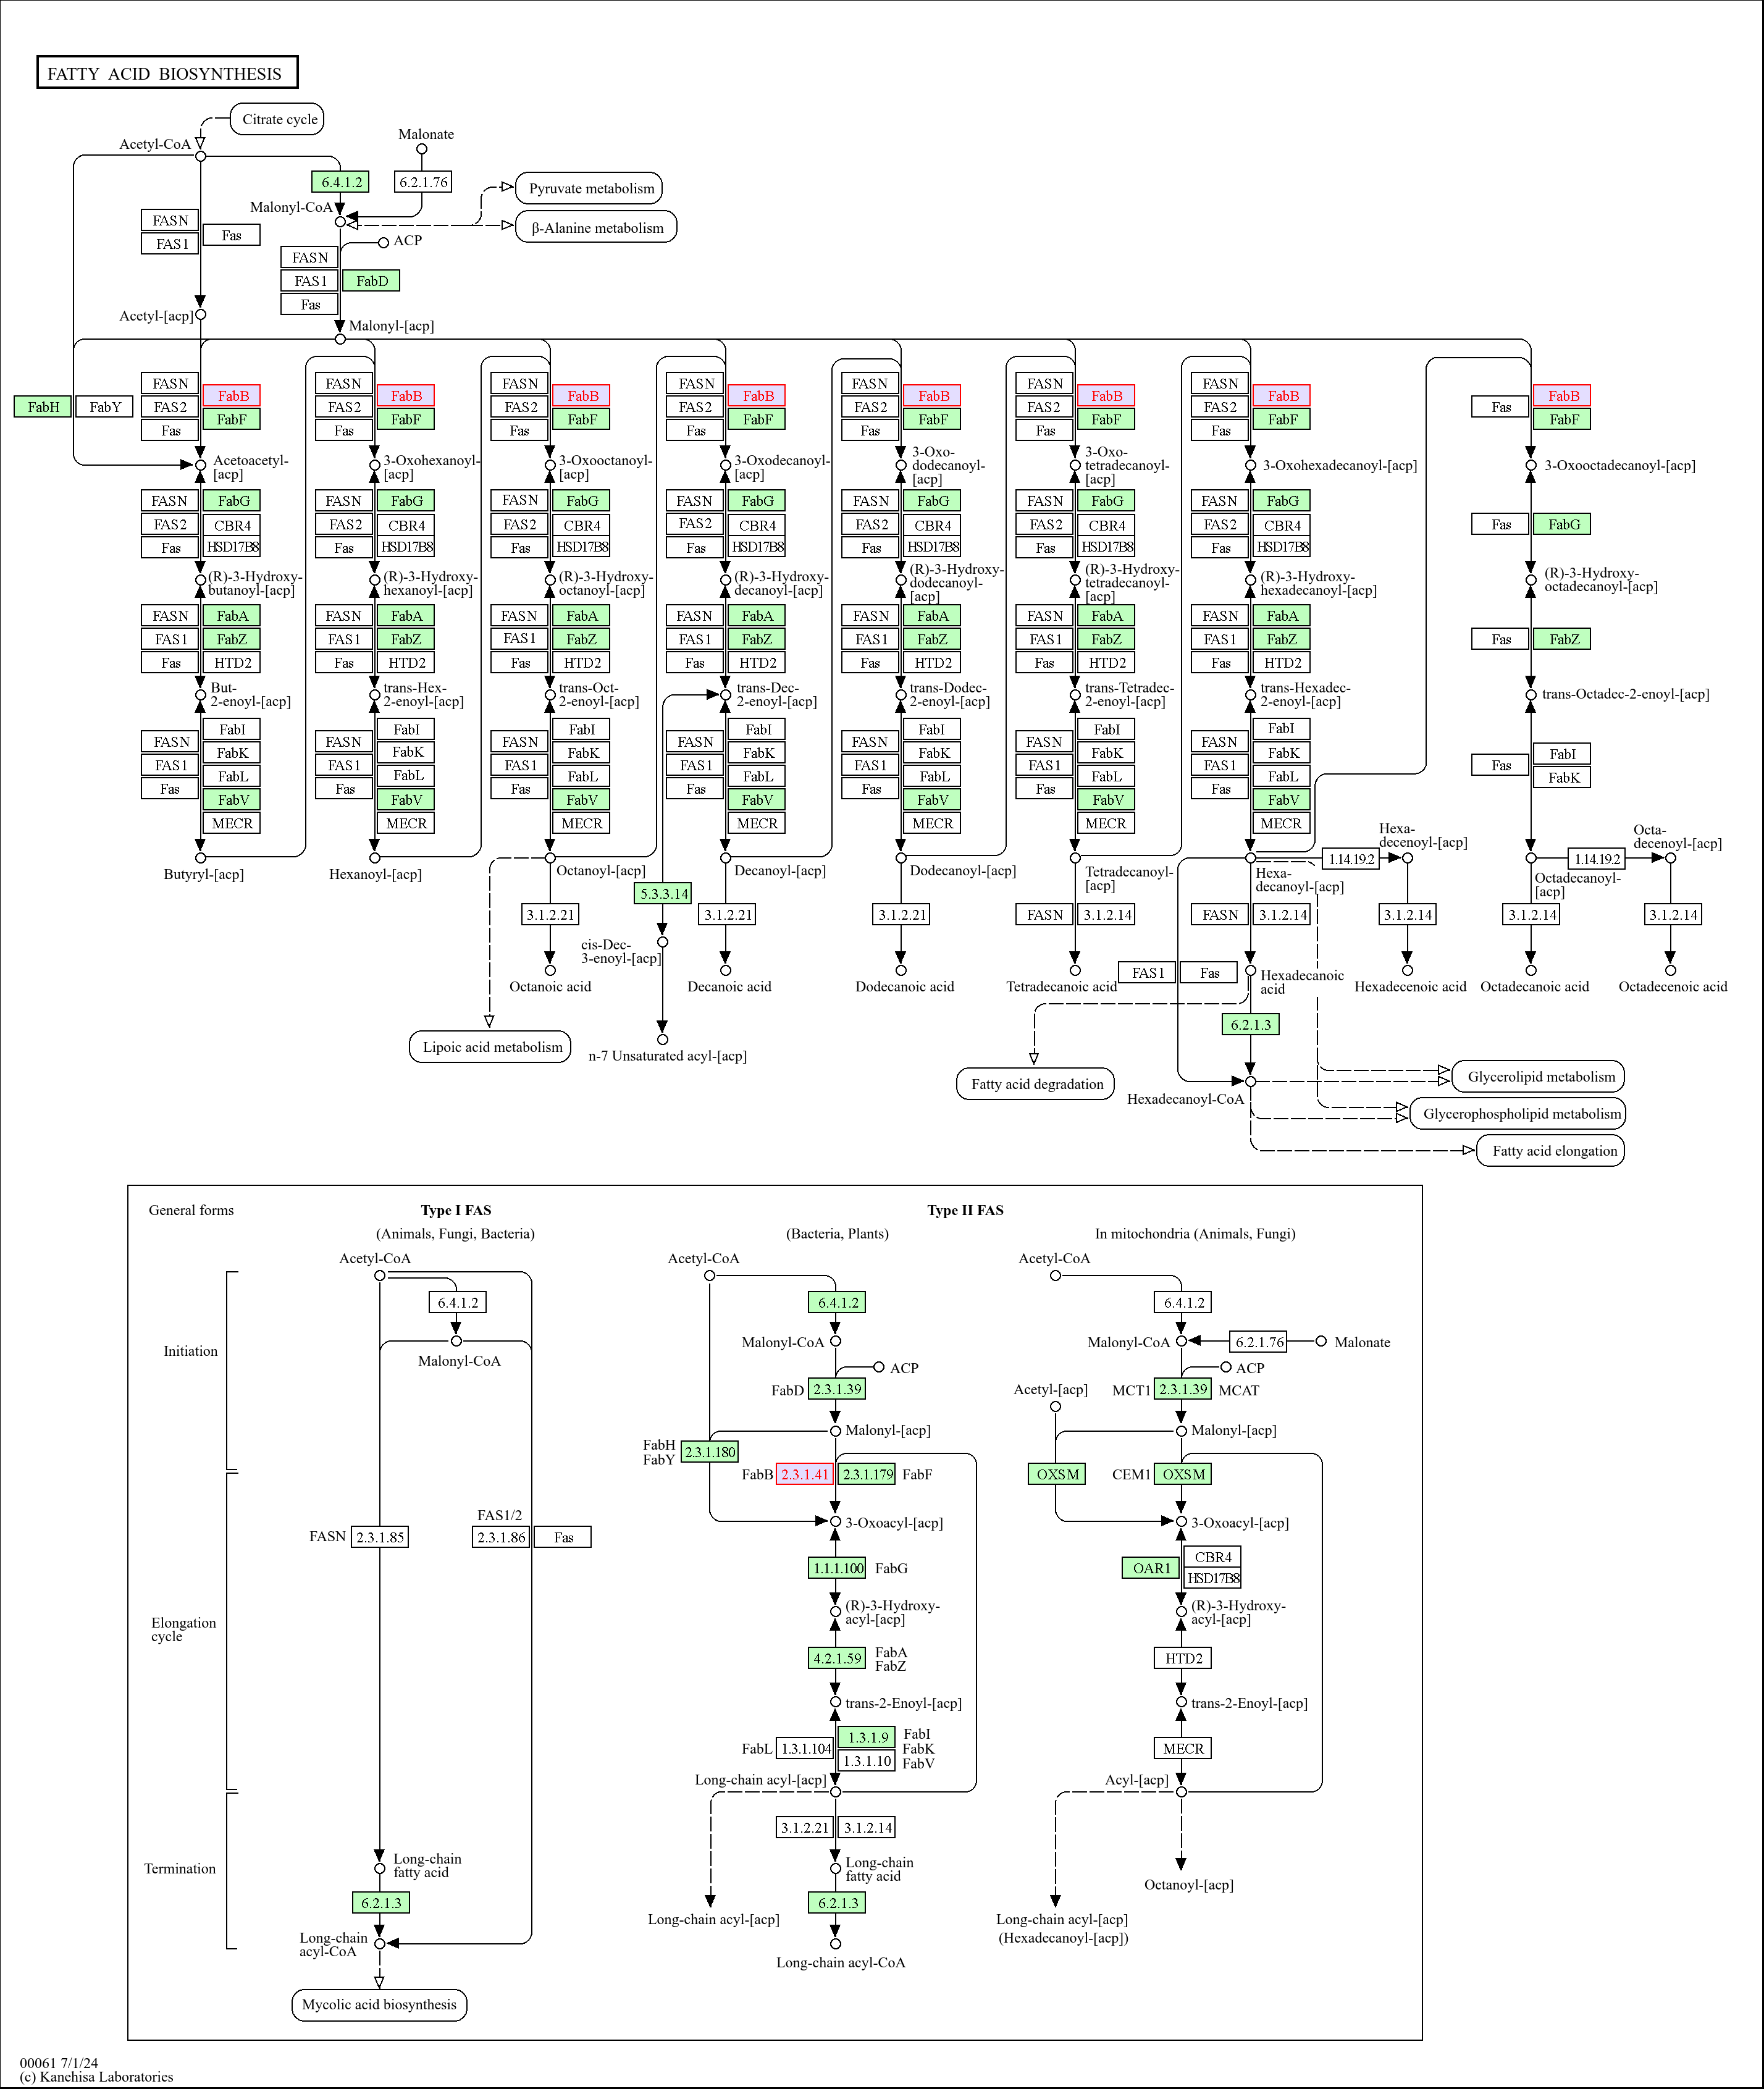
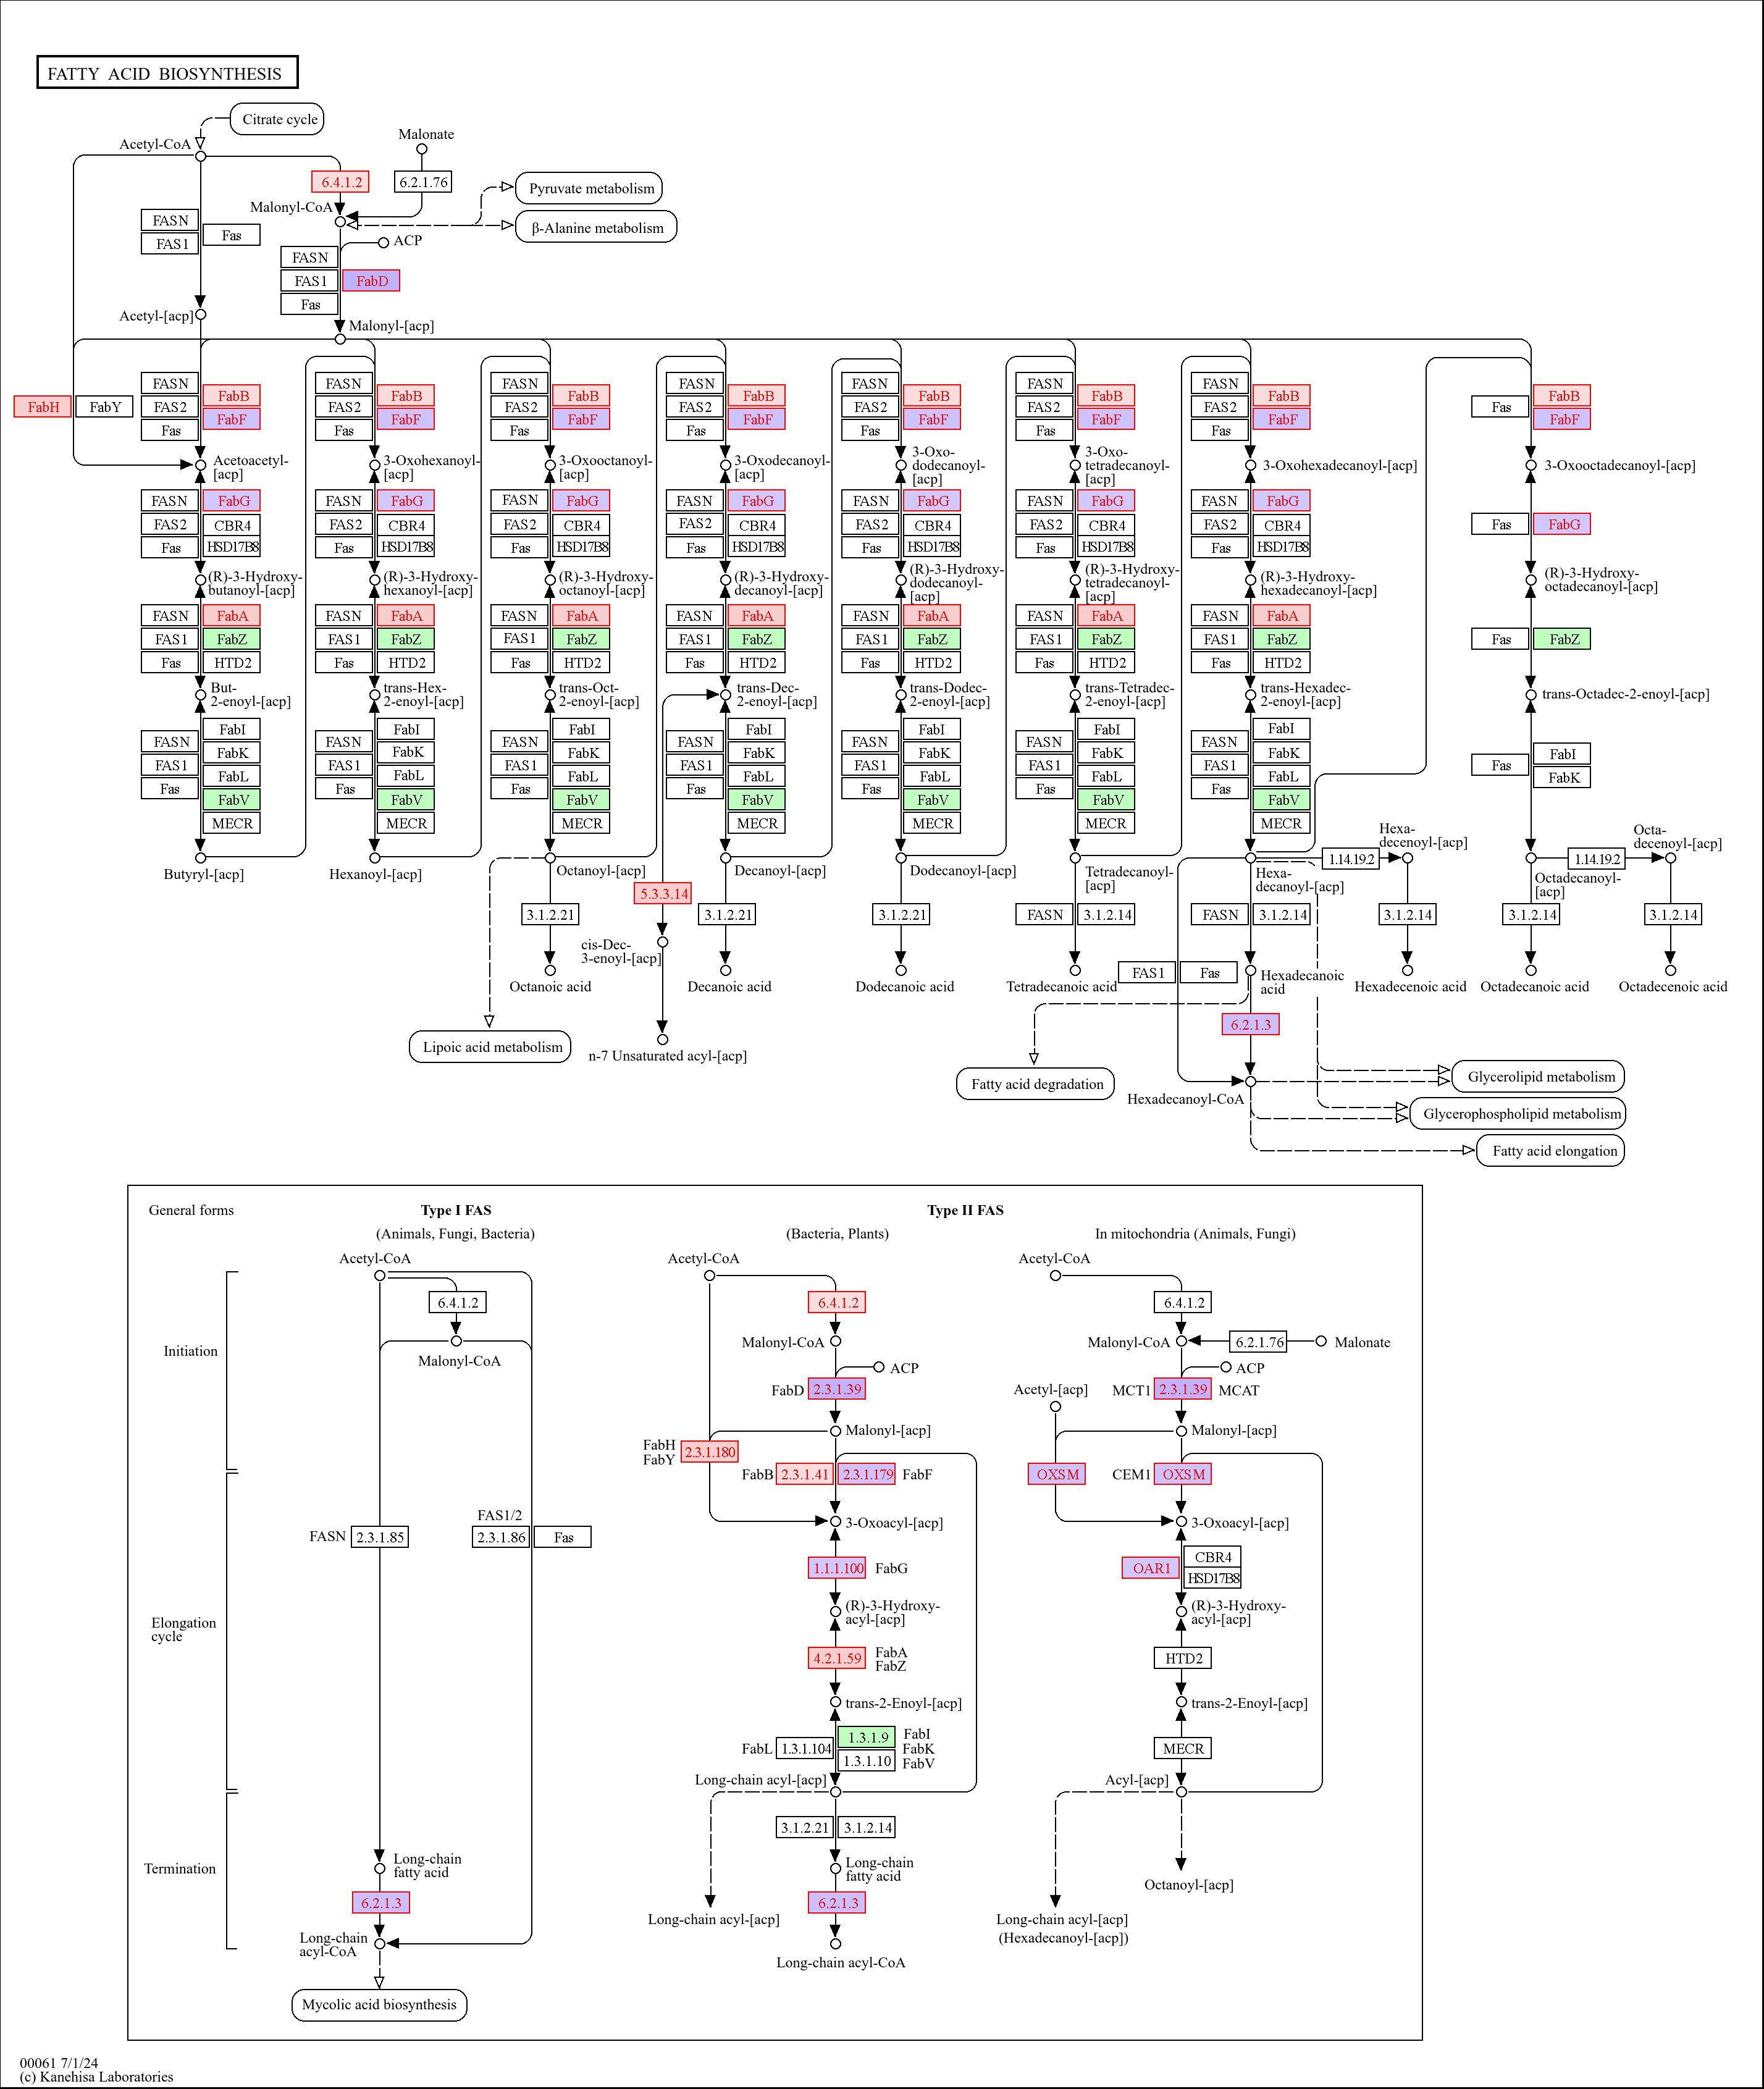
a.
b.
Fig S11. Regulation of genes in the fatty acid biosynthesis pathway following treatment of Xanthomonas euvesicatoria pv. perforans with carvacrol at (a) 0-1hr and (b) 1-4hr.
All significantly differentially expressed genes are shown in red or black color with a colored background. Genes for which no homologue exist in this study are in black with white background. Genes in black with green background indicates that the gene was not differentially expressed. Gene expression is from -1 (red, most downregulated) to +1 (blue, most upregulated)

Slide 4
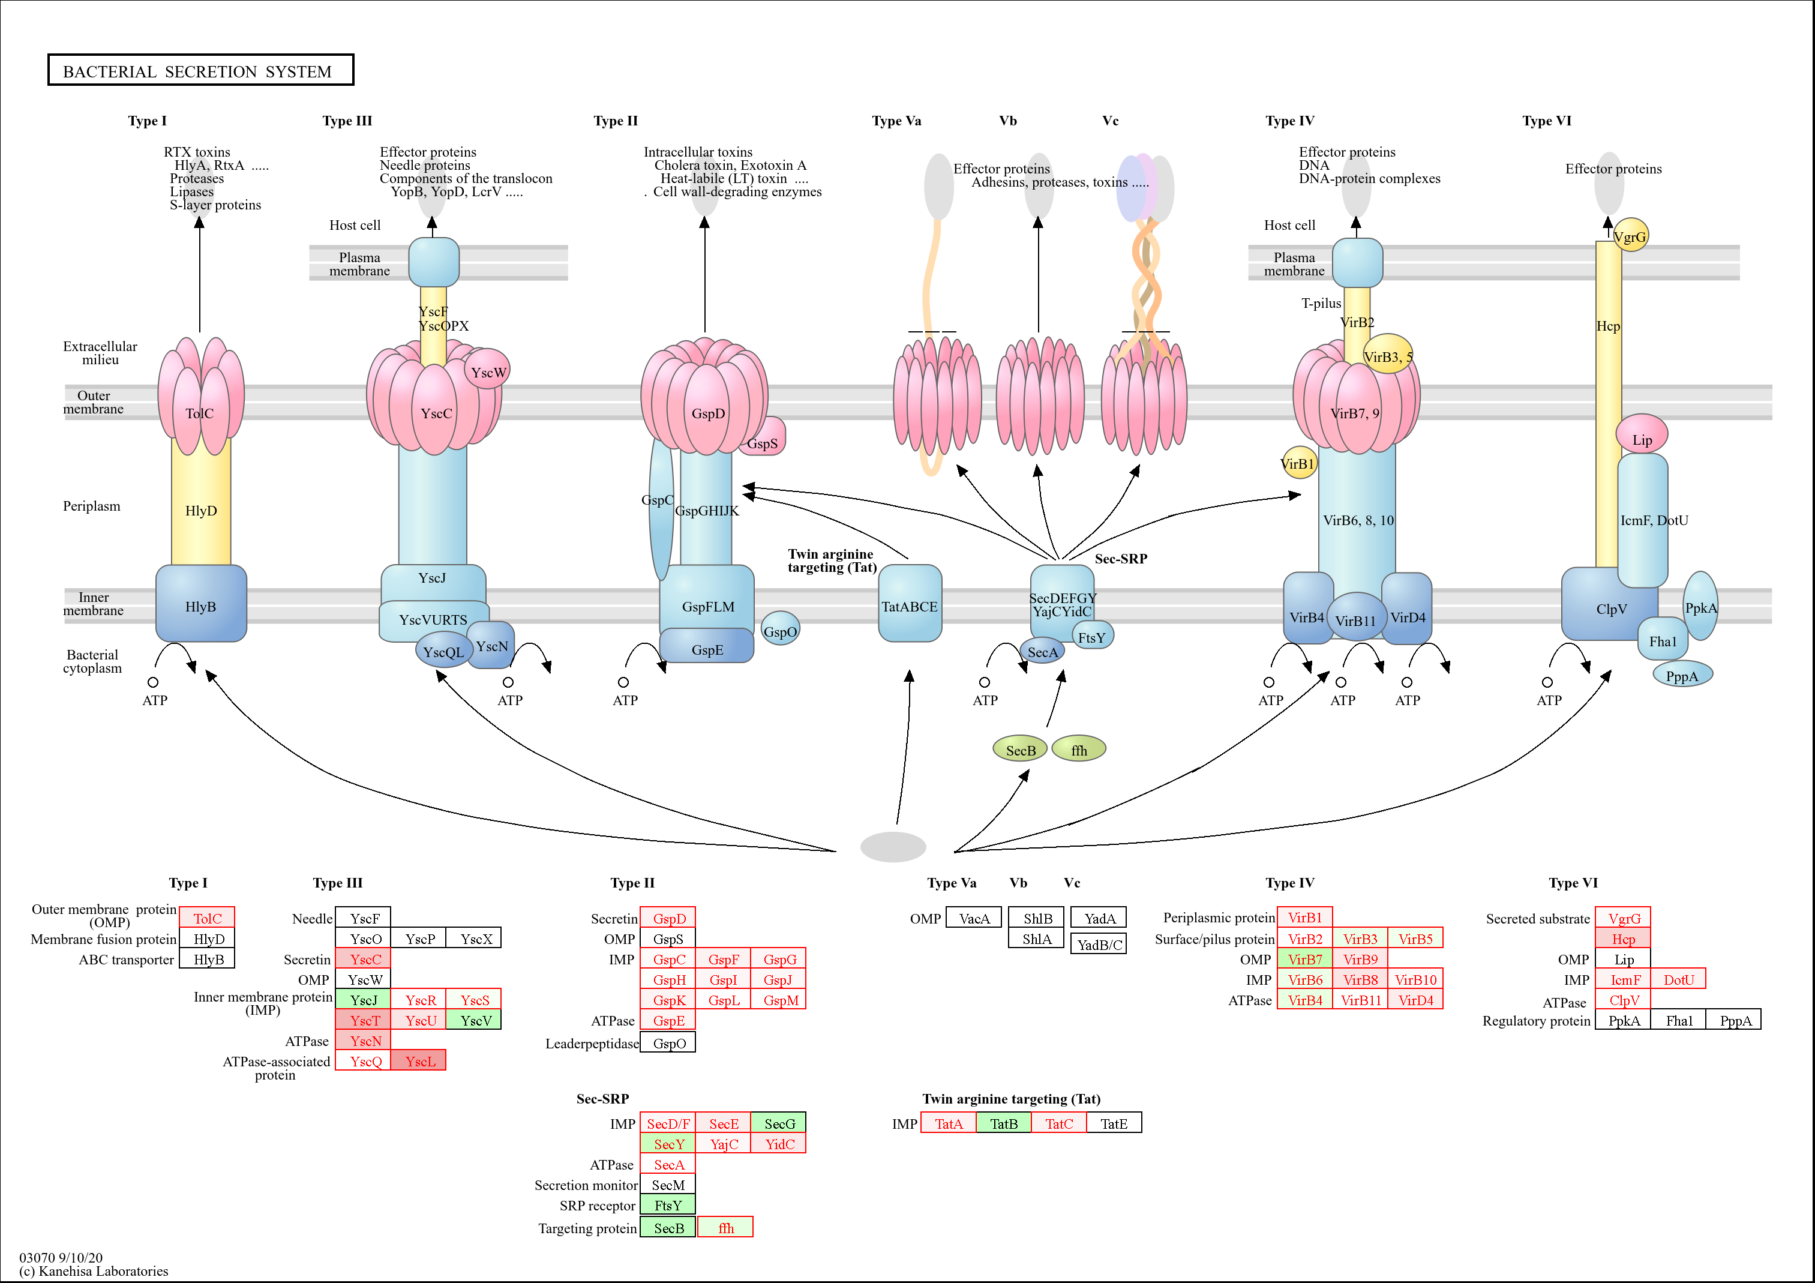
Figure S12a. Regulation of genes in the secretion systems following treatment of Xanthomonas euvesicatoria pv. perforans with carvacrol at 1hr.
All significantly differentially expressed genes are shown in red or black color with a colored background. Genes for which no homologue exist in this study are in black with white background. Genes in black with green background indicates that the gene was not differentially expressed. Gene expression is from -1 (red, most downregulated) to +1 (blue, most upregulated)

Slide 5
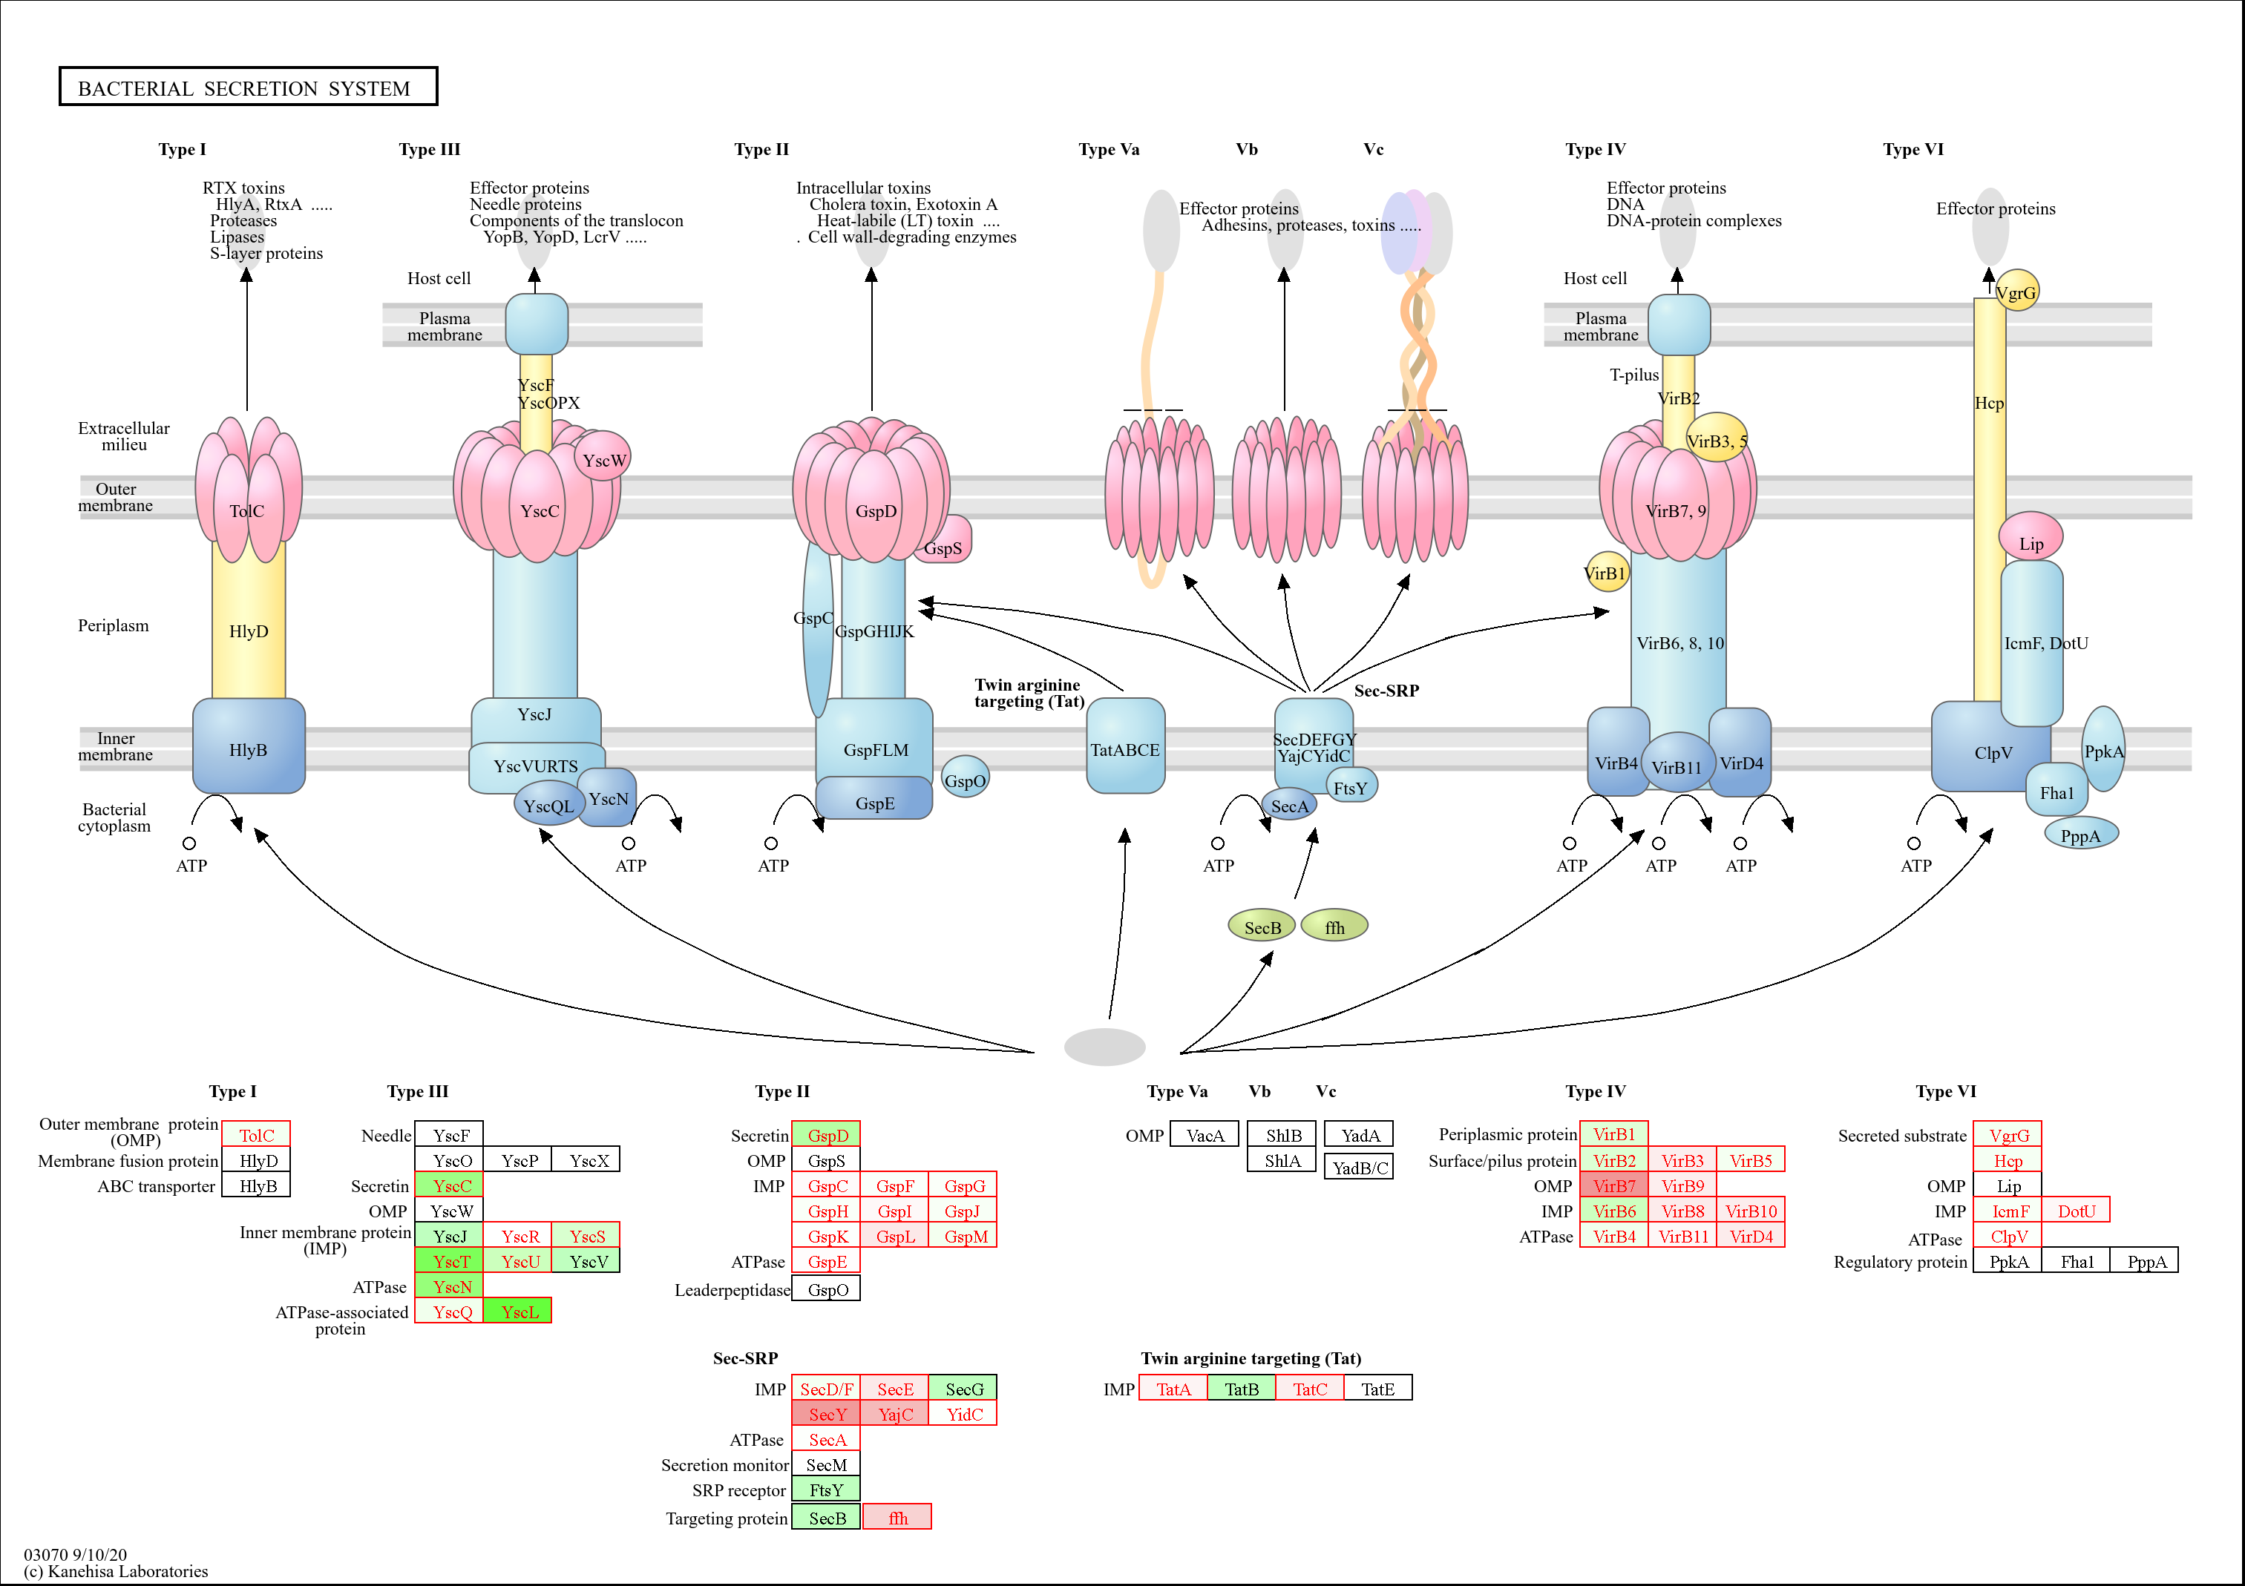
Figure S12b. Regulation of genes in the secretion systems following treatment of Xanthomonas euvesicatoria pv. perforans with carvacrol at 4hr.
All significantly differentially expressed genes are shown in red or black color with a colored background. Genes for which no homologue exist in this study are in black with white background. Genes in black with green background indicates that the gene was not differentially expressed. Gene expression is from -1 (red, most downregulated) to +1 (blue, most upregulated)

Slide 6
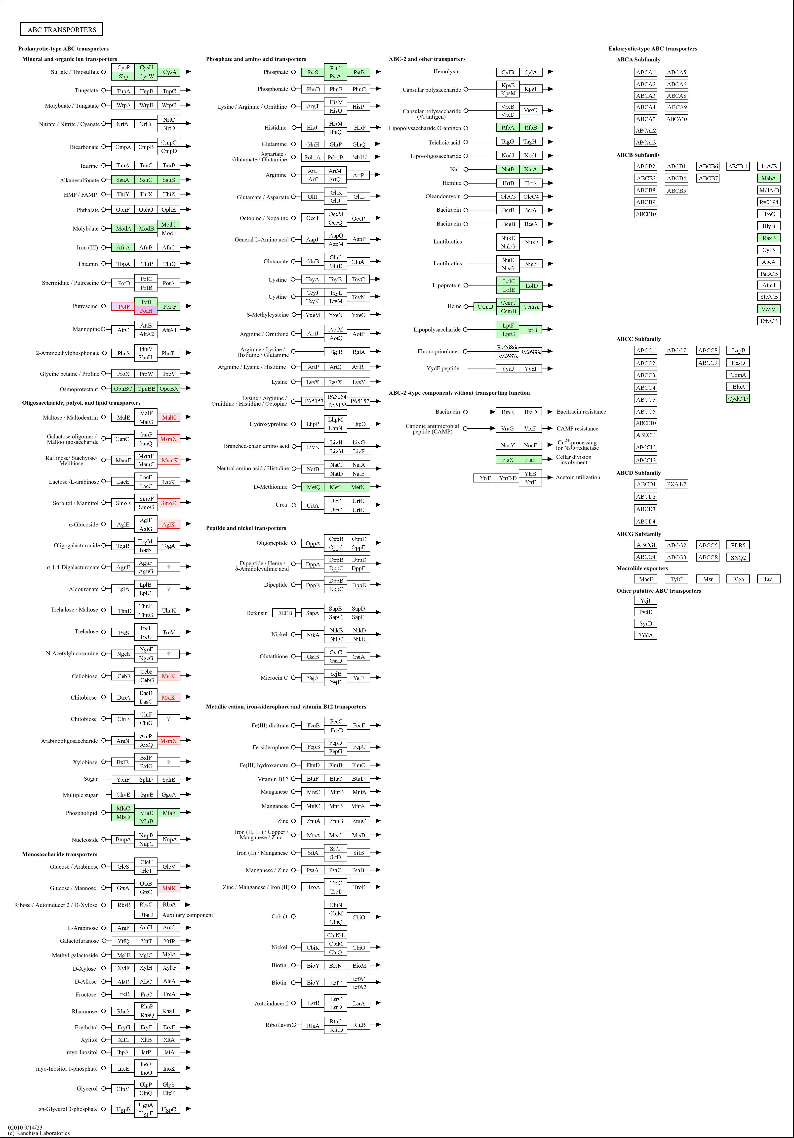
Figure S13a. Regulation of genes in the ABC transporter pathway following treatment of Xanthomonas euvesicatoria pv. perforans with carvacrol at 0-1hr.
All significantly differentially expressed genes are shown in red or black color with a colored background. Genes for which no homologue exist in this study are in black with white background. Genes in black with green background indicates that the gene was not differentially expressed. Gene expression is from -1 (red, most downregulated) to +1 (blue, most upregulated)

Slide 7
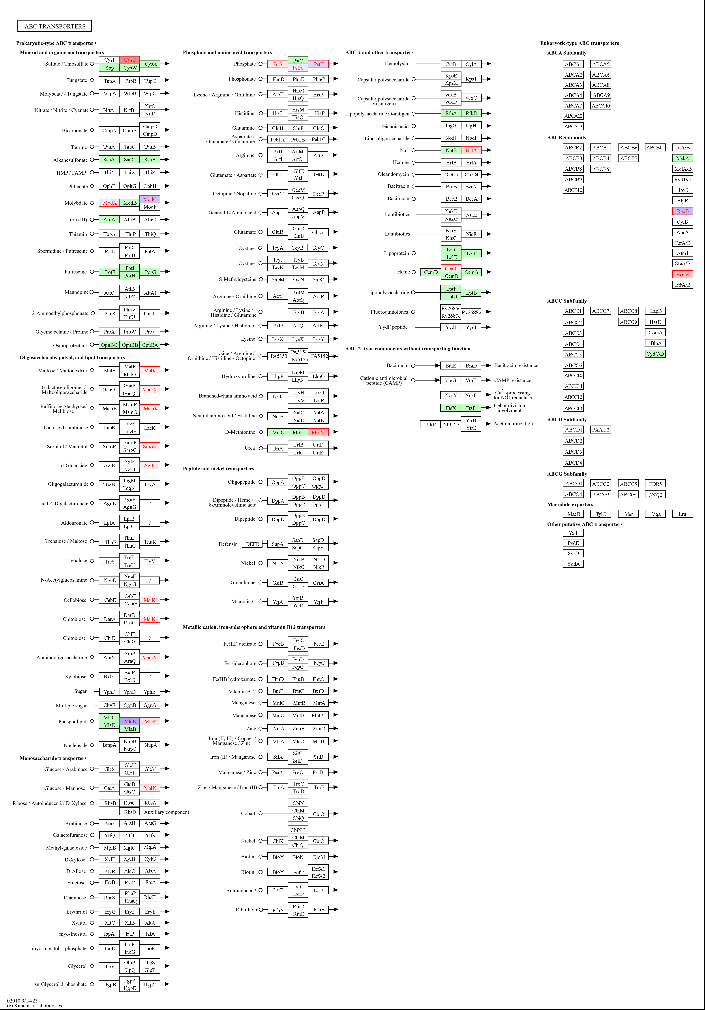
Figure S13b. Regulation of genes in the ABC transporter pathway following treatment of Xanthomonas euvesicatoria pv. perforans with carvacrol at 1-4hr.
All significantly differentially expressed genes are shown in red or black color with a colored background. Genes for which no homologue exist in this study are in black with white background. Genes in black with green background indicates that the gene was not differentially expressed. Gene expression is from -1 (red, most downregulated) to +1 (blue, most upregulated)

