Slide 1
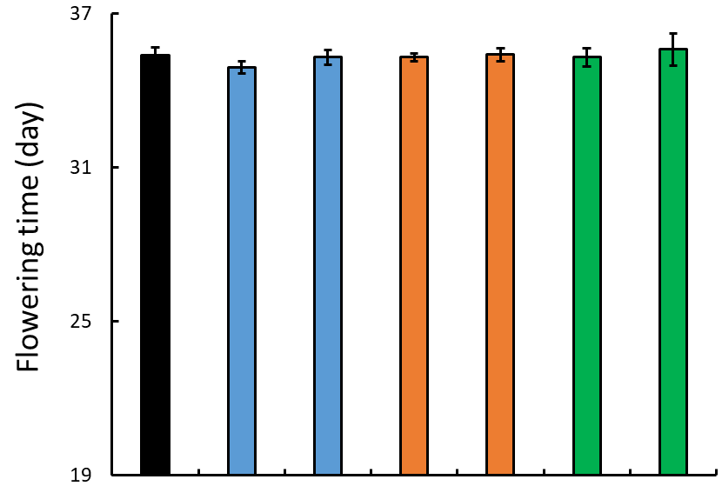
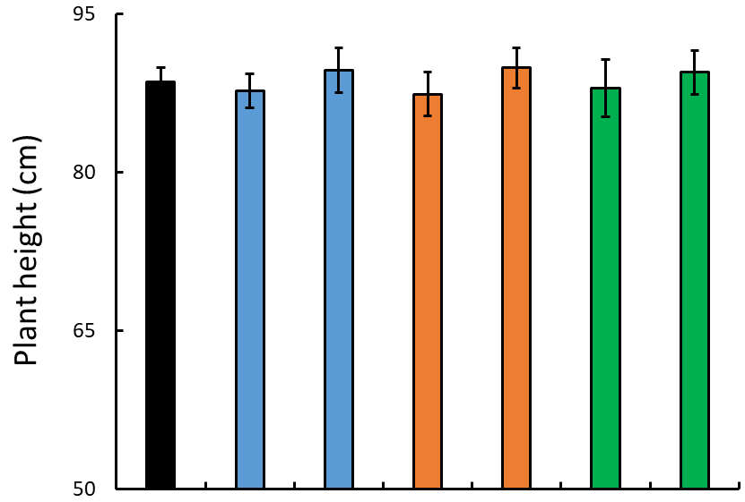
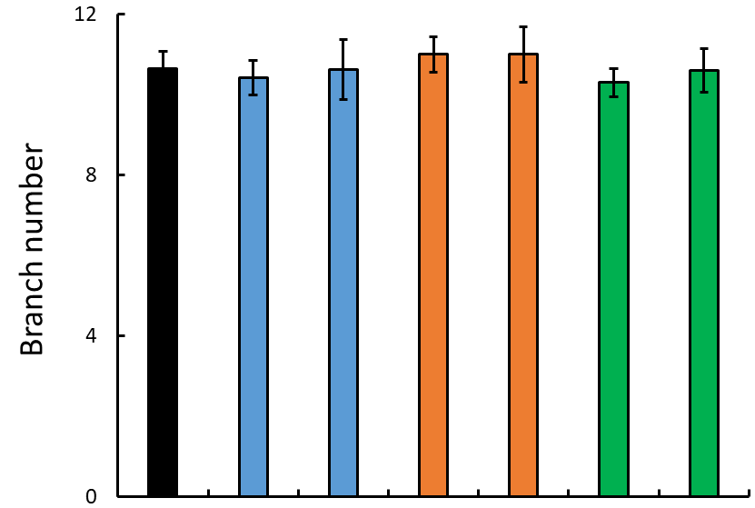
WT
FAX1-1
FAX1-2
ABCA9-1
ABCA9-2
FAX1/ABCA9-2
FAX1/ABCA9-1
Additional file 1: Figure S1. Effect of AtFAX1- and AtABCA9-OEs on other major agronomic traits. Flowering time, plant height, and branch number of mature camelina plants. Values are means ± SE (n=18).

Slide 2
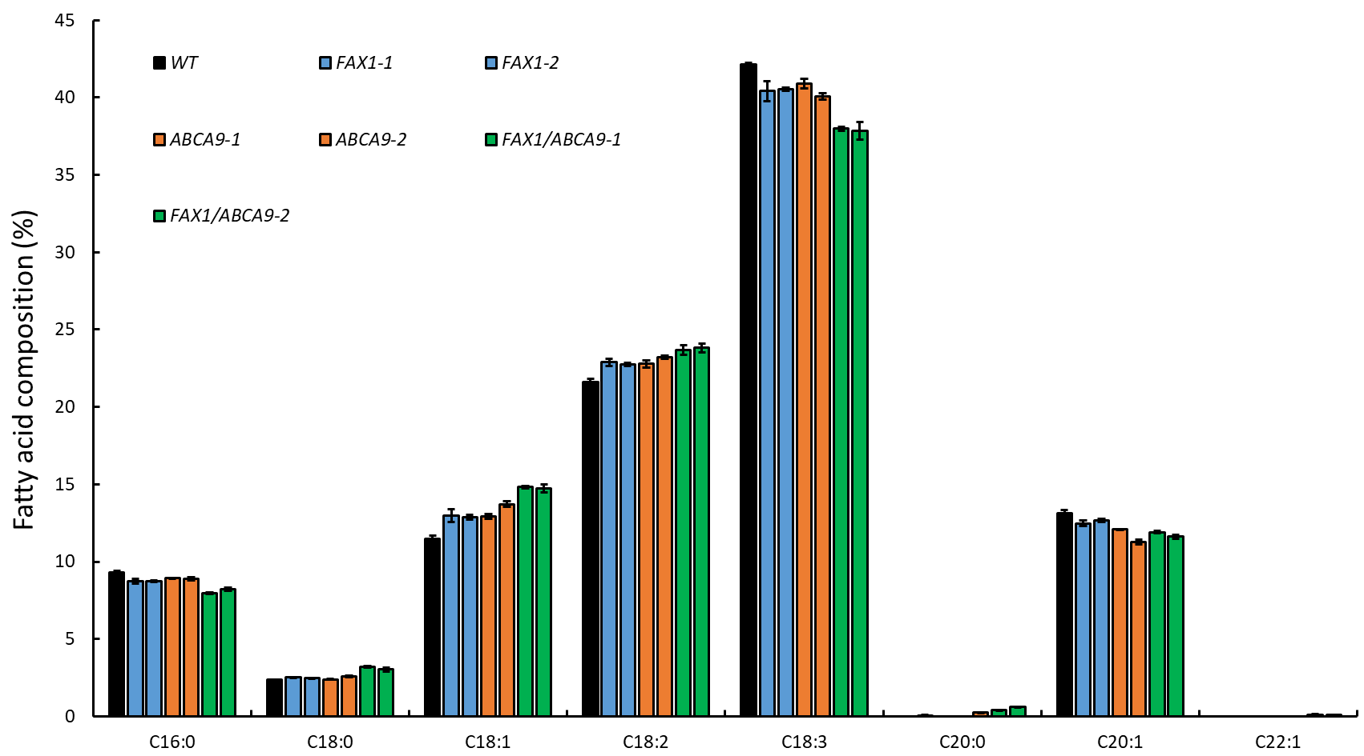
A
BC
B
B
C
D
D
B
B
B
B
A
A
C
C
B
A
A
A
D
C
C
B
B
C
D
C
CD
A
B
B
B
B
C
C
C
B
B
B
A
A
A
D
C
D
D
B
B
A
B
B
B
B
B
A
A
Additional file 2: Figure S2. Effect of AtFAX1- and AtABCA9-OEs on seed fatty acid composition. Seed fatty acid composition was measured by gas chromatography, and calculated based on the peak area. Values are means ± SE (n=3). Capital letters indicates a significant difference (P < 0.01) based on Duncan-test.

Slide 3
Additional file 3: Figure S3. Seed germination rate of AtFAX1- and AtABCA9-OEs. The seeds germination rate was monitored at the time-point of 12-, 18-, 24-, 36-, 42-, 48-, and 60-hrs after imbibition. Seeds were scored as germinated when radicle protrusion was visible. The experiment was repeated 3 batches, each batch with 30 seeds of each plant line. Values are means ± SE.

Slide 4
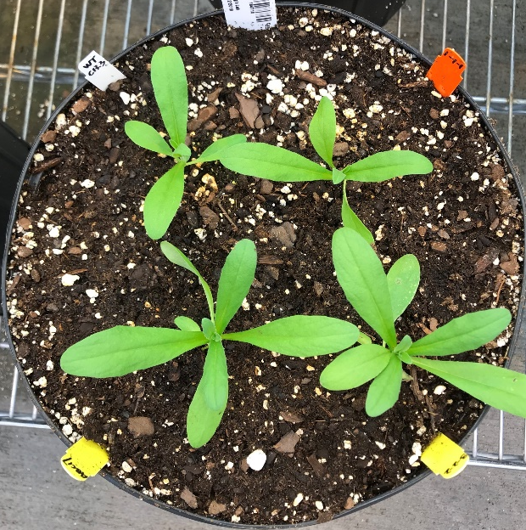
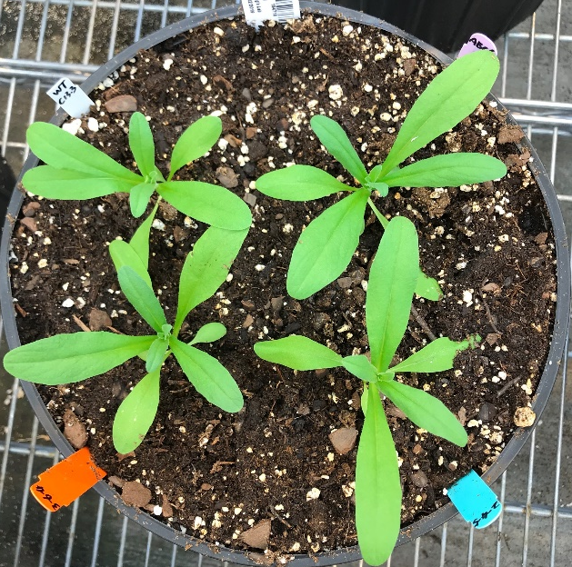
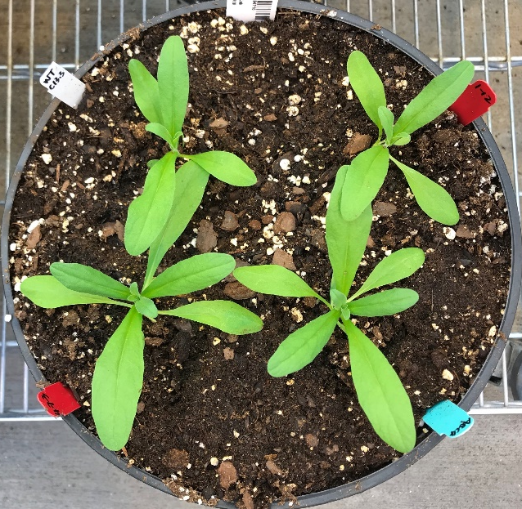
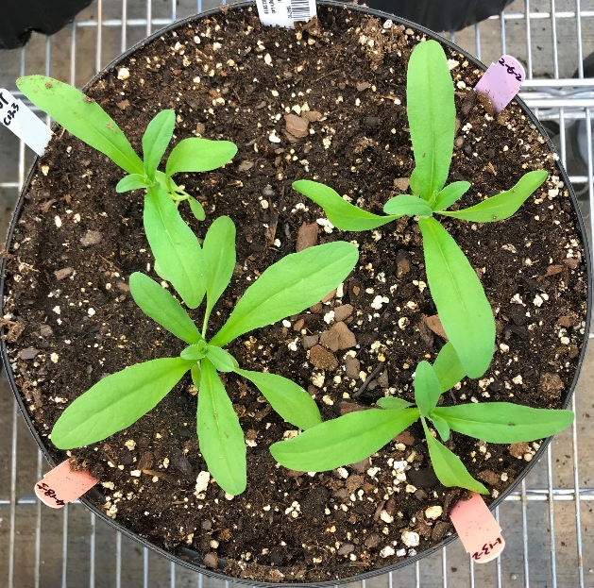
a
WT
FAX1-1
WT
ABCA9-2
WT
WT_{seg}
WT
FAX1-4
ABCA9-3
FAX1/ABCA9-1
FAX1/ABCA9-2
FAX1-3
FAX1/ABCA9-3
ABCA9-1
FAX1/ABCA9-4
FAX1-2
b
A
C
C
B
B
B
B
A
D
D
D
C
C
E
WT
FAX1-1
FAX1-2
WT
FAX1-1
FAX1-2
ABCA9-2
ABCA9-1
ABCA9-2
ABCA9-1
FAX1/ABCA9-2
FAX1/ABCA9-2
FAX1/ABCA9-1
FAX1/ABCA9-1
Additional file 4: Figure S4. Effect of AtFAX1- and AtABCA9-OEs on vegetative tissues. a Morphology of 3-week-old plants. Bar=5 cm. b The fresh weight and leaf number of 3-week-old overground plants. Values are means ± SE with three batch of repeats, each repeat with 12 plants of each line. Capital letters indicate a significant difference (P < 0.01) based on Duncan-test.

Slide 5
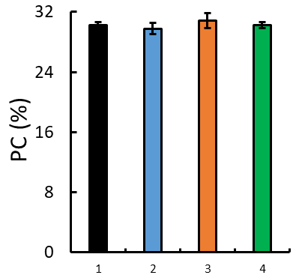
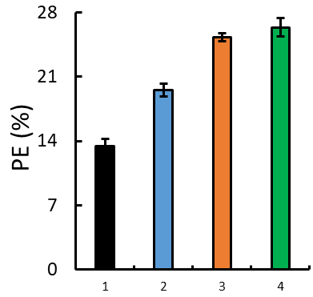
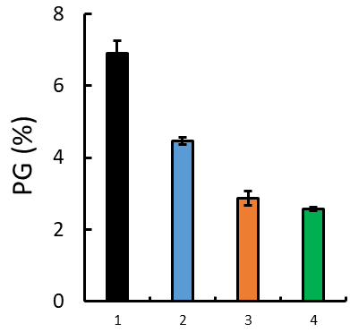
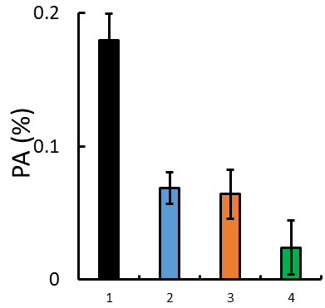
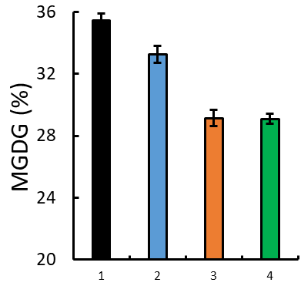
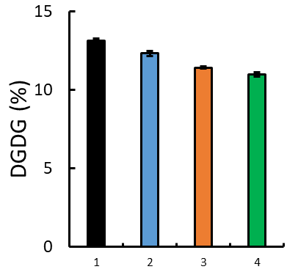
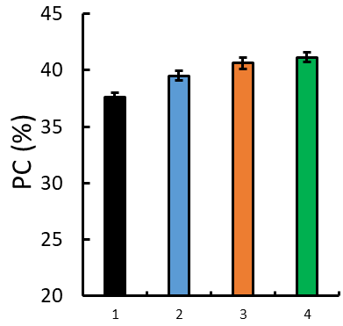
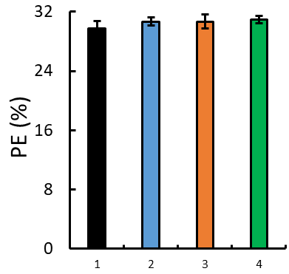
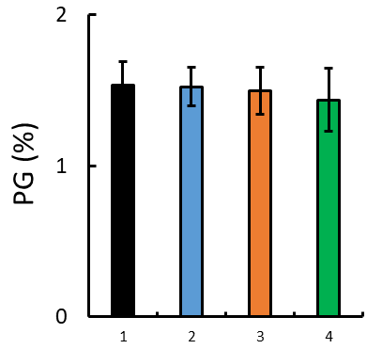
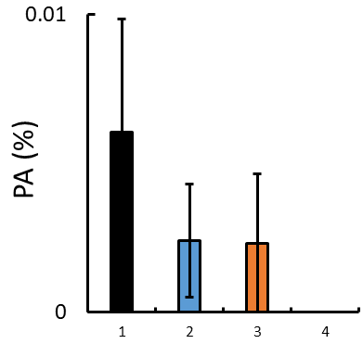
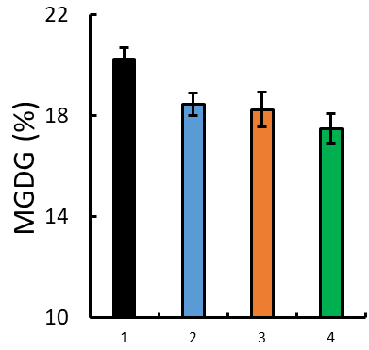
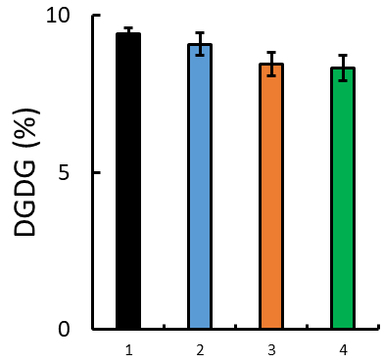
A
A
A
A
A
A
A
A
A
A
B
B
C
B
D
C
B
C
C
C
D
B
B
C
A
A
A
A
A
A
A
B
C
C
B
A
A
A
A
A
A
B
BC
C
C
AB
AB
B
WT
FAX1-1
WT
FAX1-1
WT
FAX1-1
WT
FAX1-1
WT
FAX1-1
ABCA9-1
WT
FAX1-1
ABCA9-1
ABCA9-1
ABCA9-1
ABCA9-1
FAX1/ABCA9-1
ABCA9-1
FAX1/ABCA9-1
FAX1/ABCA9-1
FAX1/ABCA9-1
FAX1/ABCA9-1
FAX1/ABCA9-1
Additional file 5: Figure S5. Alterations of membrane glycerolipid levels (mol%) in developing pods of AtFAX1- and AtABCA9-OEs. 2-week (upper panel) and 4-week (lower panel) old developing pods were sampled for lipid profiling by ESI-MS/MS. The total lipid levels referred to the total amount of major phospholipid (PC, PE, PG, and PA) and galactolipid (MGDG and DGDG) measured. Values are means ± SE with 5 biological replicates. Capital letters on the top of each panel indicate a significant difference (P < 0.01) based on Duncan-test. PC: phosphatidylcholine; PE: phosphatidylethanolamine; PG: phosphatidylglycerol; PA: phosphatidic acid; MGDG: monogalactosyldiacylglycerol; DGDG: digalactosyldiacylglycerol.

Slide 6
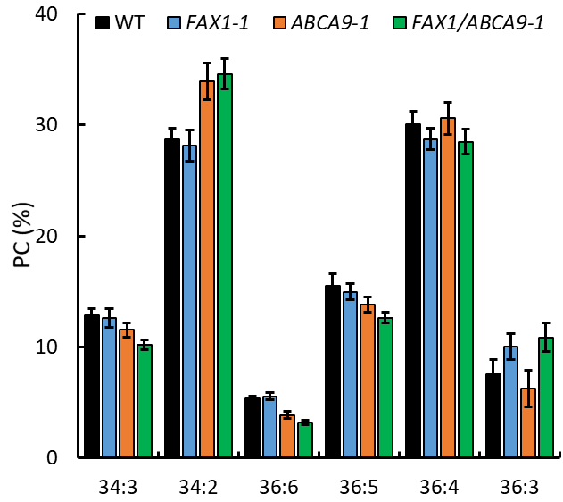
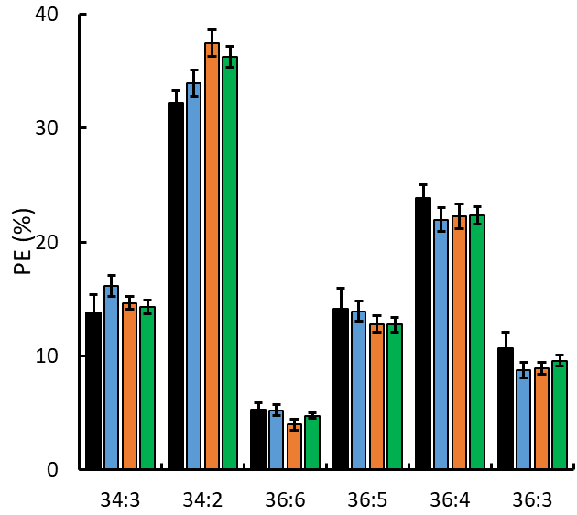
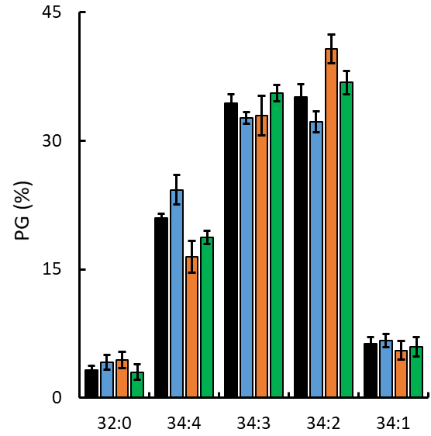
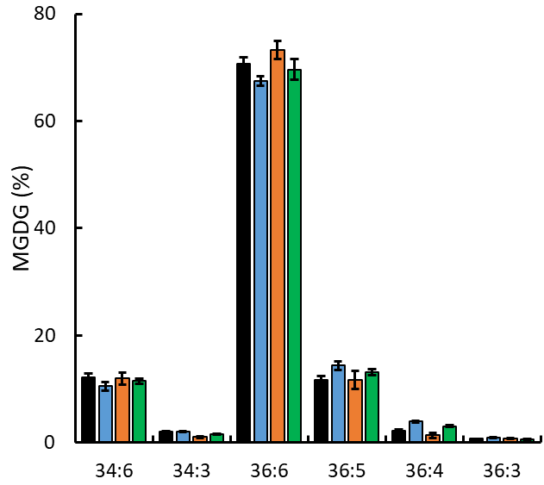
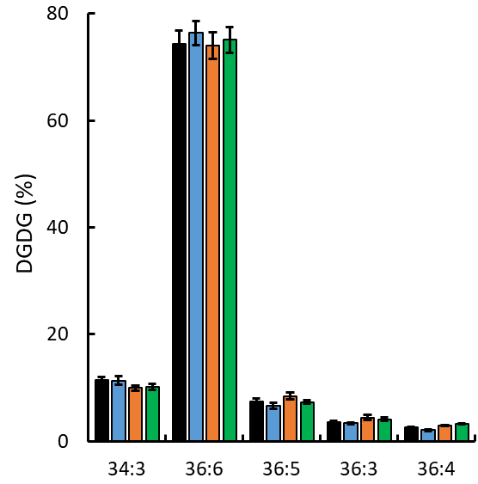
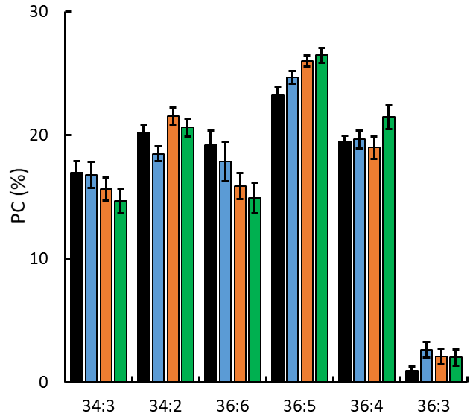
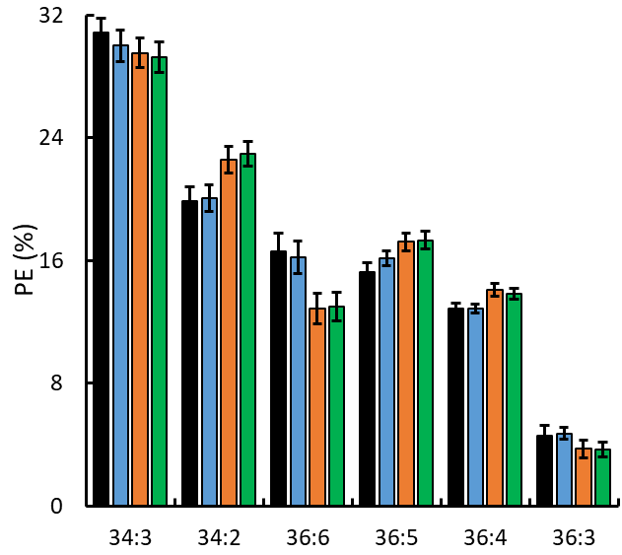
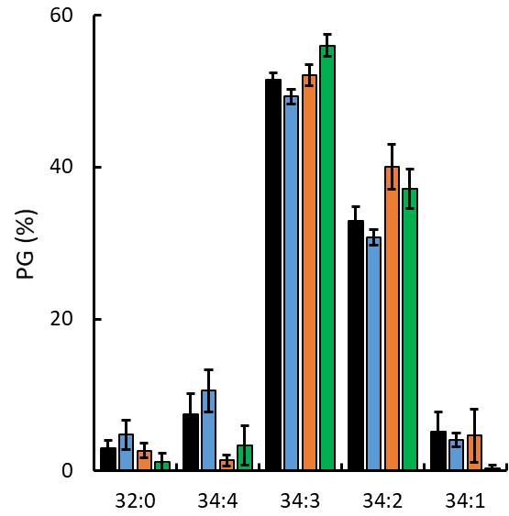
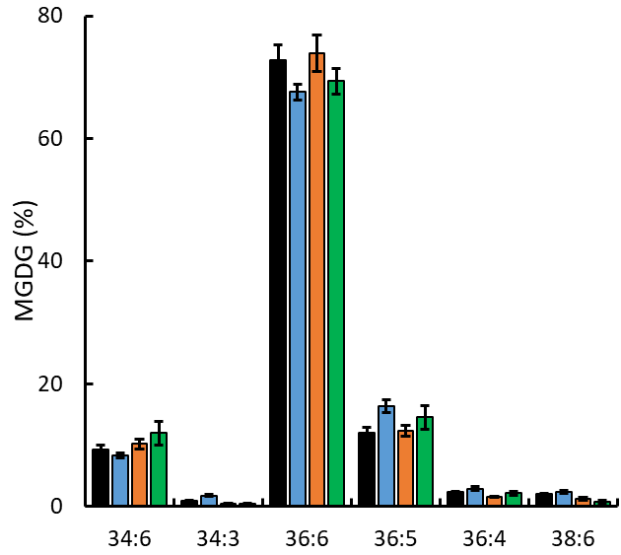
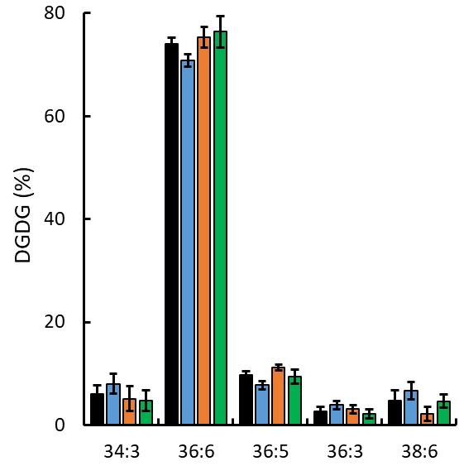
A
A
A
A
A
B
A
B
A
A
A
A
A
B
B
A
A
B
B
C
A
AB
B
B
B
B
B
C
A
B
B
B
A
A
B
B
A
A
B
C
C
A
A
C
D
A
B
B
A
B
B
A
AB
A
B
B
B
B
B
B
A
A
A
A
A
A
A
A
B
C
A
A
B
A
A
A
A
A
A
A
B
A
B
AB
A
A
B
B
A
B
A
B
A
A
A
B
A
B
A
B
A
A
A
A
A
B
B
A
A
B
A
A
A
A
A
A
A
A
A
A
A
B
A
A
C
B
A
B
C
B
B
B
A
A
A
A
A
B
AB
A
B
B
B
B
B
A
A
A
C
AB
B
AB
B
B
A
A
A
A
B
B
B
B
B
B
A
A
B
B
A
A
A
A
AB
A
B
B
A
A
A
A
B
B
B
A
B
A
A
A
A
A
A
B
B
B
A
A
B
B
A
B
A
A
A
A
A
C
AB
A
A
A
A
A
A
B
A
B
B
A
B
B
C
A
B
B
Additional file 6: Figure S6. Alterations of PC, PE, PG, MGDG, and DGDG species (mol%) in developing pods of AtFAX1- and AtABCA9-OEs. 2-week (upper panel) and 4-week (lower panel) old developing pods were sampled for lipid profiling by ESI-MS/MS. The species levels were measured by internal standards. Values are means ± SE with 5 biological replicates. Capital letters on the top of each panel indicate a significant difference (P < 0.01) based on Duncan-test. PC: phosphatidylcholine; PE: phosphatidylethanolamine; PG: phosphatidylglycerol; MGDG: monogalactosyldiacylglycerol; and DGDG: digalactosyldiacylglycerol.

Slide 7

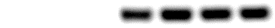
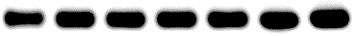
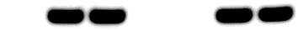
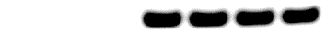

ABCA9/FAX1-1
ABCA9-2
ABCA9/FAX1-2
FAX1-1
ABCA9-1
WT
FAX1-2
2W
AtFAX1
AtABCA9
CsACT2
4W
AtFAX1
AtABCA9
CsACT2
Additional file 7: Figure S7. Gene expression level of AtFAX1 and AtABCA9 in developing seeds of camelina OE lines. The RNA was extracted from 2- (upper) and 4- (lower) week (W) old developing seeds. ACT2 (actin2) was used as the internal standard for cDNA input adjustment. The expression of AtFAX1 and AtABCA9 were semi-quantified by PCR with the primers specific binding to AtFAX1 and AtABCA9. The experiment was performed at least three times with similar results.

