Slide 1
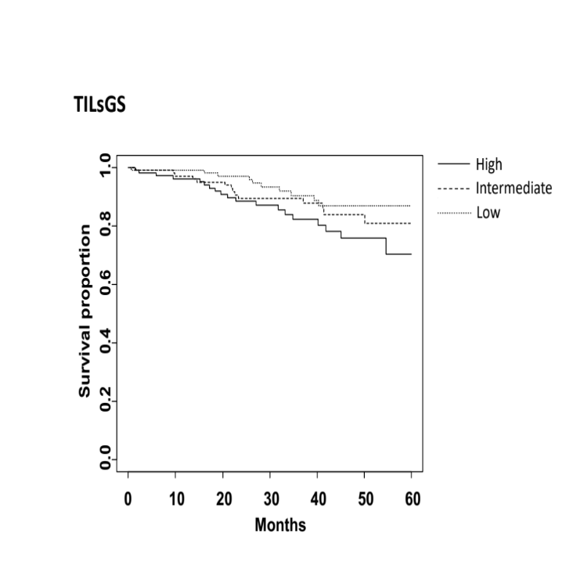
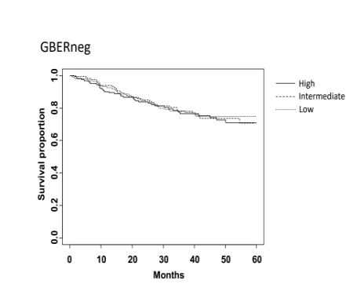
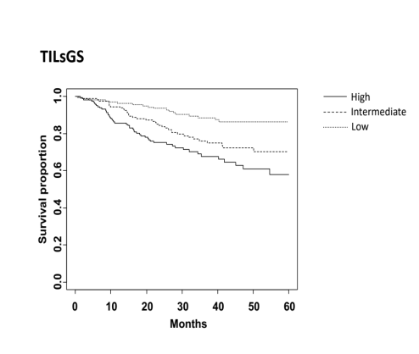
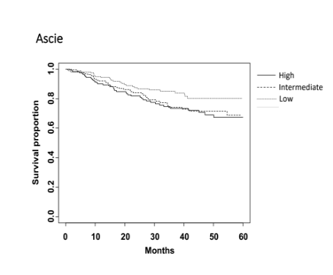
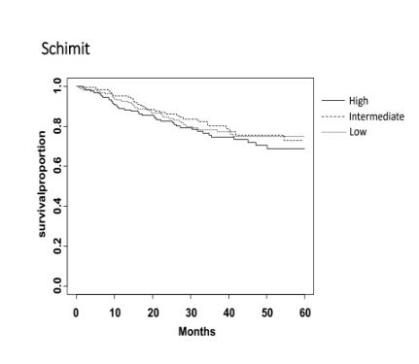
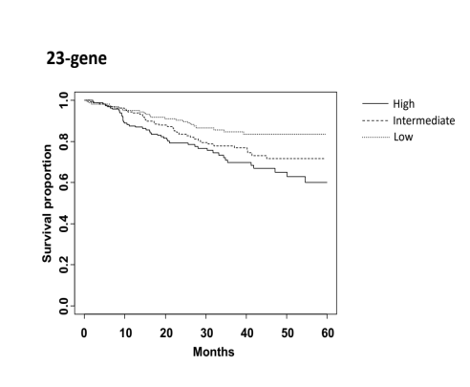
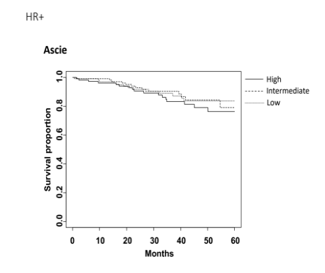

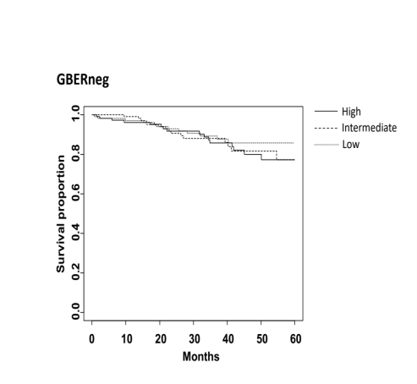
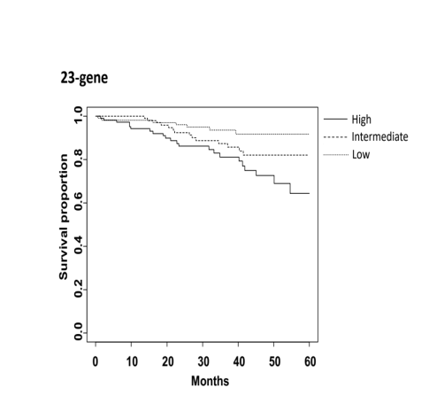
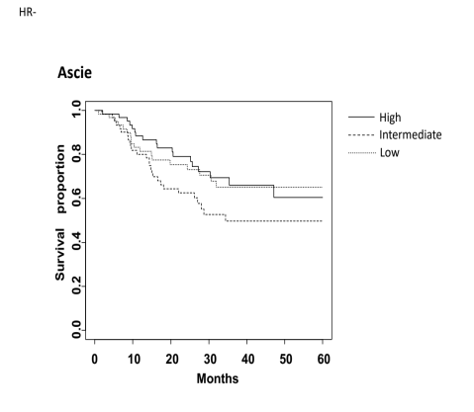
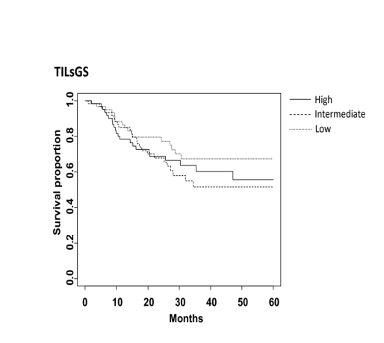
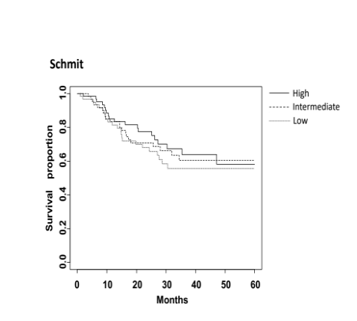
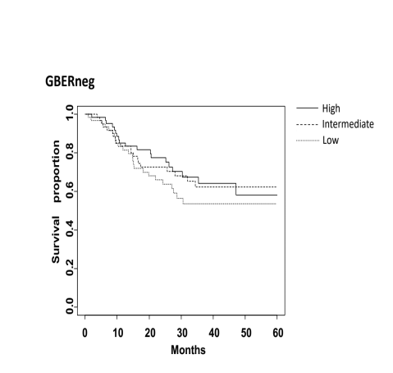
(A)
Bianchini
P<0.001
Schmnidt
P=0.9
IRSN-23
P=0.003
Ascierto
P=0.07
P=0.5
(B)
IRSN-23
P=0.4
P=0.1
P=0.03
Ascierto
P=0.6
Schmidt
Bianchini
P=0.7
(C)
P=0.5
P=0.4
P=0.03
Ascierto
P=0.1
P=0.7
Bianchini
IRSN-23
Schmidt
Notes:
Supplementary figure1 Kaplan–Meier 5-year DRFS curves by tertiles of IGS gene expression level (low/intermediate/high) in (A) all, (B) hormone receptor-positive and (C) hormone receptor-negative breast cancer patients. P values were calculated by log-rank test. DRFS: distant relapse-free survival

Slide 2
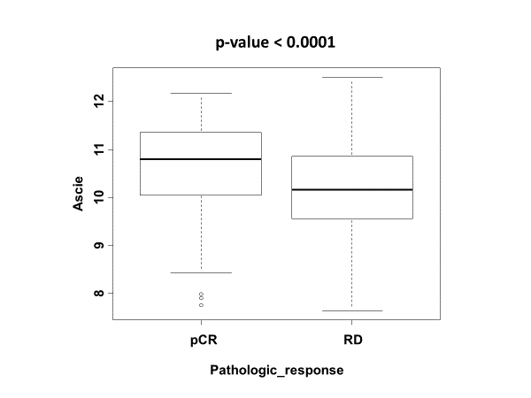
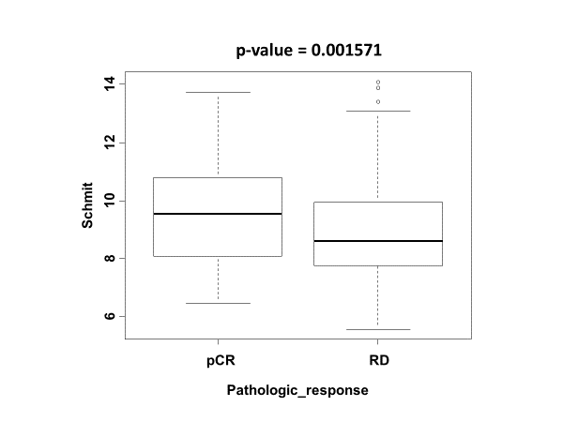
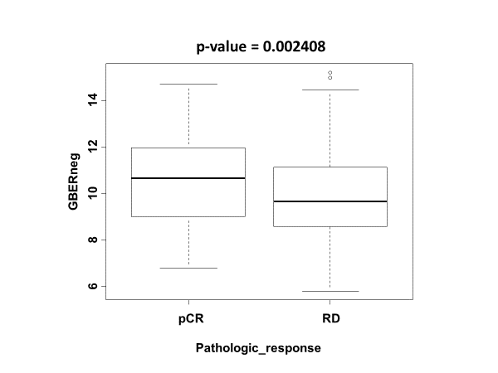
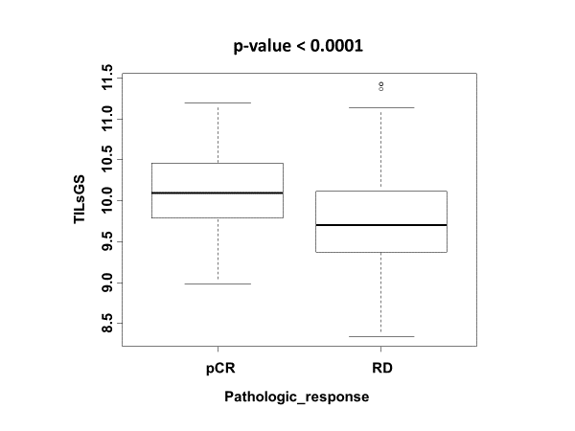
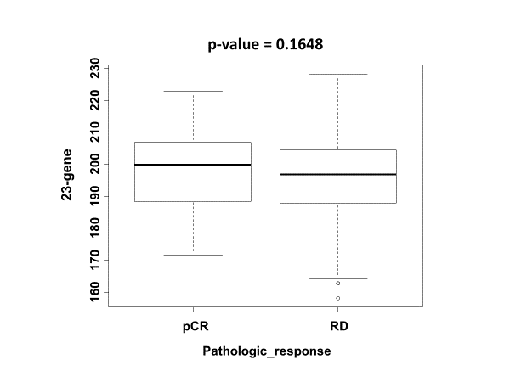
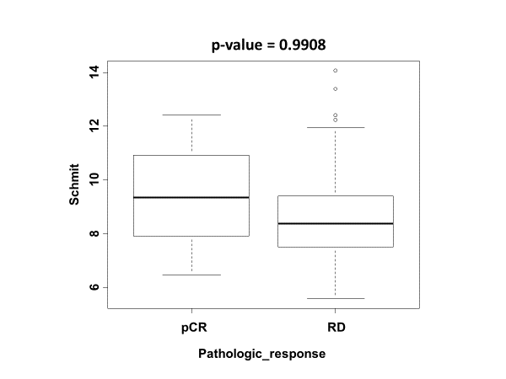
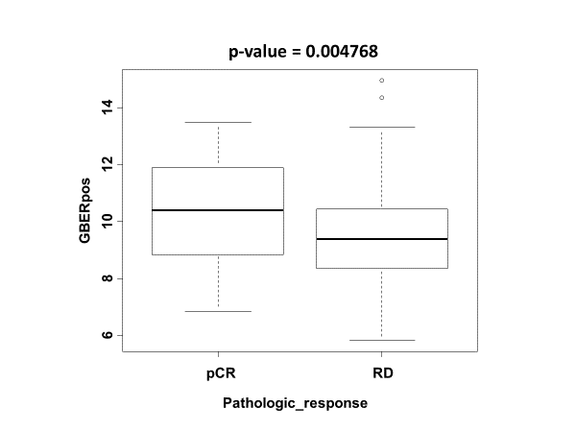
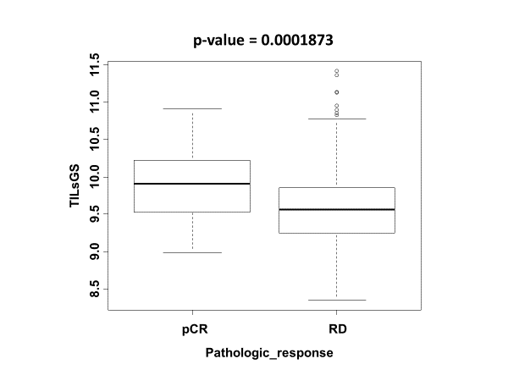
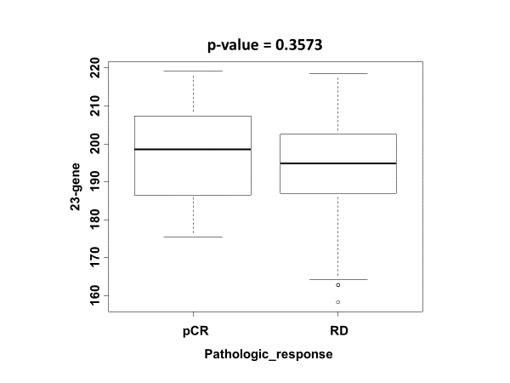
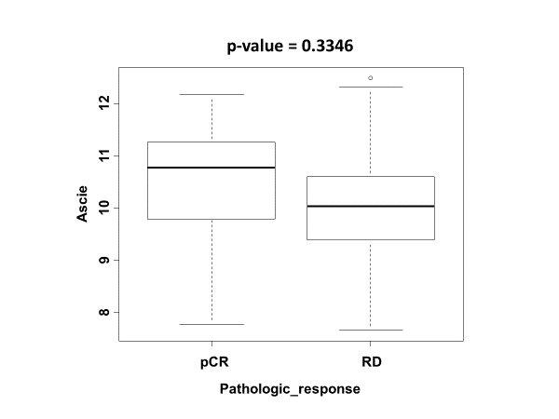
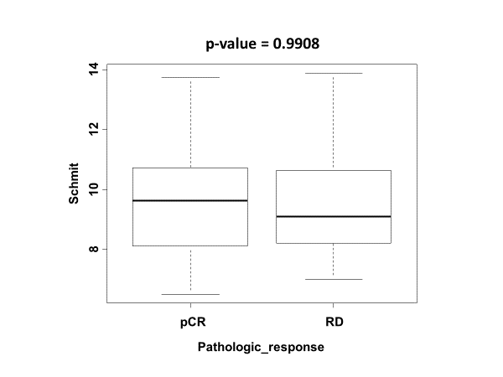
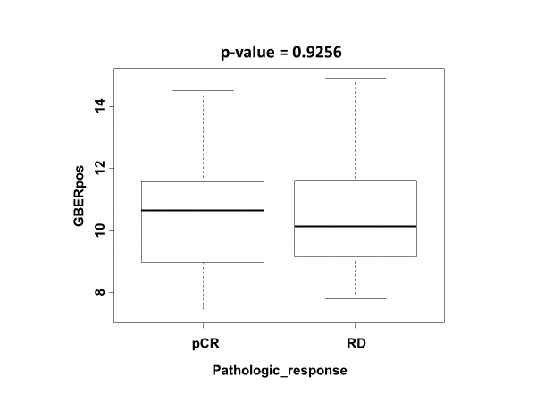
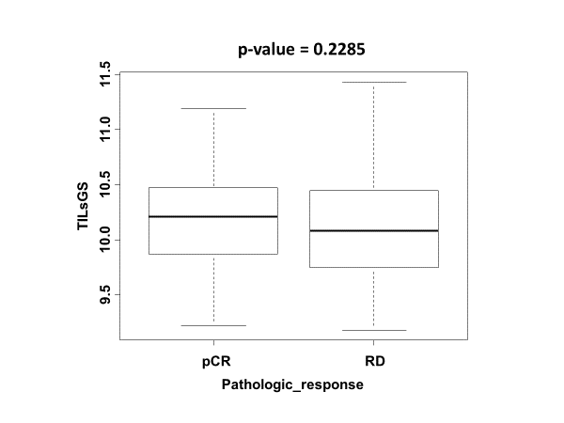
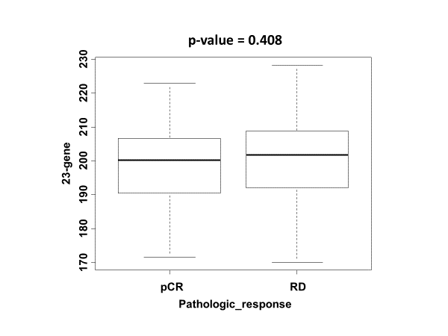
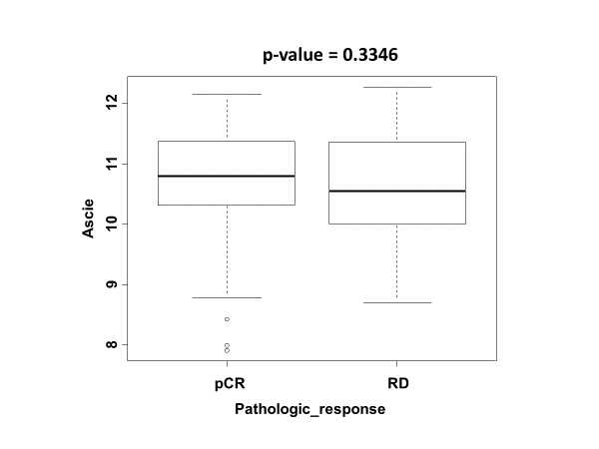
(A)
P<0.001
P=0.002
P=0.002
P<0.001
P=0.165
Ascierto
Schmidt
Bianchini
TILsGS
IRSN-23
Ascierto
Bianchini
TILsGS
(B)
P=0.335
Schmidt
P=0.991
P=0.005
P<0.001
IRSN-23
P=0.357
Bianchini
IRSN-23
(C)
Schmidt
P=0.926
TILsGS
P=0.408
Ascierto
P=0.335
P=0.991
P=0.229
Notes:
Supplementary figure2 Boxplots of the predictive value of IGSs for response to chemotherapy in (A) all(pathological complete response[pCR]: n=93; residual disease[RD]: n=373 ), (B) hormone receptor-positive (pCR: n=36; RD: n=259) and (C) hormone receptor-negative breast cancer patients (pCR: n=57; RD: n=114). P value was calculated by the Wilcoxon test.

