Slide 1
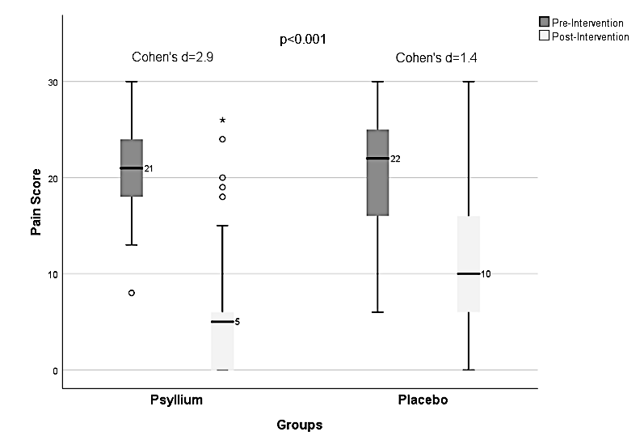


Randomized Placebo-Controlled Trial of Psyllium Fiber in Functional Abdominal Pain Disorders in Children
Randomization
Baseline
(4 weeks)
Psyllium (n=57)
Pain scores
at week-12
(post randomization)
109 Children (5-18 years) with FAPD (FAP-NOS and IBS) diagnosed by Rome IV
Placebo (Maltodextrin) (n=52)
Group | Baseline pain score | Post-intervention pain score
Psyllium | 21 | 05
Placebo | 22 | 10
CONCLUSION: A 12-week trial of psyllium fiber improves pain in most and gives sustained relief in three-fourths of children with FAP-NOS and IBS.
Kaur M et al. Randomized Placebo-Controlled Trial of Psyllium Fiber in Functional Abdominal Pain Disorders in Children. Dig Dis Sci

