Slide 1


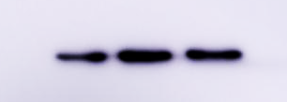

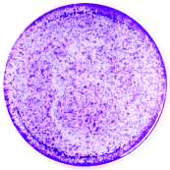
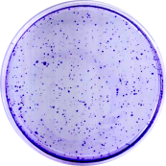
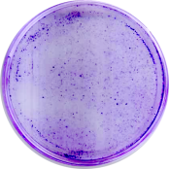
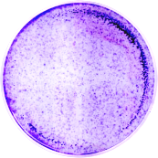
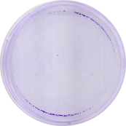
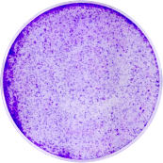
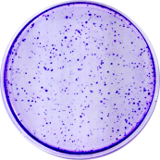
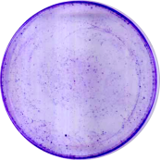
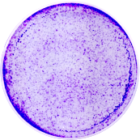
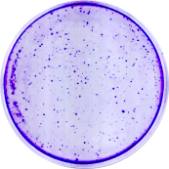
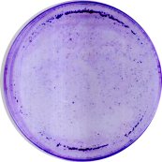
a
Supplementary Fig.1
SMARCA4def cells
MYCamp cells
H82
H69
H460
DMS273
EC₅₀: 0.83 µM
EC₅₀: 0.27 µM
EC₅₀: 0.68 µM
EC₅₀: 0.38 µM
HCC33
H2170
H446
H1963
% cell viability relative to control
EC₅₀: 0.43 µM
EC₅₀: 1.79 µM
EC₅₀: 0.58 µM
EC₅₀: 0.55 µM
H23
H841
H1299
H157
EC₅₀: 2.46 µM
EC₅₀: 1.28 µM
EC₅₀: 2.20 µM
EC₅₀: 1.42 µM
DMS114
A549
-Vehicle
-SAHA (500 nM)
-SAHA (1000 nM)
-Vehicle
-SAHA (500 nM)
-SAHA (1000 nM)
c
EC₅₀: 1.48 µM
EC₅₀: 1.35 µM
b
Log SAHA concentration [μM]
-EZH2
-ACTIN
% cell viability relative to control
DMS273
H23
DMS114 (EC₅₀, 6µM)
H23 (EC₅₀, not reached)
H446 (EC₅₀, 7.4µM)
H460 (EC₅₀, 6.9 µM)
e
DMS114
H522
DMS273
Log GSK-126 concentration [μM]
Vehicle
d
DMS114
H446
Vehicle
GSK-126 [1 µM]
SAHA [1μM]
EC₅₀ 1.9 µM EC₅₀ 1.5 µM
EC₅₀ 0.57 µM EC₅₀ 0.54 µM
% cell viability relative to control
H23
DMS273
GSK126 [1μM]
EC₅₀ 2.6 µM EC₅₀ 3.0 µM
EC₅₀ 0.2 µM EC₅₀ 2.6 µM
GSK126 [1μM] /SAHA [1μM]
Log SAHA concentration [μM]

Slide 2
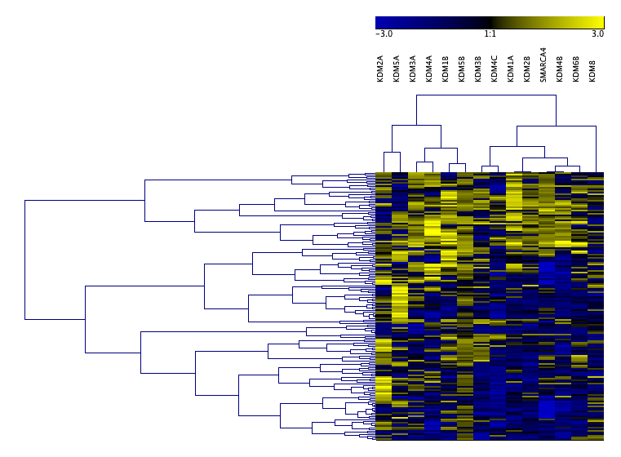
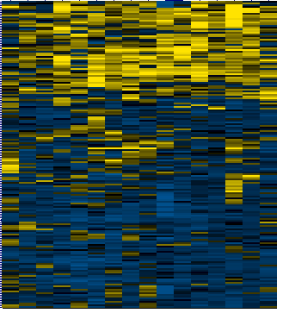


KDM2A
KDM6A
KDM4C
KDM4A
KDM3B
KDM5A
KDM3A
KDM6B
KDM5B
SMARCA4
KDM4B
KDM1A
KDM2B
KDM1B
KDM7A
KDM8
a
-3.0 1:1 3.0
b
P<0.01
P<0.0001
LOW SMARCA4 (n=65)
HIGH SMARCA4 (n=165)
LOW SMARCA4 HIGH SMARCA4
mRNA expression (z-Scores relative
to diploid samples)
c
H1299-
wtSMARCA4
H1299-
mutSMARCA4
LOW SMARCA4-
HIGH SMARCA4-
LOW SMARCA4-
HIGH SMARCA4-
-
+
-
+
Dox
-KDM6B
KDM6A
KDM6B
-KDM6A
-TUBULIN
d
shSMARCA4
shSMARCA4
-EZH2
-TUBULIN
Parental
shNT #1 #4
shNT #1 #4
-SMARCA4
-KDM6B
-KDM6A
-TUBULIN
e
P-value
DMS273
H69
0.012
SMARCA4
****
*
Relative expression levels
shNT #1 #4
KDM6B
KDM6A
0.07
0.06
0.02
0.02
****
****
****
***
shNT #1 #4
shNT #1 #4
Supplementary Fig.2

Slide 3
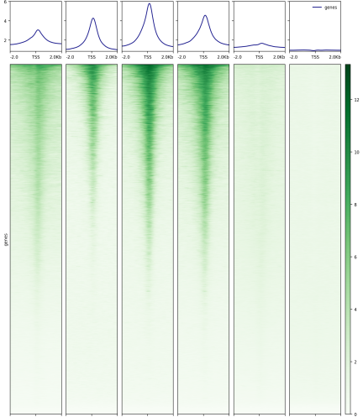
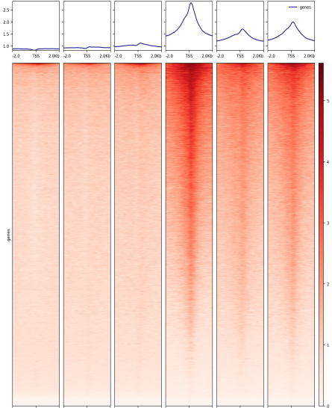
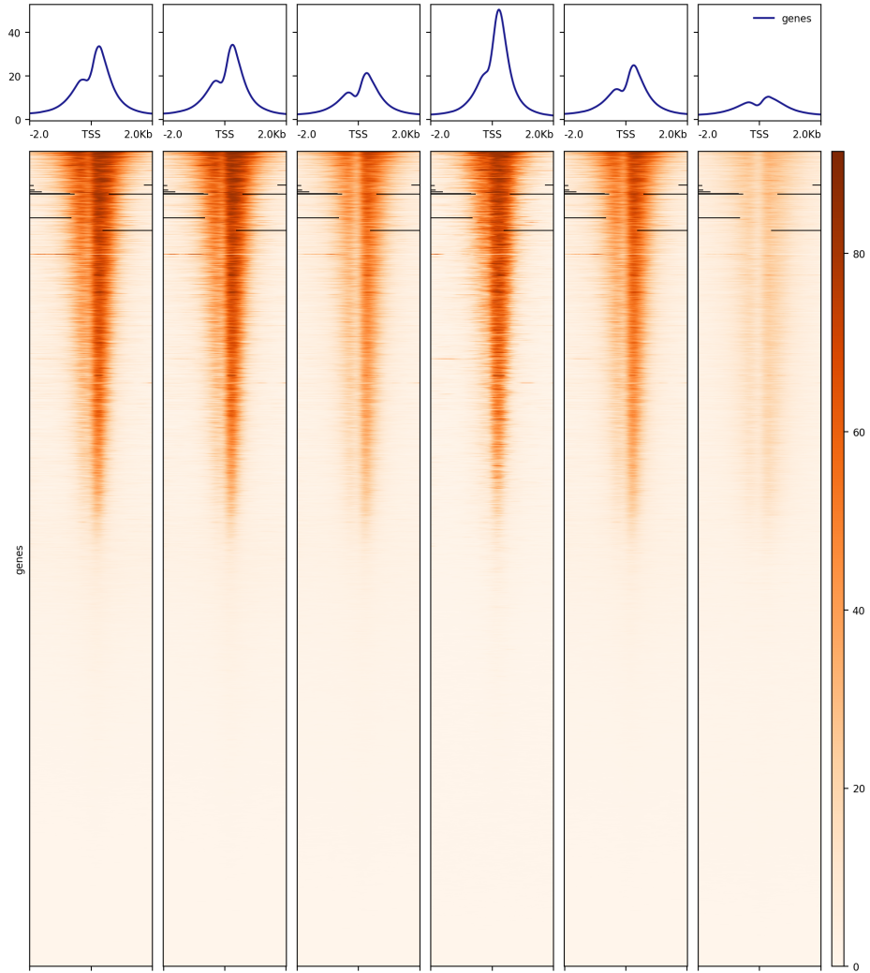
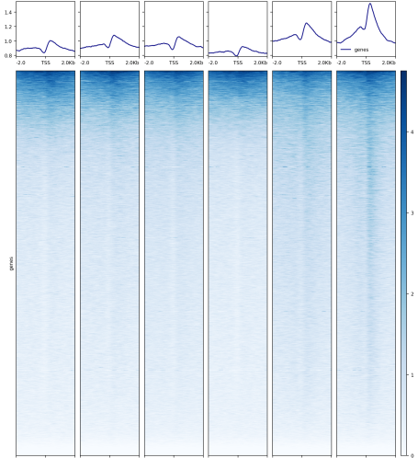
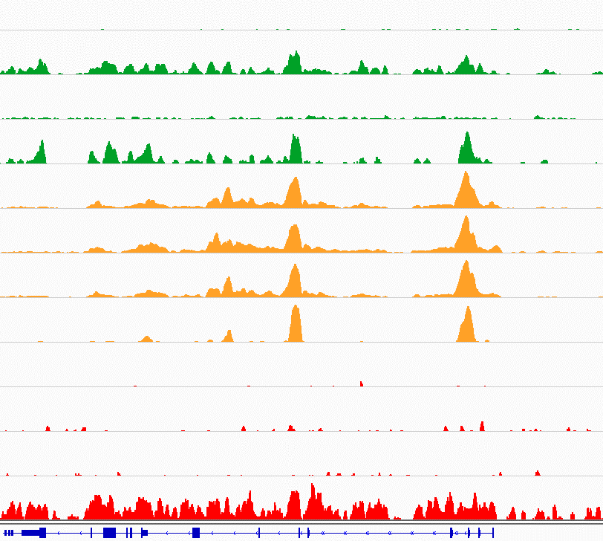
a
b
Supplementary Fig.3
-12
Dox+/SAHA
Dox+
-10
8,834
17.410
SMARCA4
-8
19,099
14.801
-6
-4
Dox+/SAHA
Dox+
Dox-
-2
15,878
13,481
-0
15,689
13,805
-5
17,040
16,325
-4
Dox+/SAHA
Dox+
Dox-
EZH2
-3
10,976
10,964
-2
1,336
20,473
-1
1,180
1,135
-0
Dox+/SAHA
Dox+
Dox-
7,059
8,134
-80
5,071
5,052
-60
H3K27ac
5,299
4,549
-40
Human Genome Distribution
Human Genome Distribution
-20
H1299-wtSMARCA4
H1299-mutSMARCA4
-0
c
wtSMARCA4 (dox-)
wtSMARCA4 (dox+)
-4
mutSMARCA4 (dox-)
mutSMARCA4 (dox+)
H3K27me3
-3
wtSMARCA4 (dox-)
wtSMARCA4 (dox+)
-2
mutSMARCA4 (dox-)
mutSMARCA4 (dox+)
-1
wtSMARCA4 (dox-)
wtSMARCA4 (dox+)
-0
mutSMARCA4 (dox-)
mutSMARCA4 (dox+)
dox- dox+ dox+/
SAHA
dox- dox+ dox+/
SAHA
H1299-wtSMARCA4
H1299-mutSMARCA4
BCAR1

Slide 4
a
H1299-
wtSMARCA4
H1299-wtSMARCA4/
H1299-mutSMARCA4
H1299-
mutSMARCA4
Supplementary Fig.4
SMARCA4
H3K27ac
EZH2
dox+
SAHA
dox+
dox+
dox+
dox+
SAHA
H1299-
wtSMARCA4
H1299-wtSMARCA4/
H1299-mutSMARCA4
H1299-
mutSMARCA4
dox+
4452 7591 2207
7546 7221 596
3712 11055 988
dox-
dox+
dox+
dox+
dox-
dox+
70 148 252
4 1 447 8432
14 204 8675
dox-
dox+
dox+
dox+
dox-
dox+
dox+
SAHA
dox+
SAHA
dox+
SAHA
dox+
SAHA
1842 12749 845
2460 11134 1592
2423 11767 959
dox+
dox+
74 414 4210
1497 3127 3994
3898 4981 2140
dox+
dox+
SAHA
dox+
SAHA
dox+
SAHA
dox+
dox+
SAHA
762 12832 972
2615 11189 985
2152 10574 1600
H1299-wtSMARCA4
(dox +)
H1299-mutSMARCA4
(dox +)
H1299-wtSMARCA4
(dox +)
H1299-mutSMARCA4
(dox +)
H1299-wtSMARCA4
(dox +)
H1299-mutSMARCA4
(dox +)
3290 11447 2117
1907 10136 2590
14307 460 28
5035 7008 1871
103 386 13280
2160 6719 6007
SAHA
SAHA
SAHA
SAHA
SAHA
SAHA
SAHA
SAHA
SAHA
SAHA
SAHA
SAHA
1661 6152 7652
3776 6022 6152
5204 2609 2015
4919 4879 2242
856 3768 10036
2124 4997 7177
b
wtSMARCA4 mutSMARCA4
wtSMARCA4 mutSMARCA4
dox-
dox+
dox+/SAHA
[0-25]
SMARCA4
[0-7]
dox-
dox+
dox+/SAHA
EZH2
[0-300]
dox-
dox+
dox+/SAHA
H3K27ac
[0-5]
dox-
dox+
dox+/SAHA
H3K27me3
KDM4B
KDM4B
KDM2B
KDM2B

Slide 5
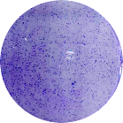
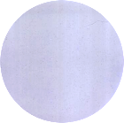
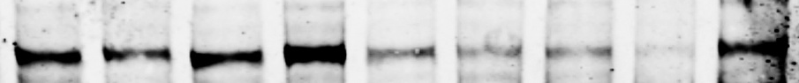
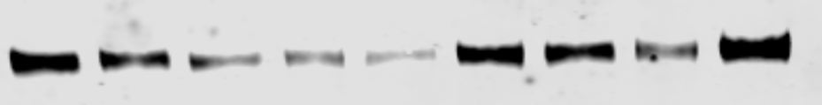
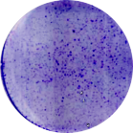
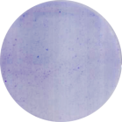
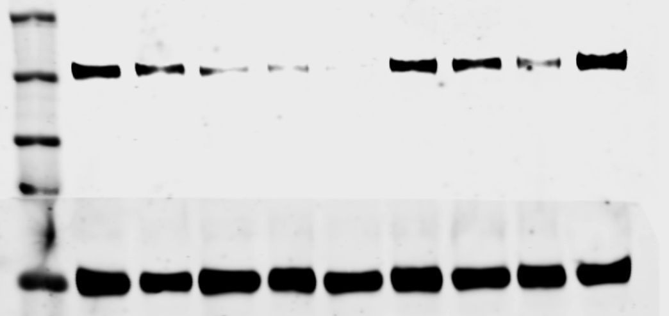
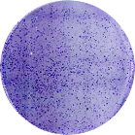
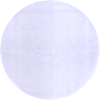


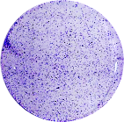
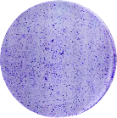
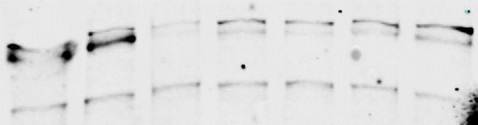
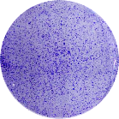
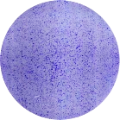
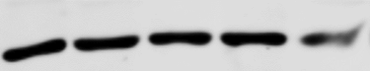
a
KDM6A
KDM6B
(n=33)
SMARCA4def cells
MYCamp cells
RNA-sequencing (CCLE)
R square: 0.01318
R square:0.1701
P-value : ns
P value: 0.0452
RT quantitative PCR
(n=9)
R square:0.24
R square:0.45
P value:n.s
P-value <0.05
Log SAHA concentration [μM]
Log SAHA concentration [μM]
b
c
Vehicle
SAHA [1µM]
shKDM6A
shKDM6B
shNT
·#60
#62
#63
#64
#676
#976
#75
#77
-KDM6B
-KDM6A
-TUBULIN
shNT
H82
#63
shKDM6A
shNT
#62
#63
#64
shNT
#60
#61
#62
#63
#64
#64
-KDM6A
-TUBULIN
shNT
#676
#976
#75
#77
shNT
#676
#976
#75
#77
#676
-KDM6B
-TUBULIN
shKDM6B
#976
DMS273
H460
Supplementary Fig.5

Slide 6
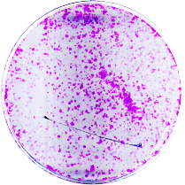
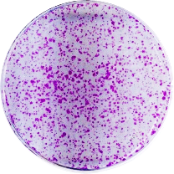
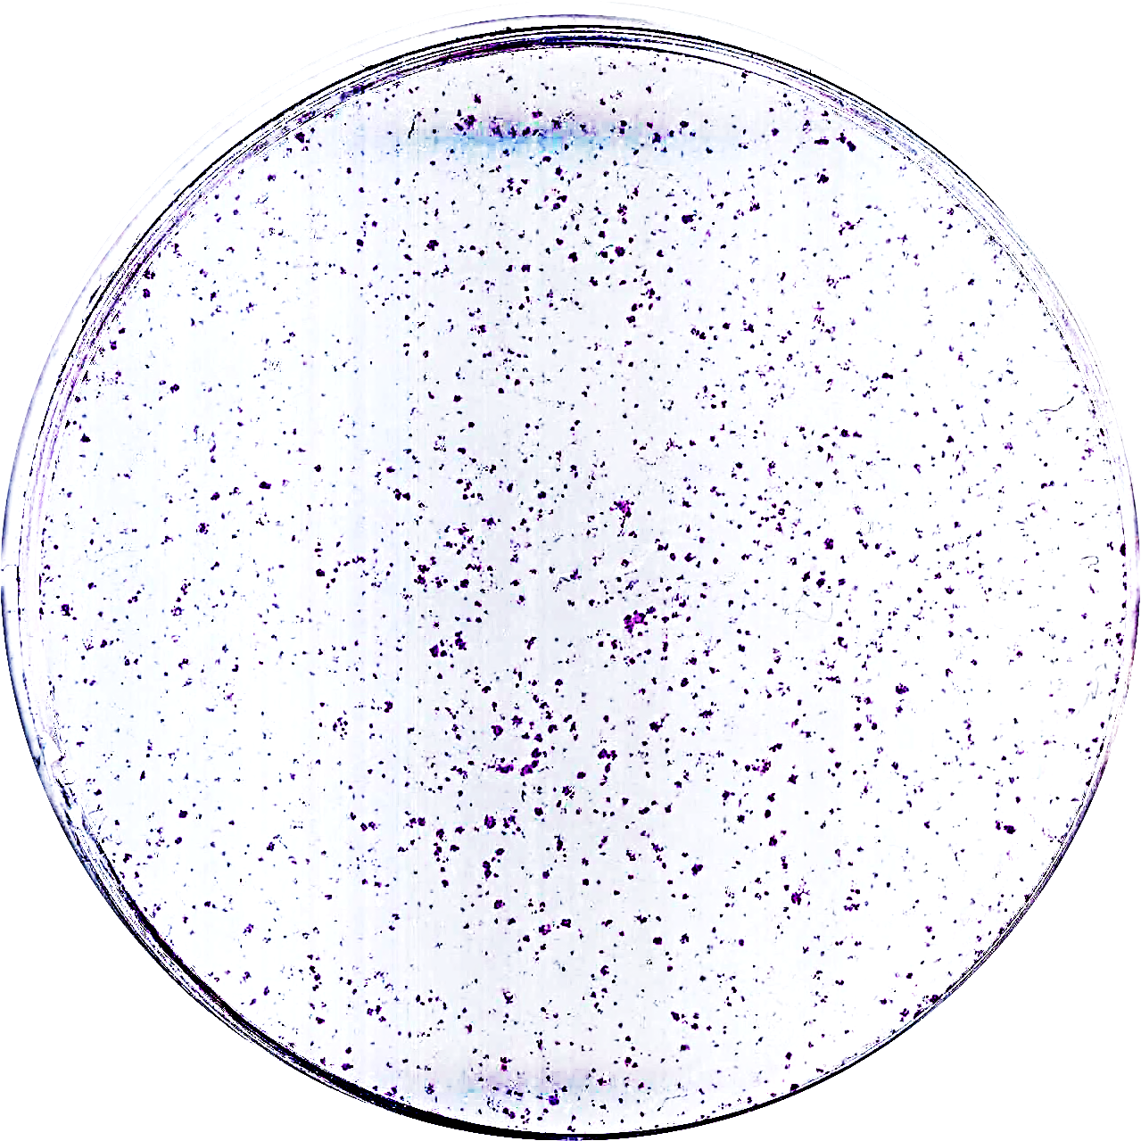
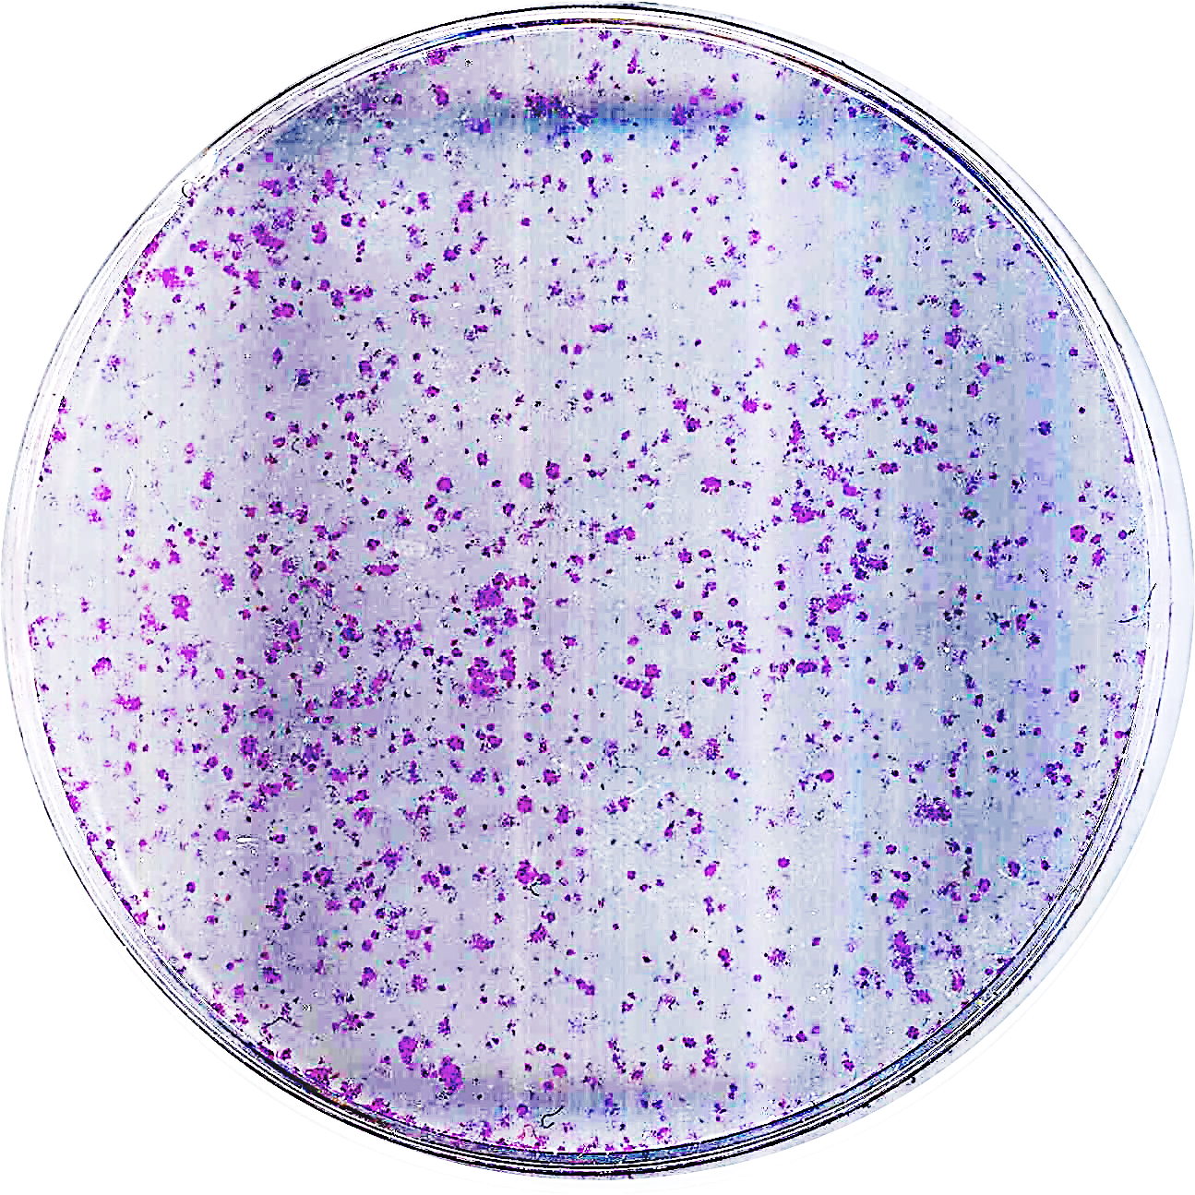
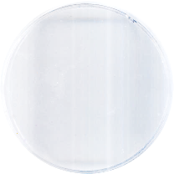
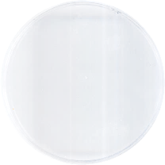
a
SMARCA4def cells
MYCamp cells
Other cells
H82
H460
H446
DMS273
EC₅₀: 2.7 µM
EC₅₀: 1.45 µM
EC₅₀: 0.83 µM
EC₅₀: 1.3 µM
H69
H2170
H522
H841
EC₅₀: 1 µM
EC₅₀: 2.67 µM
EC₅₀: 0.82 µM
EC₅₀: 0.15 µM
H1299
H23
DMS114
H1703
% cell viability relative to control
EC₅₀: 0.43 µM
EC₅₀: 0.19 µM
A427
EC₅₀: 0.2 µM
EC₅₀: 0.19 µM
PDC11
H128
H727
EC₅₀: 0.13 µM
EC₅₀: 2.07 µM
EC₅₀: 1.96 µM
EC₅₀: 0.98 µM
Lu165
Log GSK-J4 concentration [μM]
EC₅₀: 1.58 µM
d
b
P<0.05
c
GSK-J4 [uM]
wtSMARCA4 (dox-)
P<0.05
ns
0
0.5
1
SMARCA4def (dox-)
H1299
% cell viability relative to control
GSK-J4 sensitivity AUC (Prism
Repurposing Secondary Screen)
H1299-wtSMARCA4
n=23
n=44
n=446
H1299-mutSMARCA4
wtSMARCA4 (dox+)
SMARCA4def (dox+)
Log GSK-J4 concentration [μM]
Supplementary Fig.6

Slide 7
H841X: GSK-J4
Supplementary Fig.7
5X
10X
20X
H841X: Vehicle
5X
10X
20X
DMS114X: GSK-J4
5X
10X
20X
DMS114X: Vehicle
5X
10X
20X
DMS273X: GSK-J4
5X
10X
20X
DMS273X: Vehicle
5X
10X
20X

Slide 8



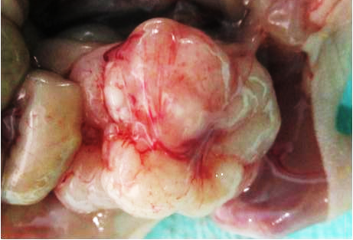
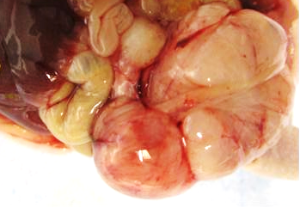
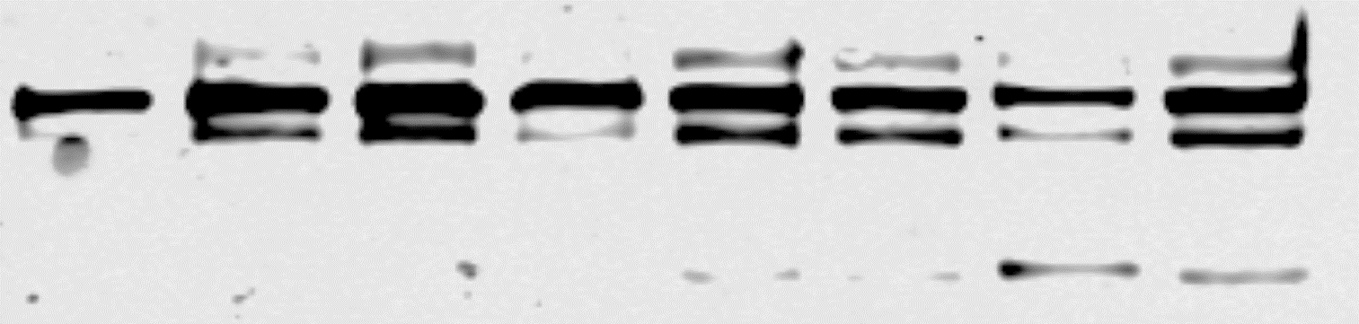
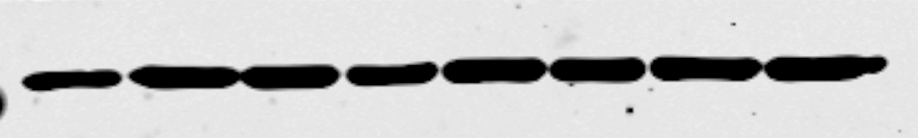
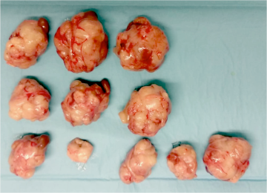
c
Supplementary Fig.8
a
-OVCAR-8
-OVA250L
-OVCAR-3
-OVA259L
-SMARCA4
-TUBULIN
b
OVCAR-8
OVA250L
d
SCCOHT (primary) OVA250X
e
OVA250X
OVA250XR
- + - +
- + - +
-SAHA
- - + +
- - + +
-GSK-J4
-PARP
(FL)
-CLEAVED
PARP
-TUBULIN
f
P<0.05
P<0.05
Tumor weight (gr)
g
VH
CDDP
GSK-J4
P<0.05
P<0.05
n.s
n.s
VH CDDP VH CDDP
Tumor weight (gr)
Tumor volume (mm³)
OVA250X
OVA250XR
VH CDDP GSK-J4
VH CDDP GSK-J4
h
Vehicle CDDP GSK-J4
i
P<0.05
Tumor necrosis (%)
VH CDDP GSK-J4

