Slide 1
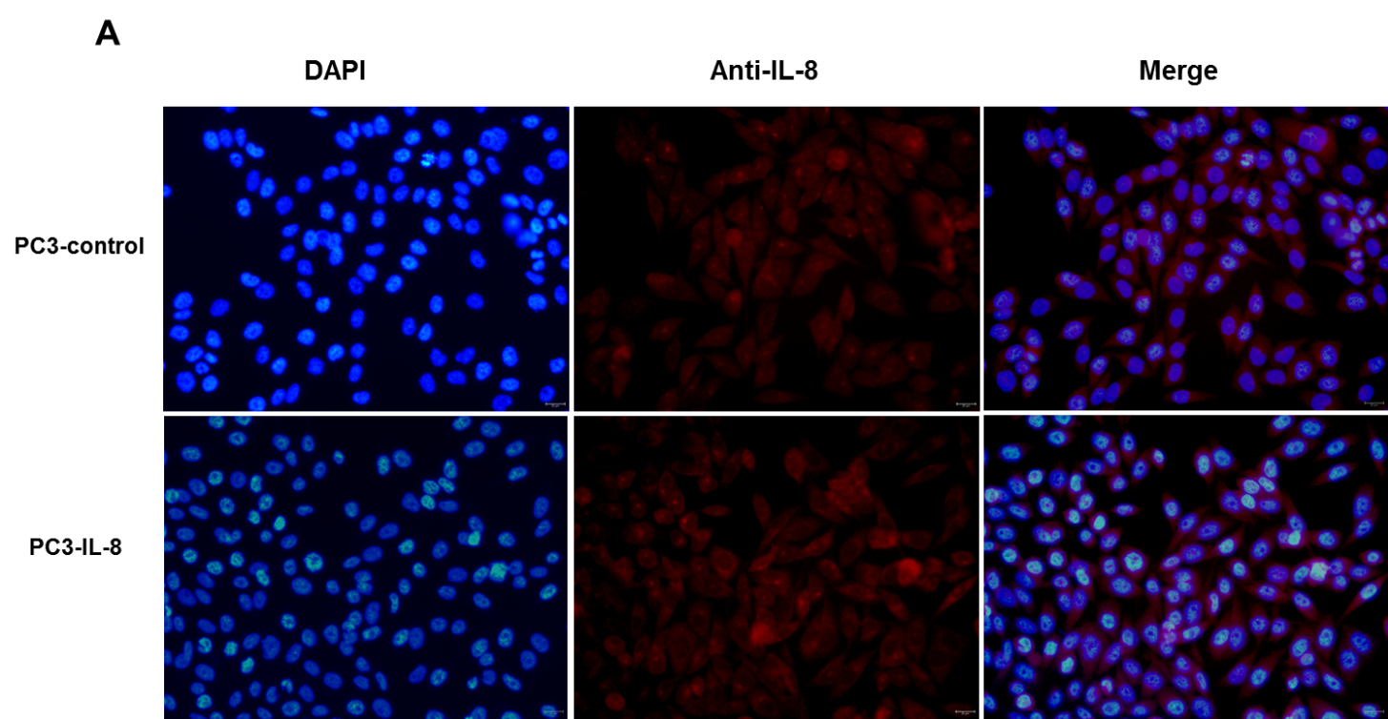

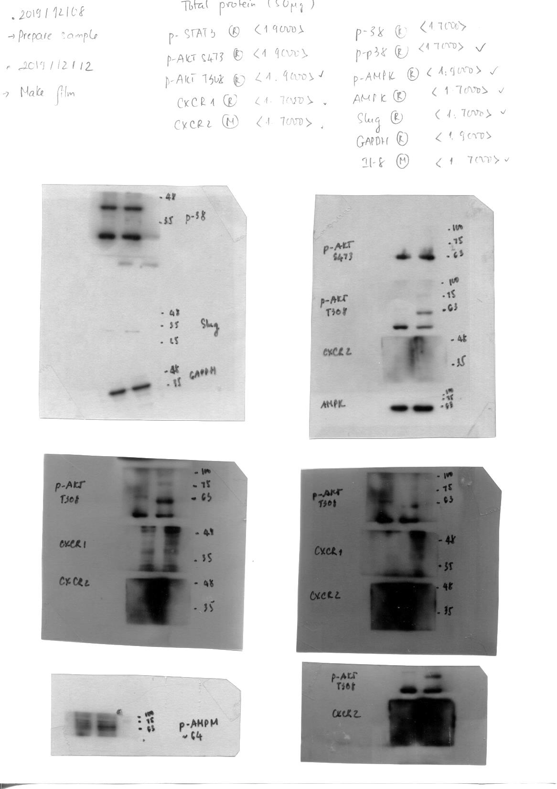

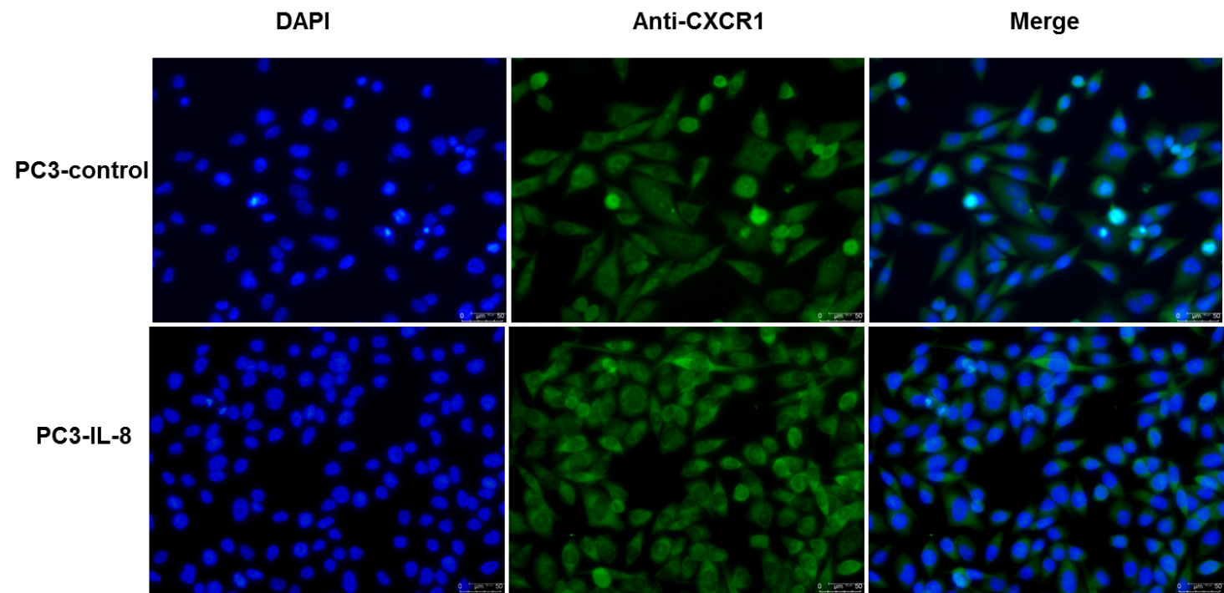
Supplementary data
B
DAPI
Anti-IL-8
Merge
A
PC3-control
PC3-IL-8
PC3-control
IL-8
CXCR1
PC3-IL-8
GAPDH
C
DAPI
Anti-CXCR1
Merge
***
PC3-control
***
PC3-IL-8

