Slide 1
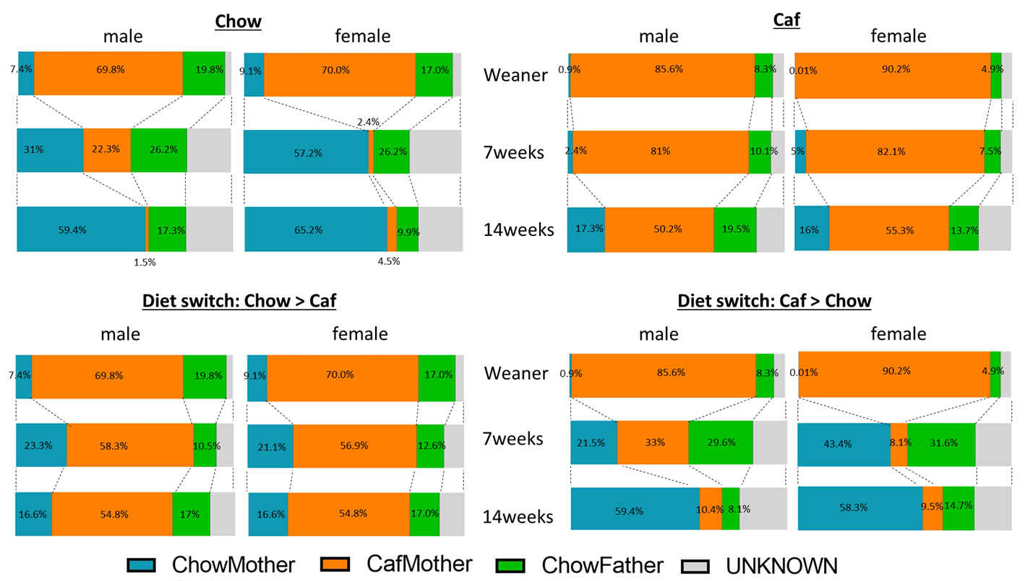
Supplemental Figure 3

