Slide 1
Supplementary Fig. S1 The levels of CBS gene associated with the prognosis of patients with different cancers.

Slide 2
Supplementary Fig. S2 The levels of CSE gene associated with the prognosis of patients with different cancers.

Slide 3
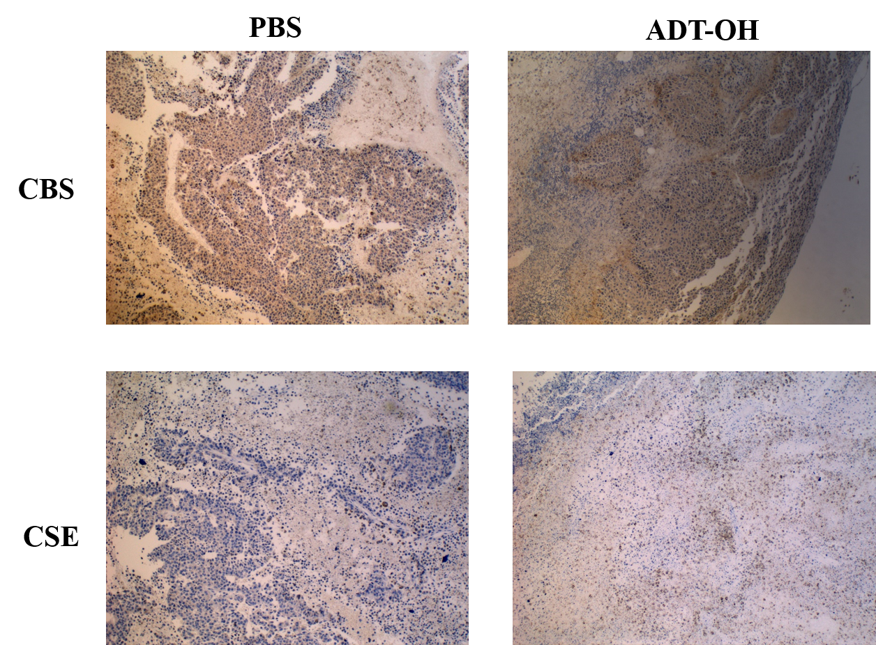
A
B
C
Supplementary Fig. S3 The effect of ADT-OH on CBS and CES expression levels in B16F10 melanoma cells in vivo and in vitro. (A) The tumor is harvested and used for CBS and CSE staining; original magnification is 400 times. (B) Western blot analysis of CSE and CBS in B16F10 cells treated with ADT-OH (24 h) at different concentration. (C) Statistical analysis of (B) by Image J. Western blot analysis of CSE and CBS in B16F10 cells. *P < 0.05, **P < 0.01, ***P < 0.005, compared with the control group.

Slide 4
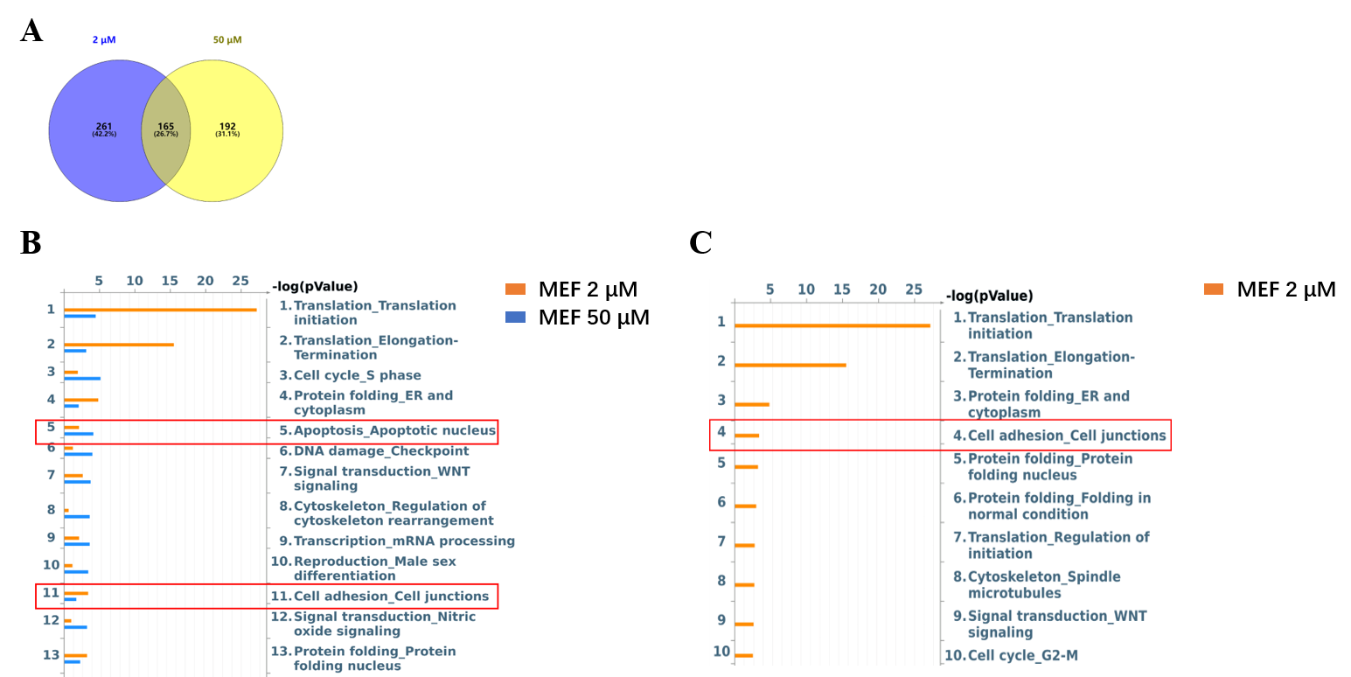
Supplementary Fig. S4 Proteomics analysis of proteins differentially expressed in ADT-OH-treated cells. (A) Venn diagram of 2 mM and 50 mM ADT-OH (15min) groups. (B-C) The protein network associated with cell adhesion and migration is differentially expressed in MEF cells treated with ADT-OH.

Slide 5
Supplementary Fig. S5 Statistical analysis of Figure 6A by Image J. Western blot analysis of p-FAK, FAK, Paxillin, p-AKT, AKT, E-Cadherin, N-Cadherin and Vimentin in B16F10 cells. *P < 0.05, **P < 0.01, ***P < 0.005, compared with the control group.

Slide 6
Supplementary Fig. S6 Statistical analysis of Figure 6B by Image J. Western blot analysis of p-FAK, FAK, Paxillin, p-AKT, AKT, E-Cadherin, N-Cadherin and Vimentin in A375 cells. *P < 0.05, **P < 0.01, ***P < 0.005, ****P < 0.001, compared with the control group.

Slide 7
Supplementary Fig. S7 The FAK, Paxillin, E-Cadherin and N-Cadherin mRNA levels of B16F10 and A375 cells were detected by qPCR analysis after ADT-OH (25 μM) treatment for 1 h and 6 h respectively. *P < 0.05, **P < 0.01, ***P < 0.005. Data are expressed as mean ± SD of three independent experiments.

Slide 8
Supplementary Fig. S8 ADT-OH inhibits the viability of A375 and B16F10 cells in vitro. A375, B16F10 melanoma cells and MEF normal cells were incubated with increasing concentrations of ADT-OH for 24 h. Cell viability was determined by CCK8 assay. *P < 0.05, **P < 0.01, ***P < 0.005, ****P < 0.001 compared with vehicle group.

Slide 9
Supplementary Fig. S9 ADT-OH inhibits tumor cell proliferation. F1(B16F1), A375, A549, H446, HCT-116, MDA231(MDA-MB-231), H1299, and HepG2 cells were incubated with increasing concentrations of ADT-OH for 24 h. Cell viability was determined by MTT assay. *P < 0.05, **P < 0.01, ***P < 0.005, ****P < 0.001, compared with the vehicle group.

Slide 10
Supplementary Fig. S10 ADT-OH inhibits tumor cell proliferation. Colony formation ability of A375 cells treated with ADT-OH (3.2-50 μM). The experiments were repeated three times (n = 3); representative data are shown. Data are represented as mean ± SD. *P < 0.05, **P < 0.01.

Slide 11
Supplementary Fig. S11 ADT-OH inhibits the viability of melanoma cells in vitro. (A) B16F10, B16F1 and A375 cells were treated with different concentrations of ADT-OH (0, 6.3, 25, 100 μM) for 24 h. The cell cycle distribution (G0/G1, G2/M and S) was determined by flow cytometry. (B) Representative FACS analysis and quantitative analysis of Annexin V and propidium iodide (PI) staining after ADT-OH treatment at different concentration in B16F10, B16F1 and A375 cells. *P < 0.05, **P < 0.01, ***P < 0.005. Data are expressed as mean ± SD of three independent experiments.

Slide 12
Supplementary Fig. S12 ROS production. The ROS concentration was determined in B16F10 and A375 cells following treatment with ADT-OH (12.5 μM, 25 μM and 50 μM) for 24 hours. Data are represented as mean ± SD for different experiments performed in duplicate. *P < 0.05, **P < 0.01, ***P < 0.005 compared with the vehicle group.

Slide 13
Supplementary Fig. S13 A proposed signaling pathway by which ADT-OH inhibits melanoma metastasis.

