Slide 1
Cardiac fibers characteristics
separation
broken
arrangement

Slide 2
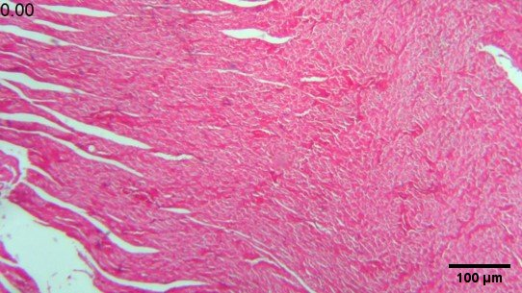
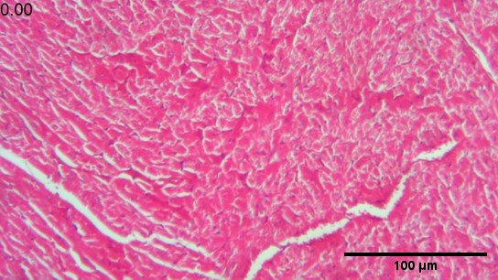
intact
4x
10x
a
b

Slide 3
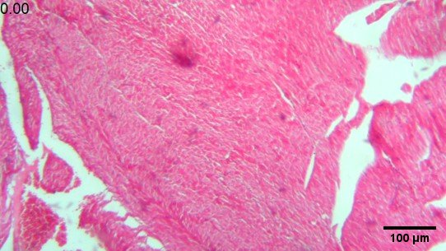
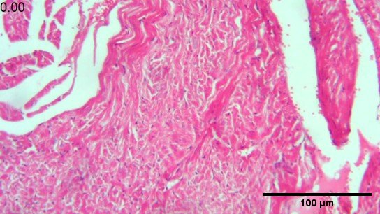
Vit c
4x
10x
c
d

Slide 4
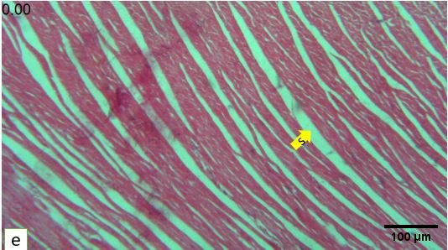
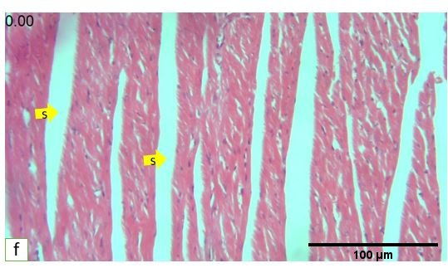
TCA
Separation cardiac fibers 4x
10x
s
s
s
f

Slide 5
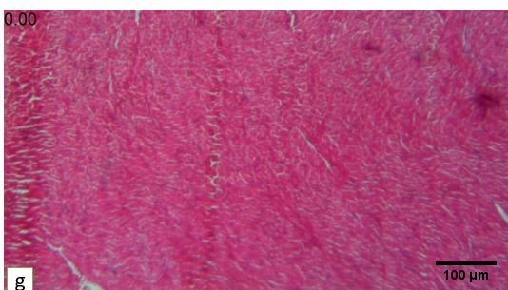
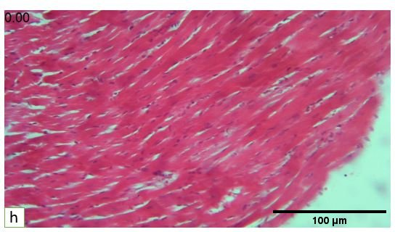
TCA+vitc
4x
10x
g
h

Slide 6
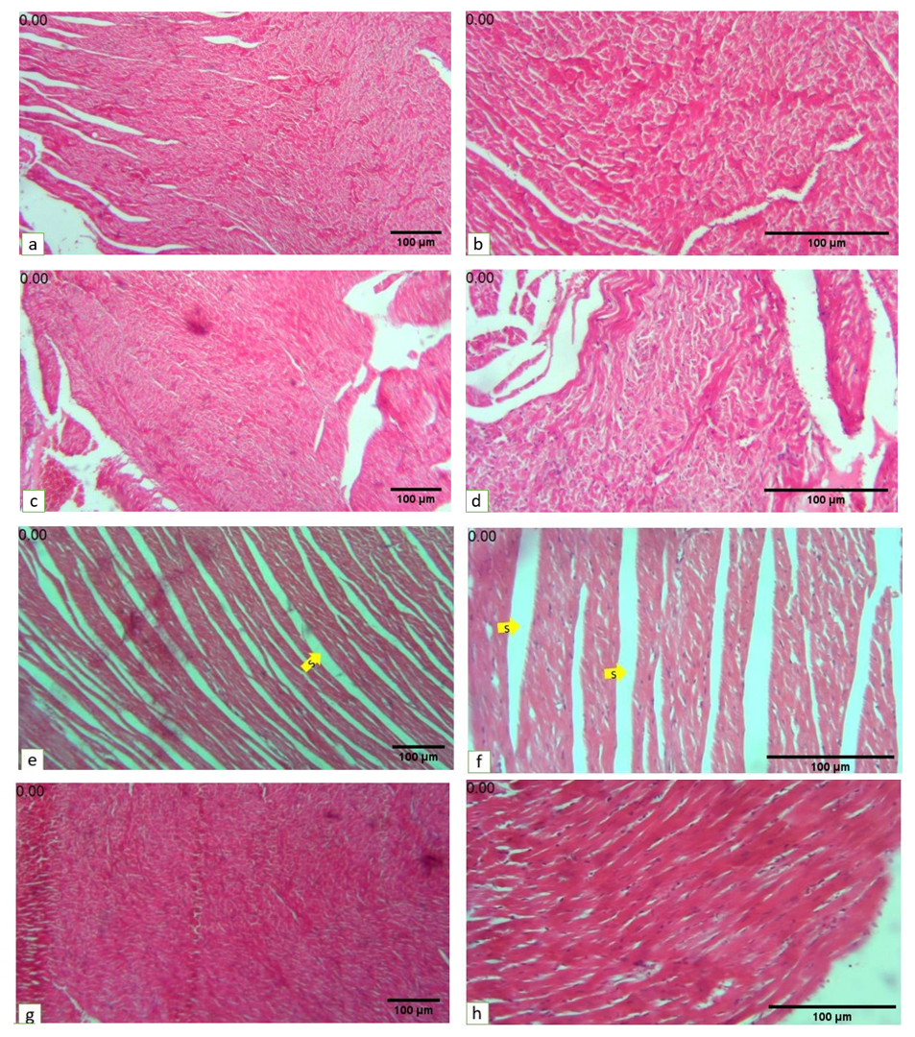

Slide 7
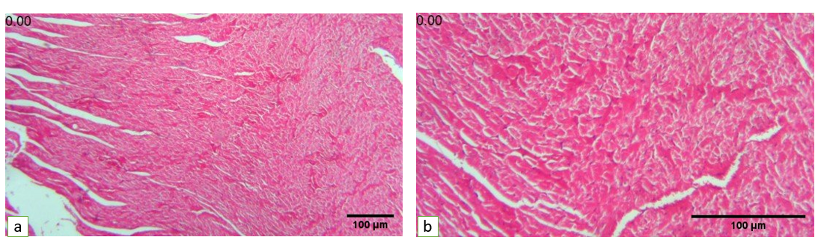
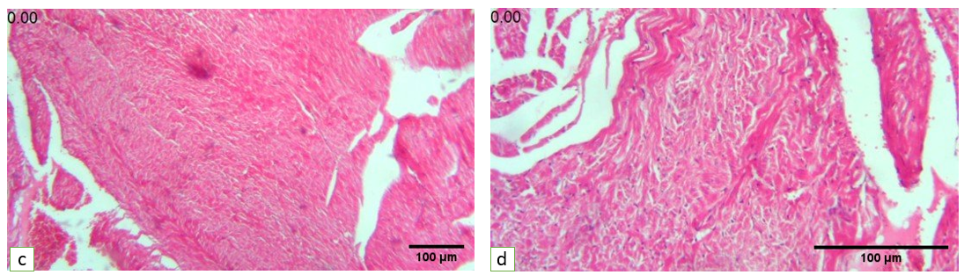
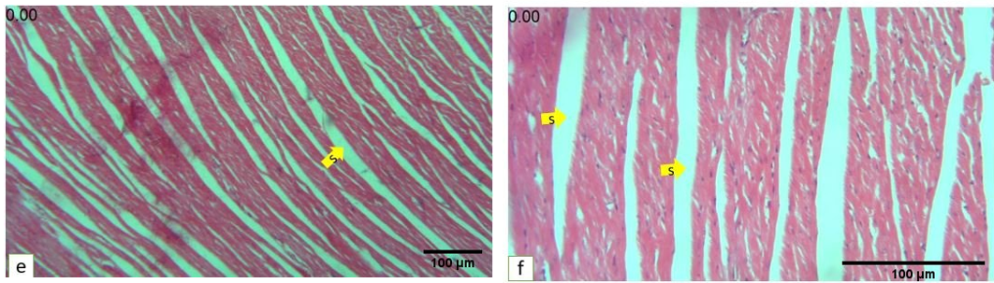
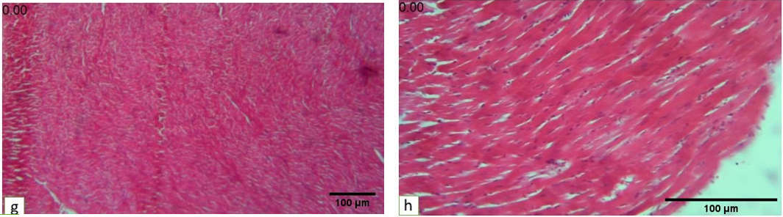

Slide 8
Hemorrhage
congestion

Slide 9
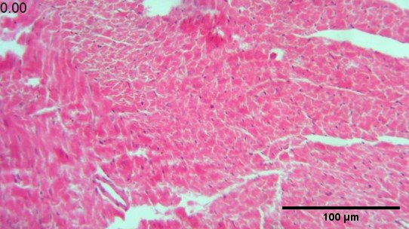
intact
Congestion
10x

Slide 10
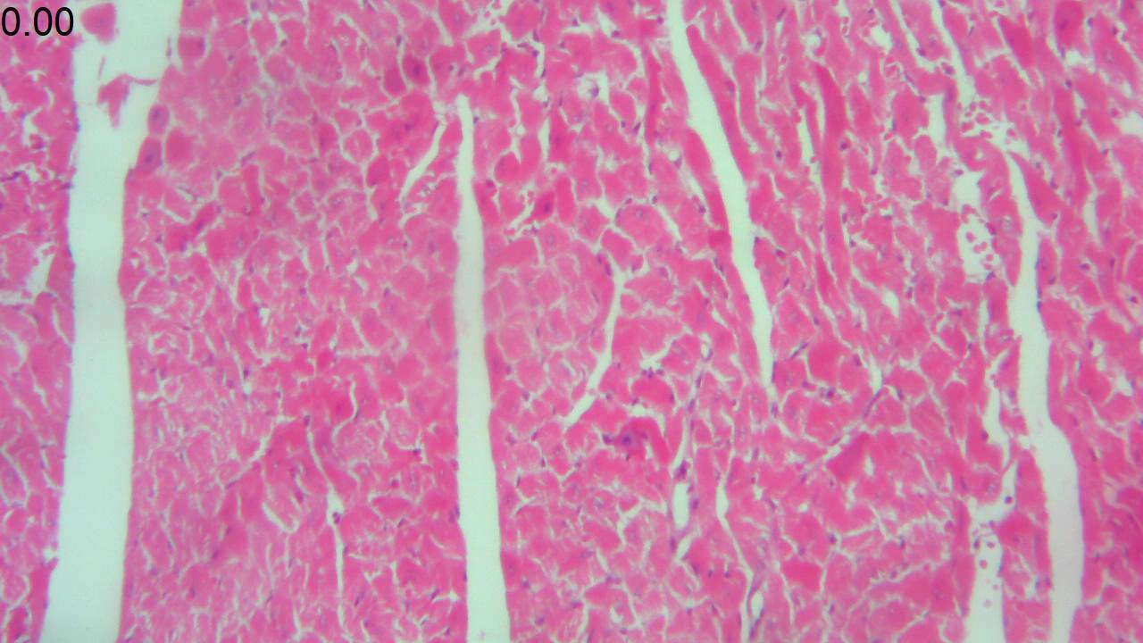
Vit c
Congestion
10x

Slide 11
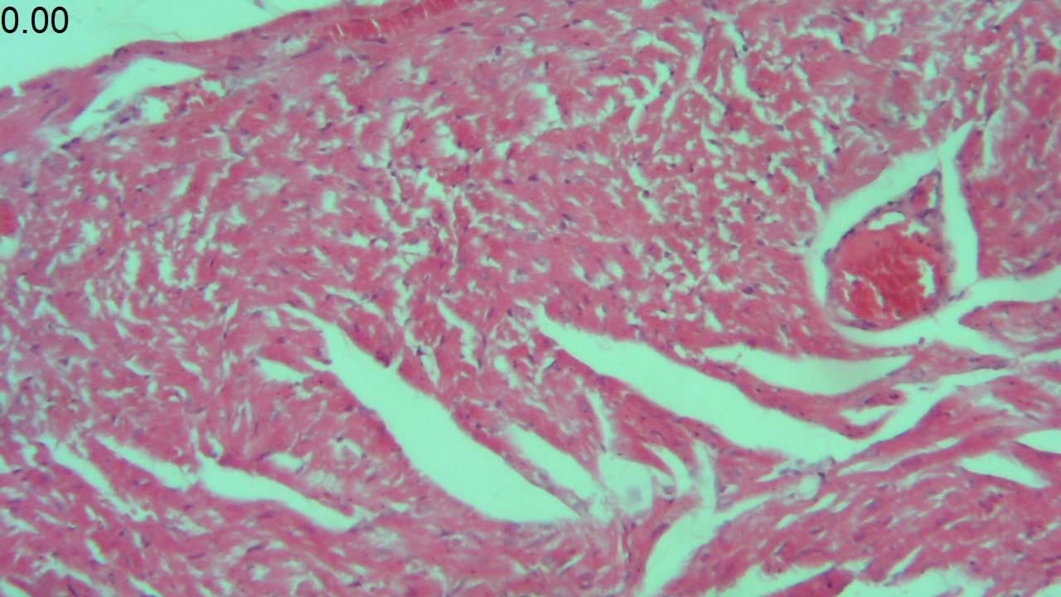
TCA
Congestion 40x
Hemorrhage
*
*
*

Slide 12
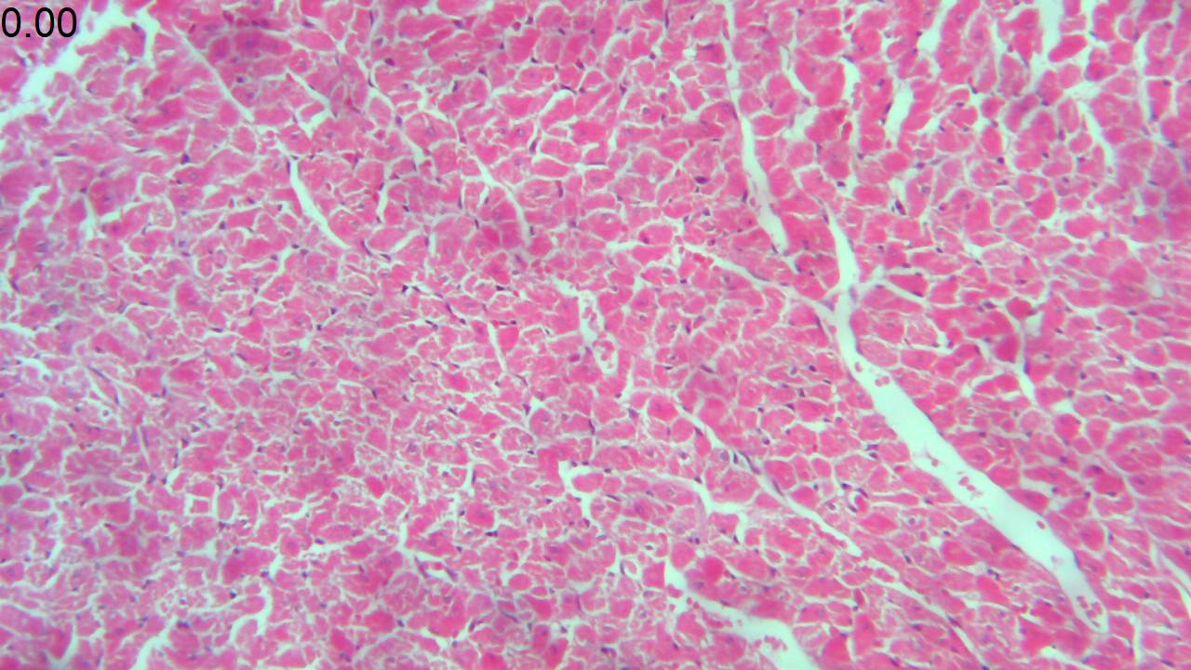
TCA+vitc
Congestion 10x

Slide 13
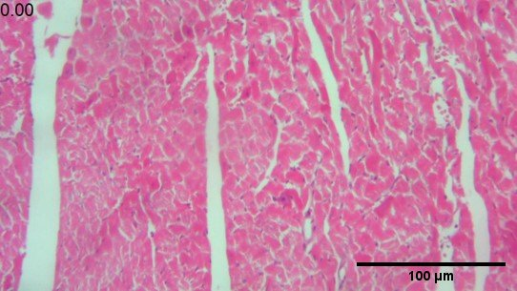
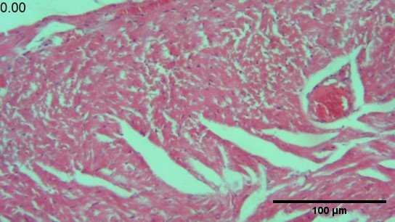
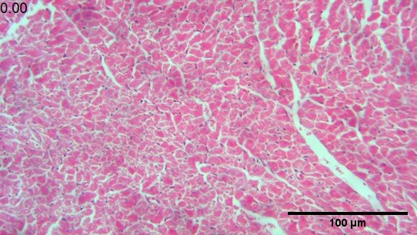
v
v
v
v
a
b
cn
v
c
d

Slide 14
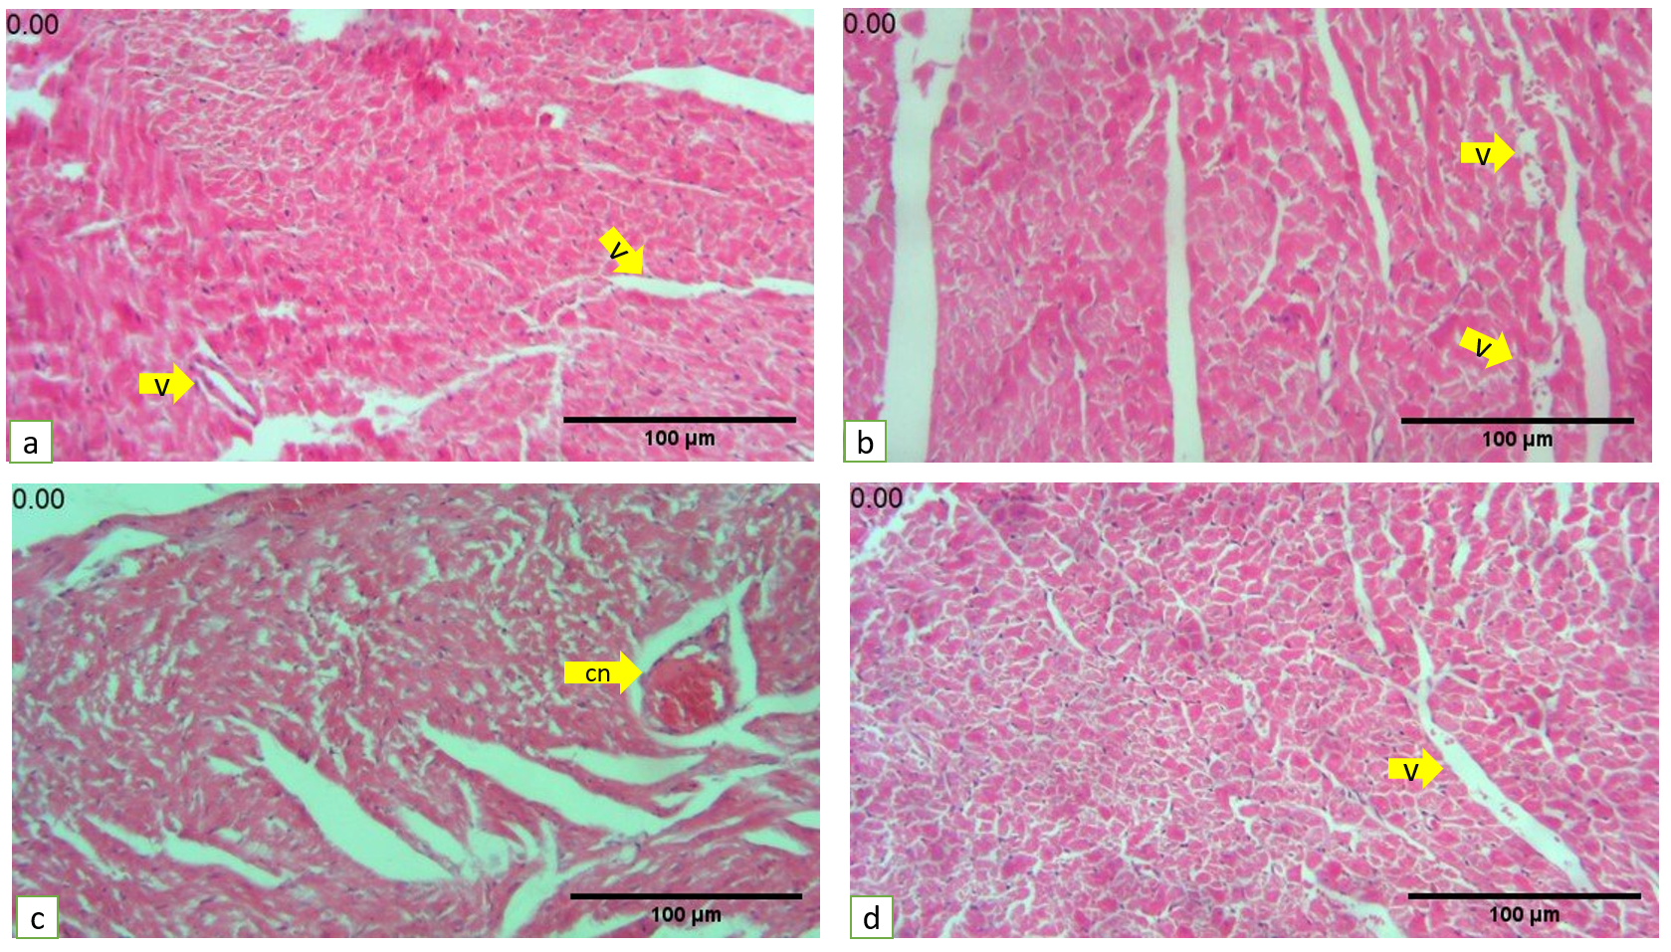

Slide 15
Longitudinal section
Cardiac fibers characteristics
striation
nucleus location
pyknosis

Slide 16
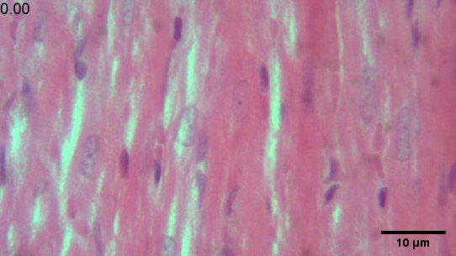
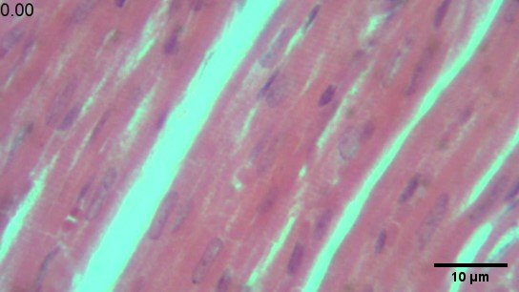
Longutiudinal section
intact
Vitc
F
M
F
N
M
N

Slide 17
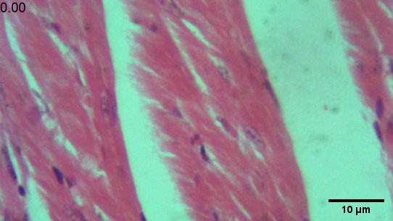
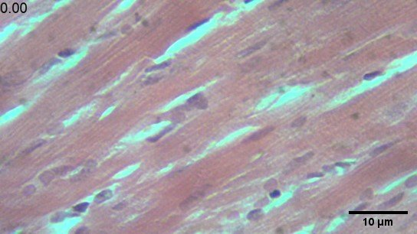
TCA
TCA+vitc
Striation 40x
Separation
Plasmalema border
Cytoplasmic vacuolation
s
N
N
PM
M
bF
F
PM

Slide 18
F
M
F
N
M
N
a
b
s
N
N
PM
M
bF
F
PM
c
d

Slide 19
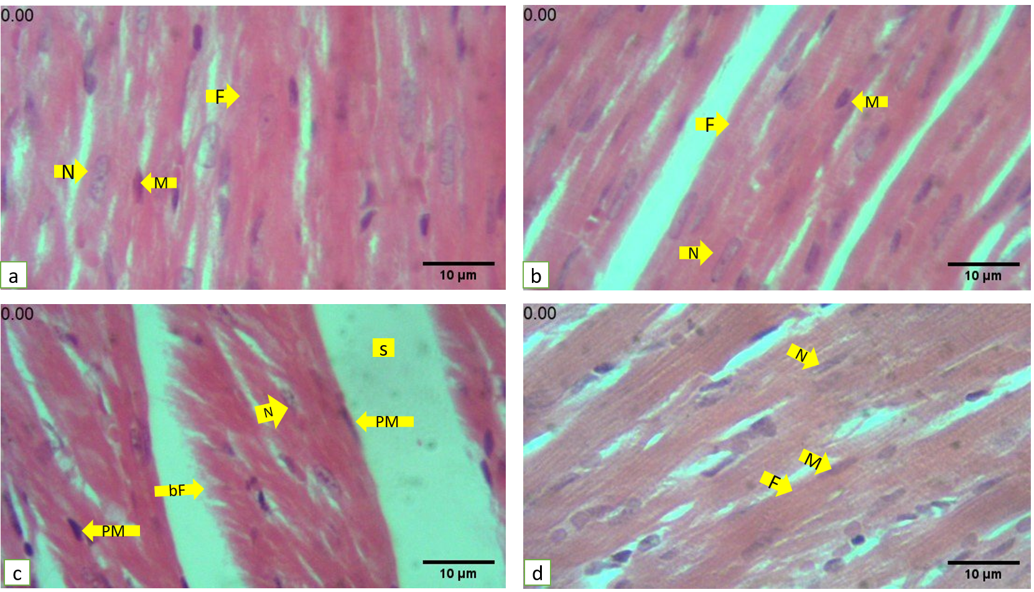

Slide 20
Cross section
Cardiac fibers characteristics
striation
nucleus location
pyknosis

Slide 21
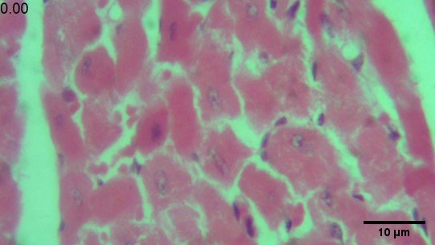
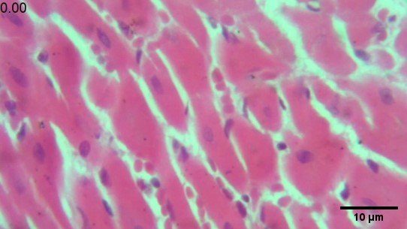
intact
vitc
F
N
F
N
a
b

Slide 22
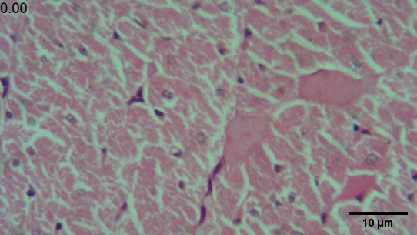
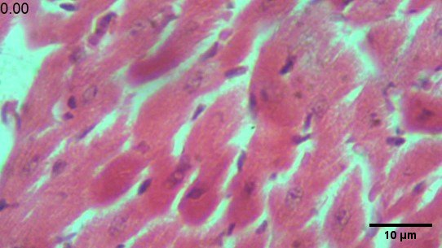
TCA
TCA+vitC
pN
*
F
*
F
*
N
c
d

Slide 23
F
N
F
N
a
b
pN
*
F
*
F
*
N
c
d

Slide 24
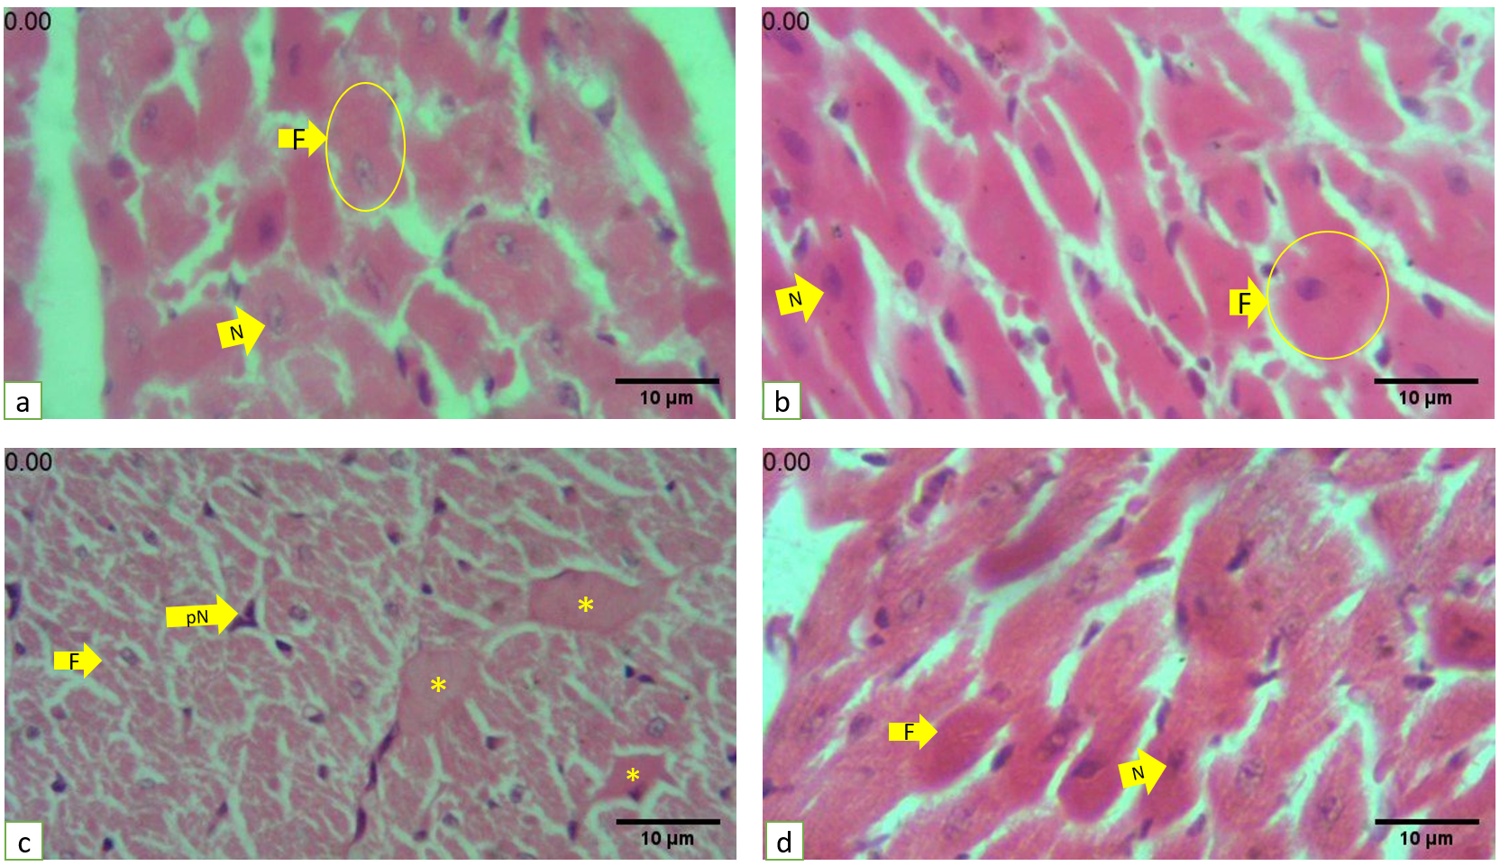

Slide 25
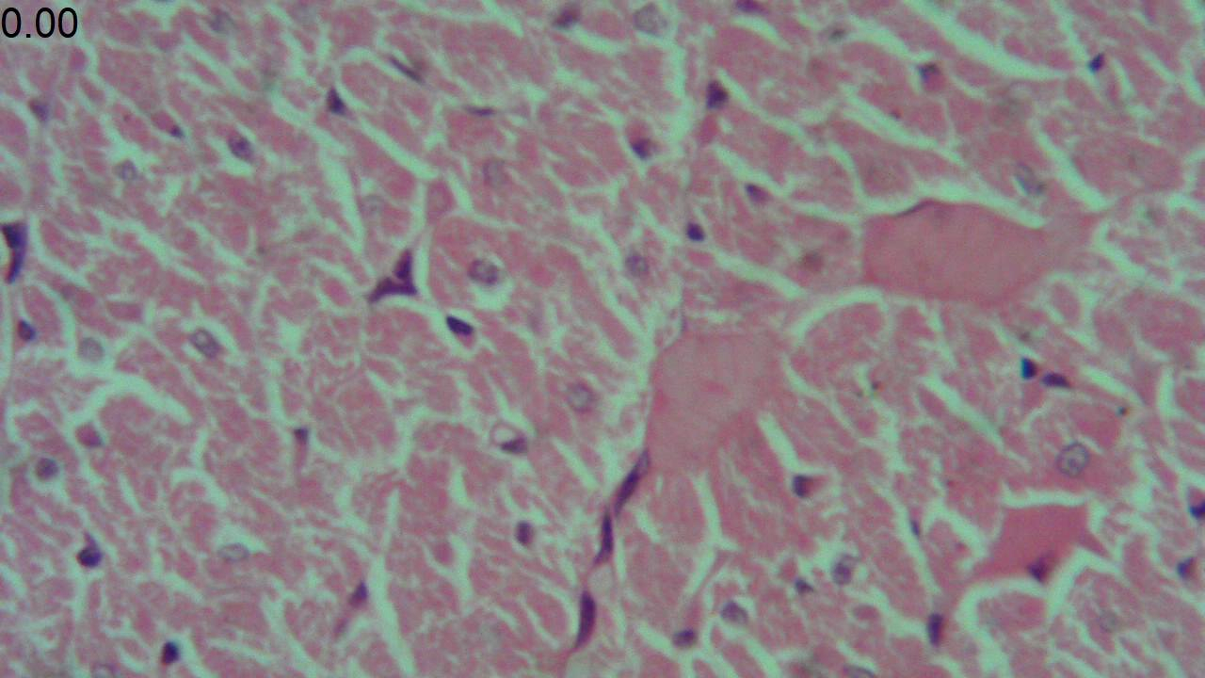
TCA
Pycnotic nuclei
Separation
Irregular shape
Broken fiber
Eccentric nuclei
Irregular shape
Pigmentation
Irregular shape
Hyalinization 40x
*
*
*

Slide 26
Cardiac fibrosis

Slide 27
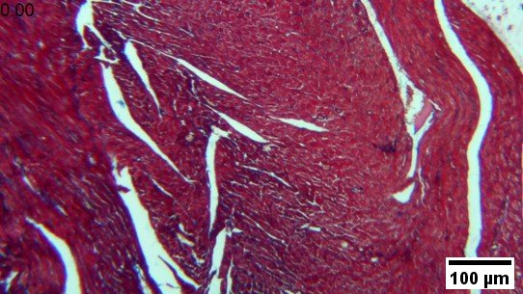
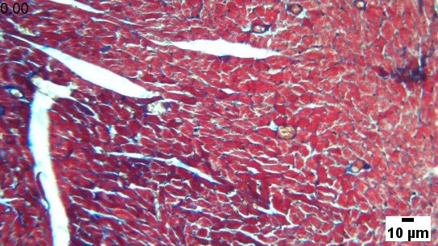
intact
4x
10x
e
f

Slide 28
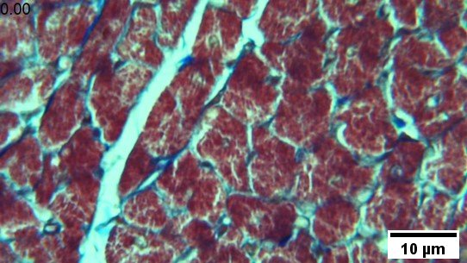
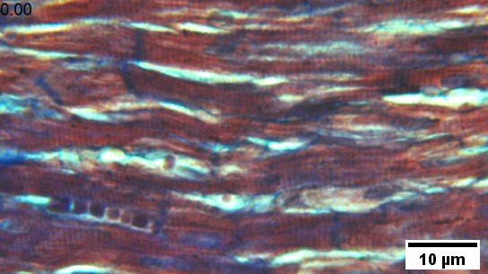
intact
40X
40X
g
h

Slide 29
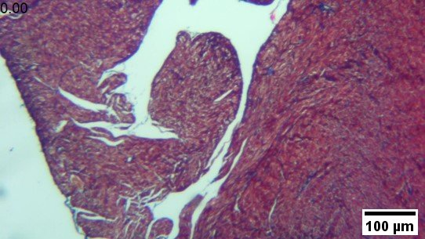
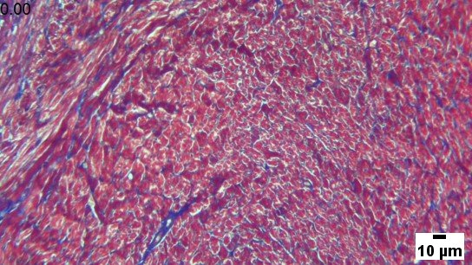
Vit c
TRICROME
10X
a
b

Slide 30
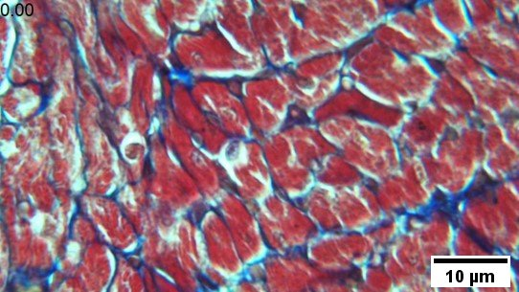
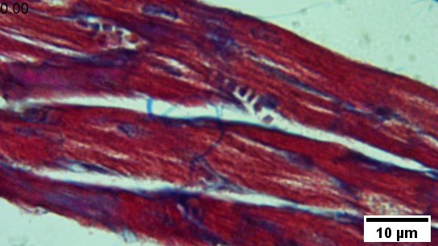
vitc
40X
40X
c
d

Slide 31
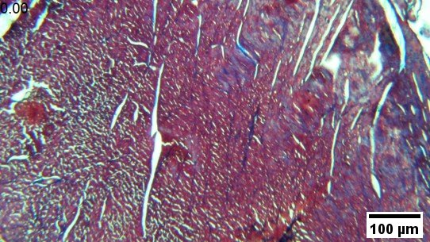
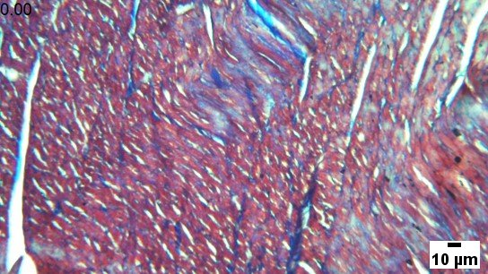
TCA-tri
i
j

Slide 32
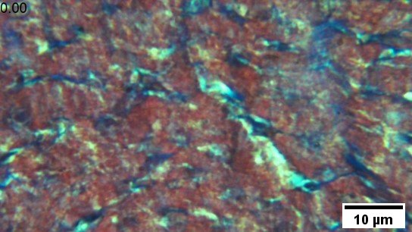
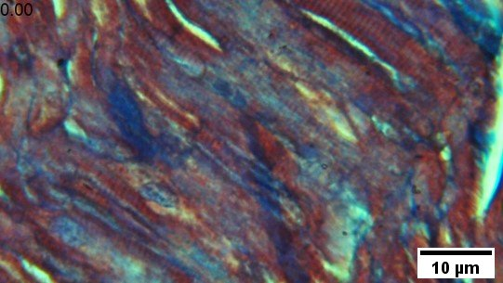
TCA-tri
k
l

Slide 33
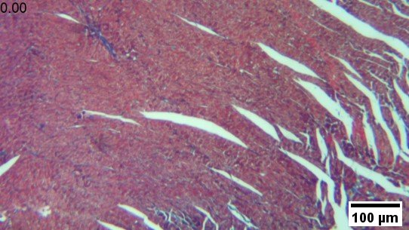
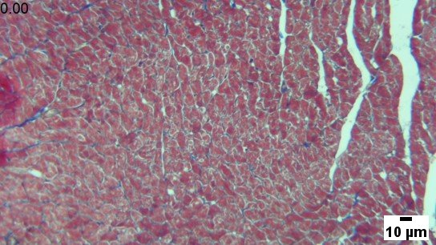
TCA+vitc-tri
m
n

Slide 34
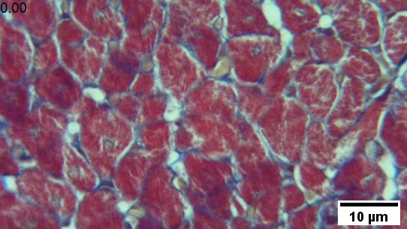
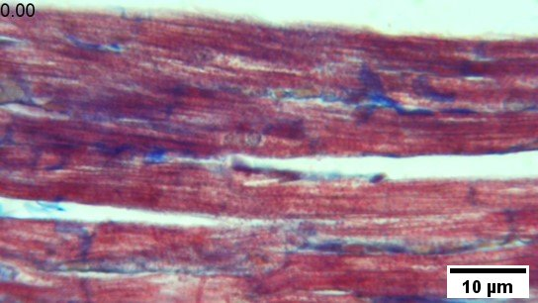
TCA+vitc-tri
0
p

Slide 35
a
b
c
d
e
f
g
h
i
j
l
m

Slide 36
