Slide 1
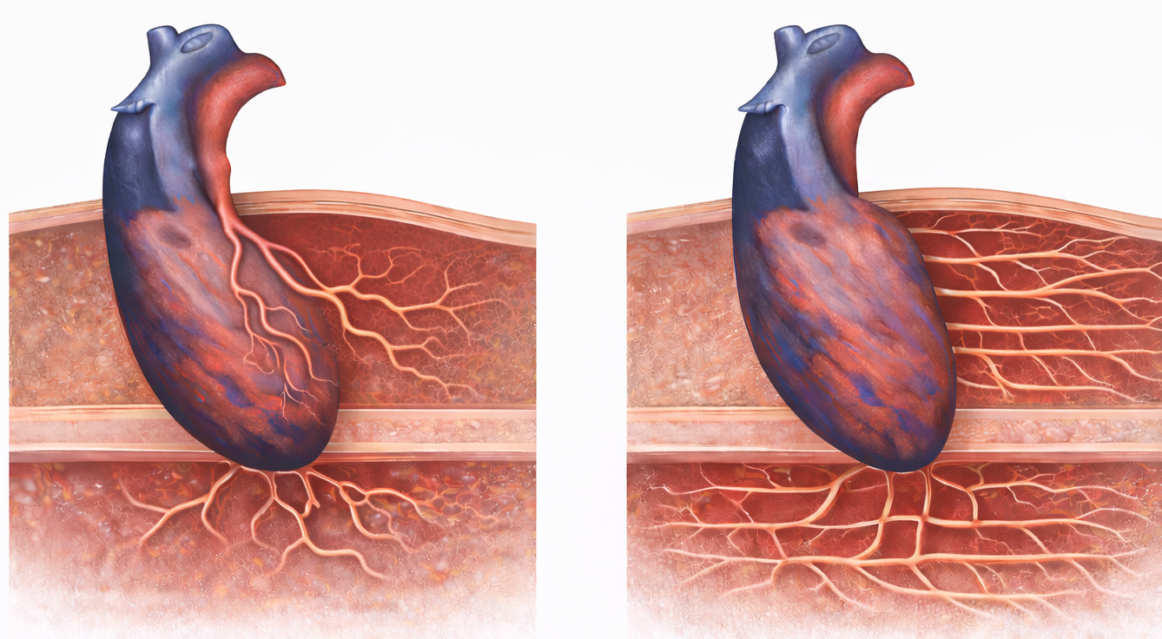
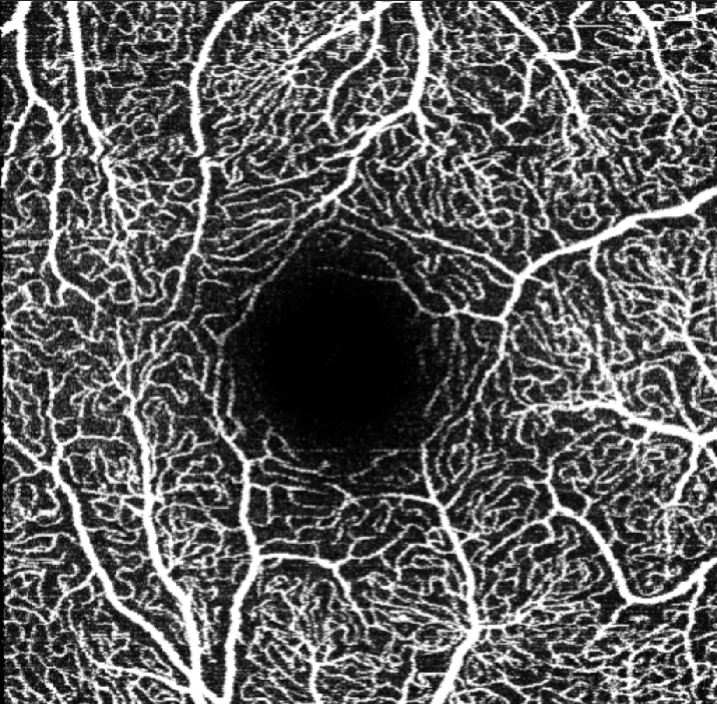
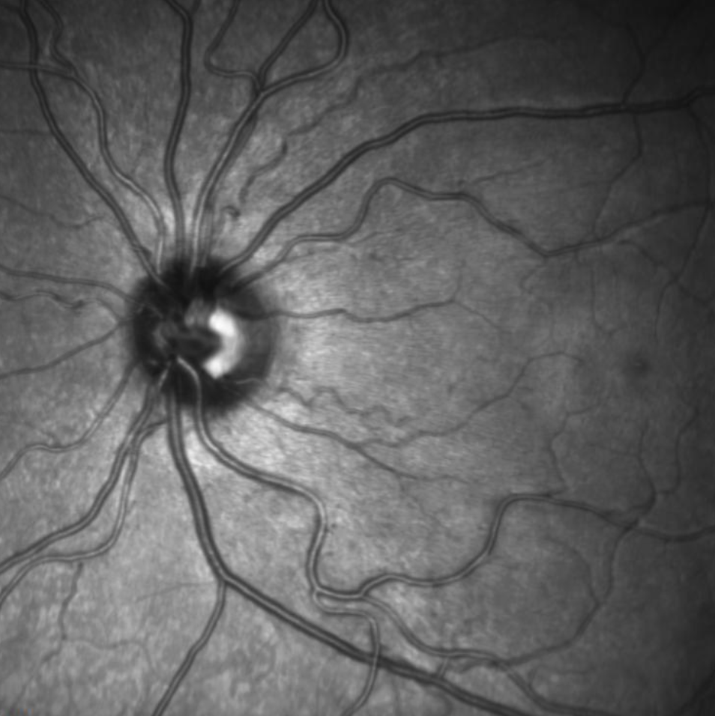
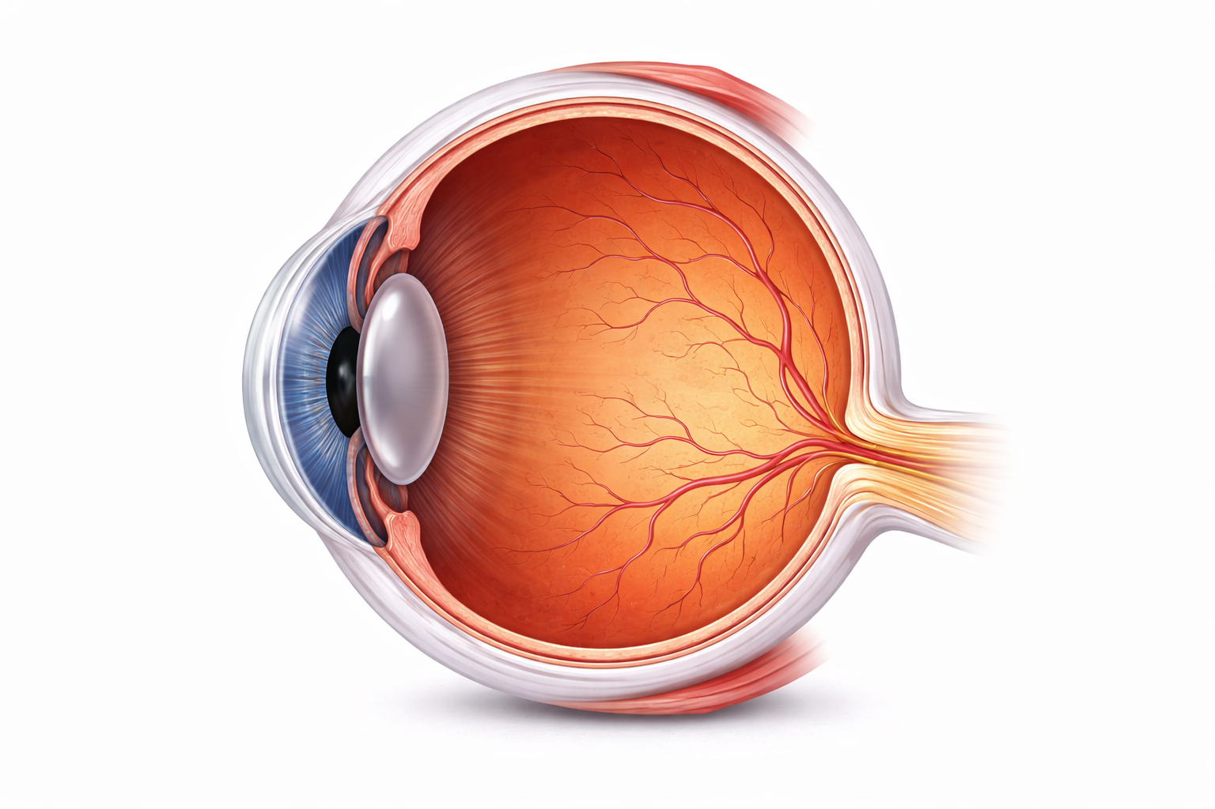
1
2
3
Retinal Imaging
1. Vessel Density
2. Retinal Vascular Tortuosity
3. Choroidal Vascularity Index
Aortic coartation patients
↓ Vessel Density
↑ Retinal Vascular Tortuosity
↓ Choroidal Vascularity Index
Study Design
Case–control study
49 Treated aortic coartation patients
49 matched controls
Cardiovascular Associations
  Hypertension
  Left ventricular hypertrophy
  Abnormal circadian BP pattern
  Residual gradient / HT response to exercise
  Persistent systemic microvascular alterations
  Retinal imaging as a non-invasive biomarker of cardiovascular burden

