Slide 1
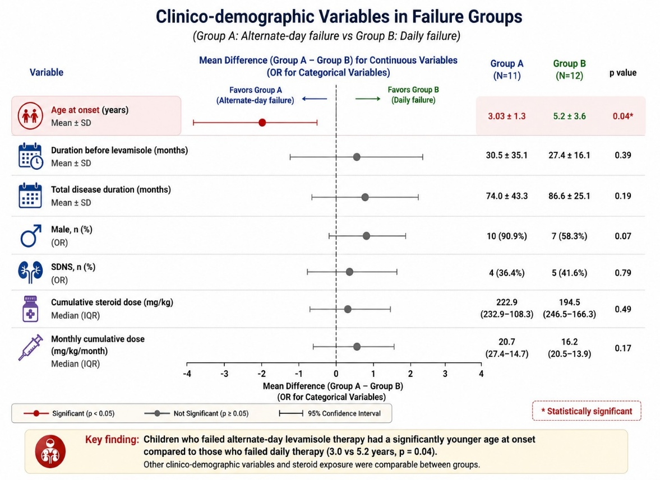
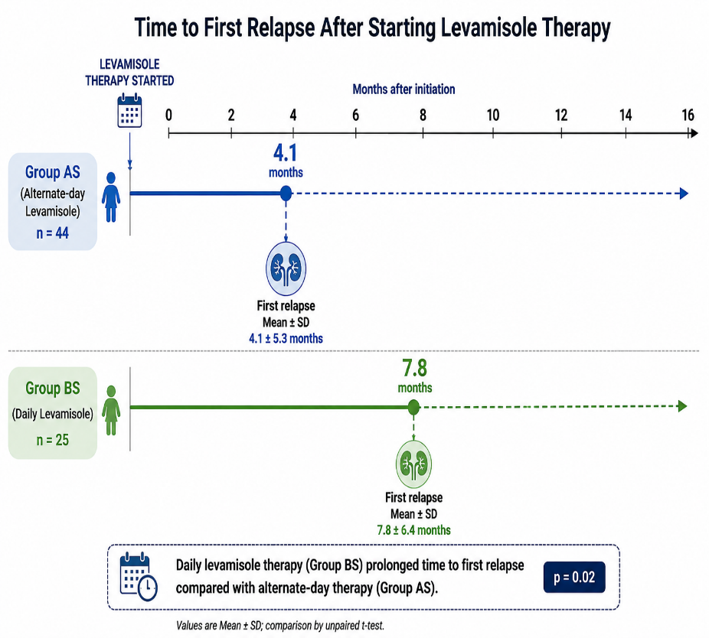
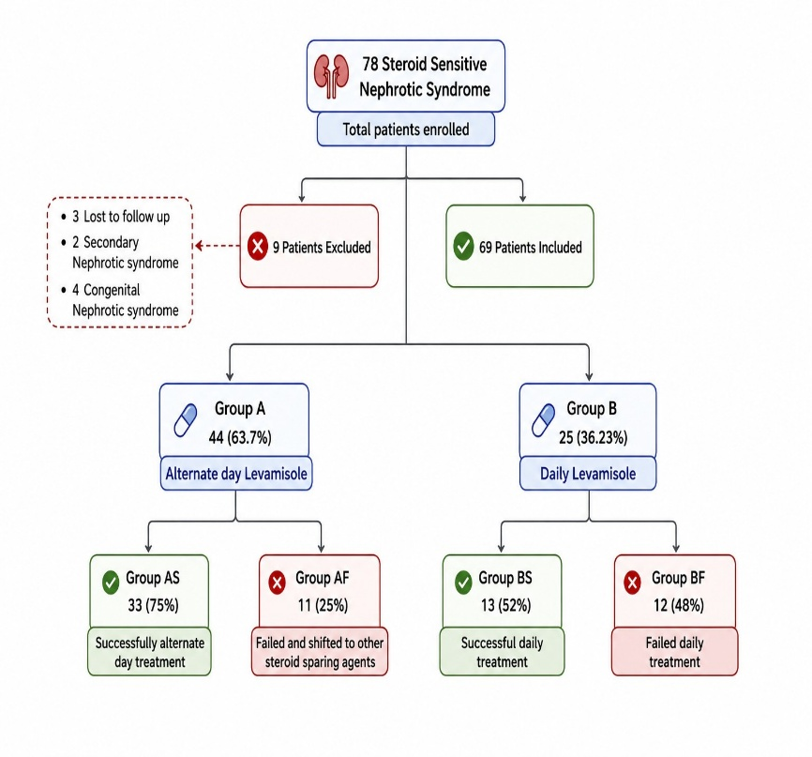
Retrospective observational study comparing profile of steroid-sensitive nephrotic patients on alternate day versus daily levamisole therapy.
AIM: Comparing Clinicodemographic profile and response to daily versus alternate day levamisole therapy.
DESIGN & OUTCOMES:
Retrospective study (2014-2024)
(2014-2024)
CONCLUSION: Daily levamisole therapy can be considered in those who fail alternate day levamisole treatment and have younger age at onset.
Shrivastava A et al. 2026

