Slide 1
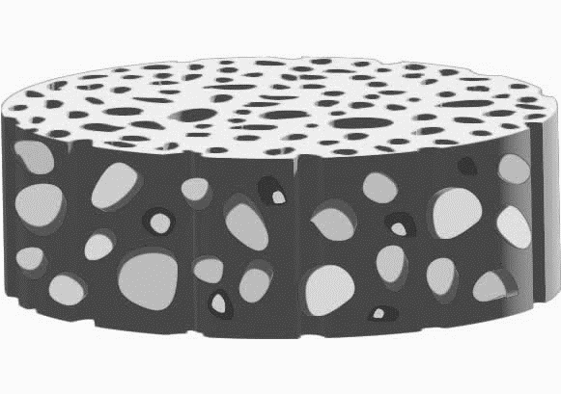
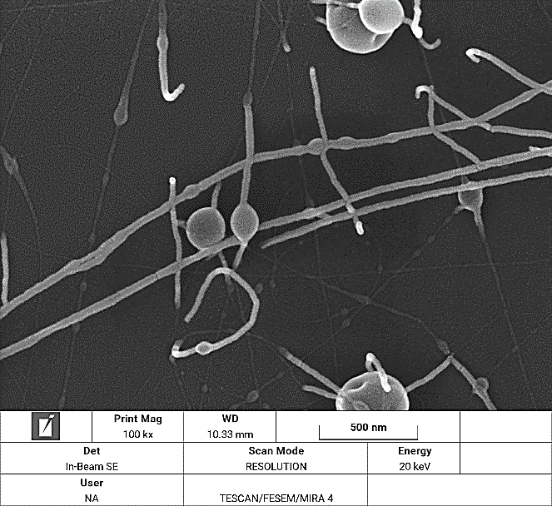

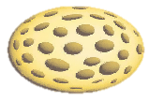
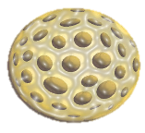
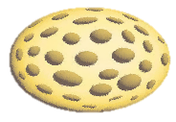
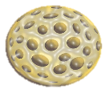
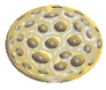



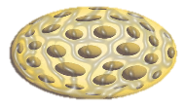
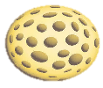
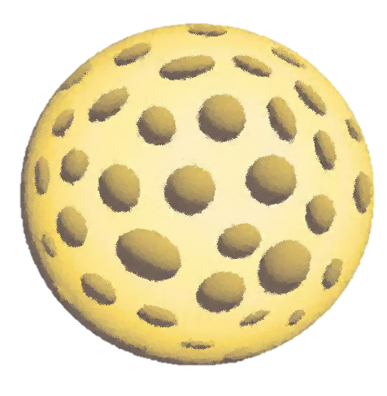
Size-selective Preparation of CaCO₃ NPs by Membrane Emulsification
Polyethersulfone (PES)
W/O/W Emulsion
Before filtration
Mean size: 47.8 µm
CaCl₂ _{(aq)}
Paraffin oil
Na₂CO₃ _{(aq)}
Polyurethane-Melamine (PUMA)
After filtration
Mean size: 3.7 µm
PES-PUMA Membrane
CaCl₂ _{(aq)} + Na₂CO₃ _{(aq)} CaCO₃ _{(s)} + 2NaCl _{(aq)}

