Slide 1
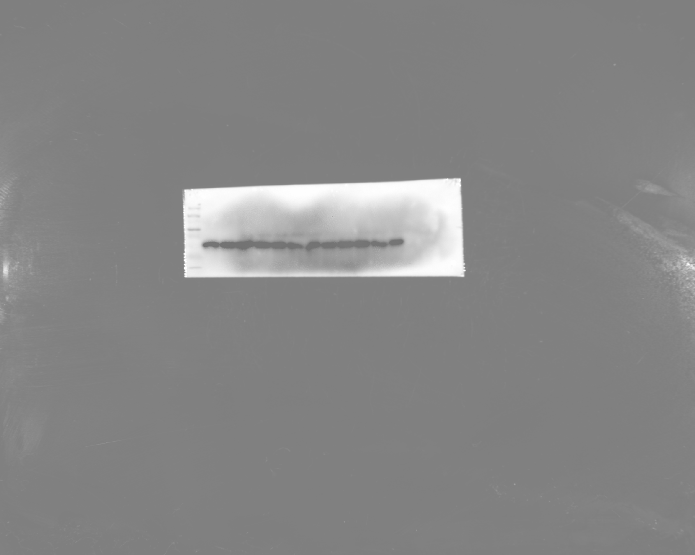
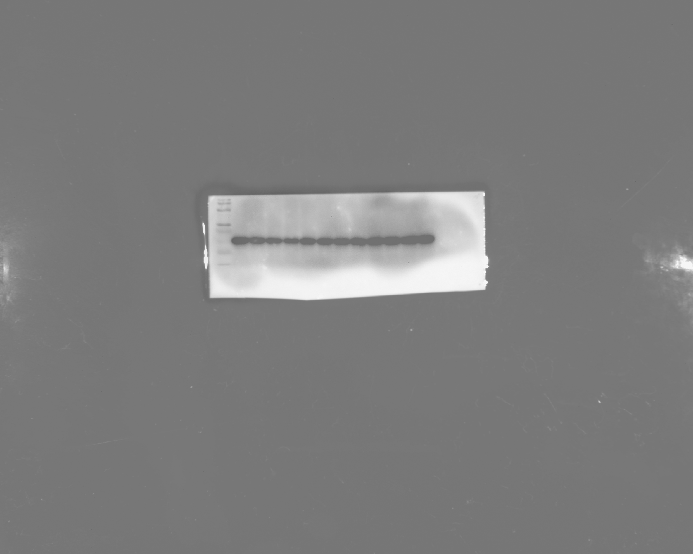
Figure 3A
KIF24
GAPDH
KIF24
GAPDH
Figure 3L
GAPDH
KI67
KIF24
SLC7A11

Slide 2
Figure 5C
GAPDH
NFS1
VDAC1
KIF24
Figure 5D
GAPDH
NFS1
VDAC1
KIF24

Slide 3
Figure 5E
VDAC1
NFS1
NFS1
KIF24
GAPDH
Figure 5F
VDAC1
NFS1
NFS1
KIF24
GAPDH

Slide 4
Figure5Q
GAPDH
KI67
KIF24
SLC7A11

Slide 5
Figure 6D
GAPDH
FTH1
MKN45
GAPDH
FTH1
AGS

Slide 6
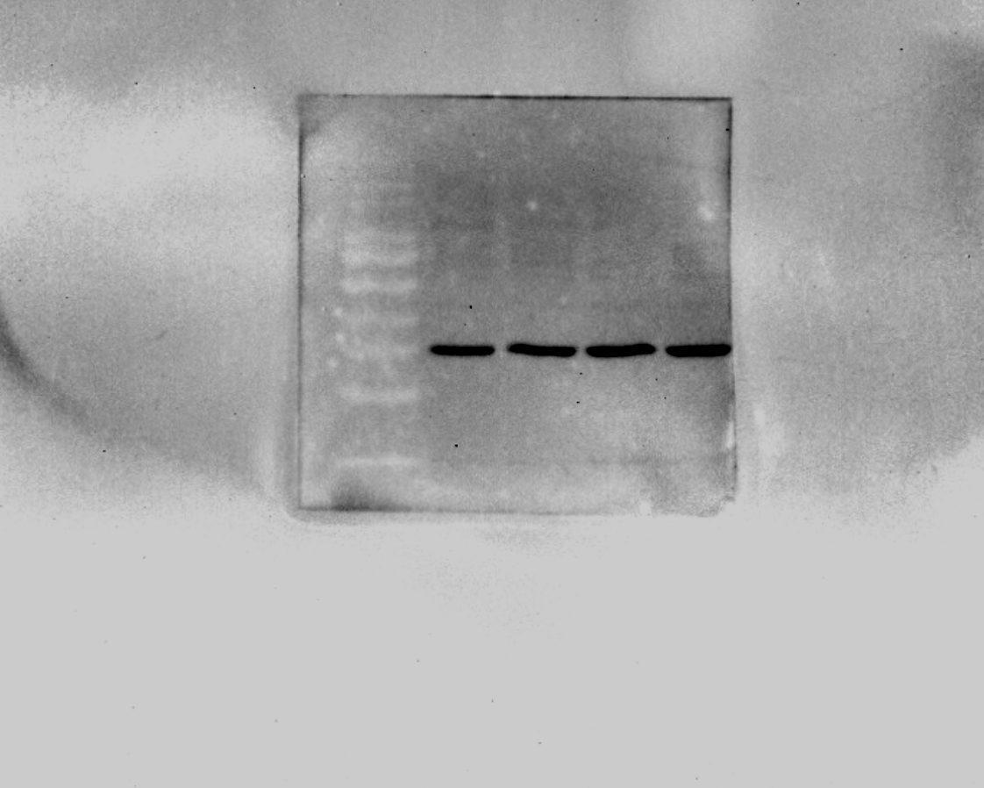
Figure S4 C
GAPDH
p-Ampk
Ampk

Slide 7
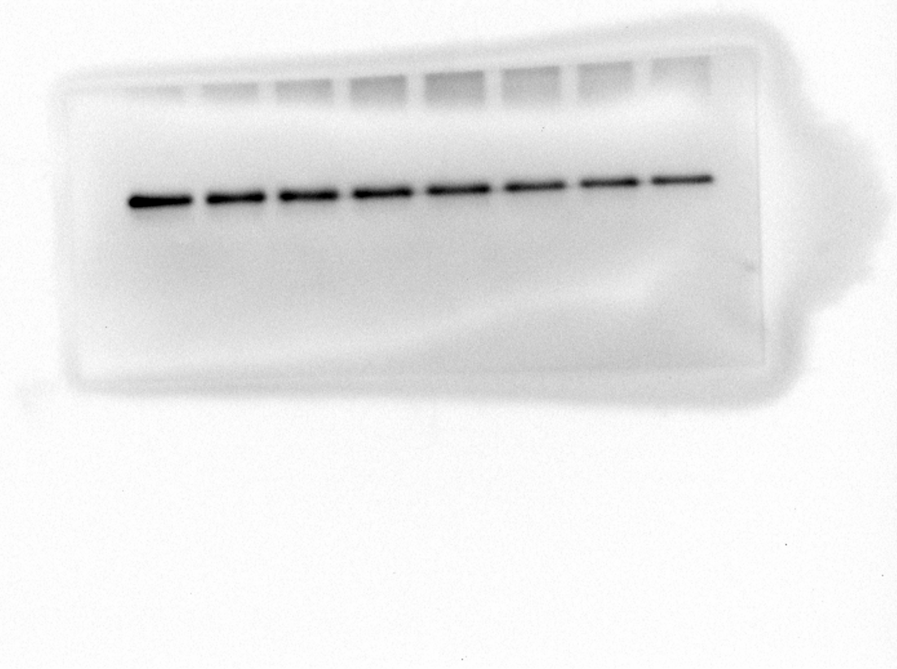
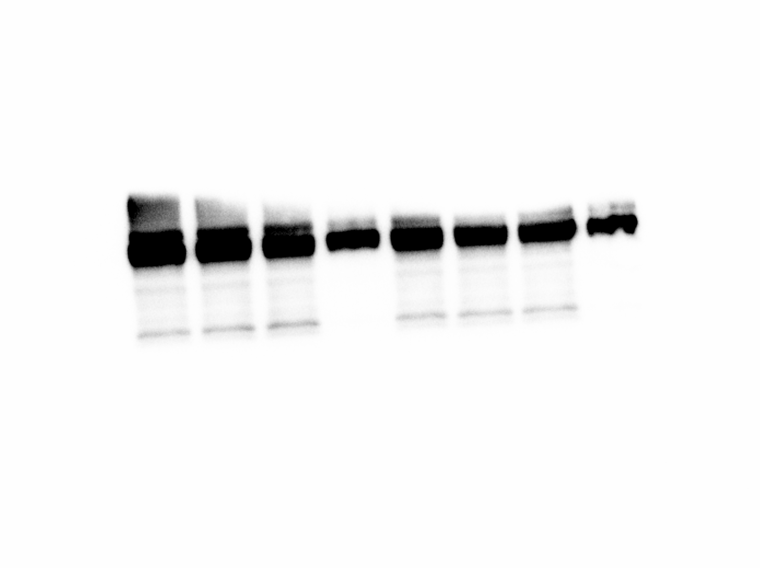
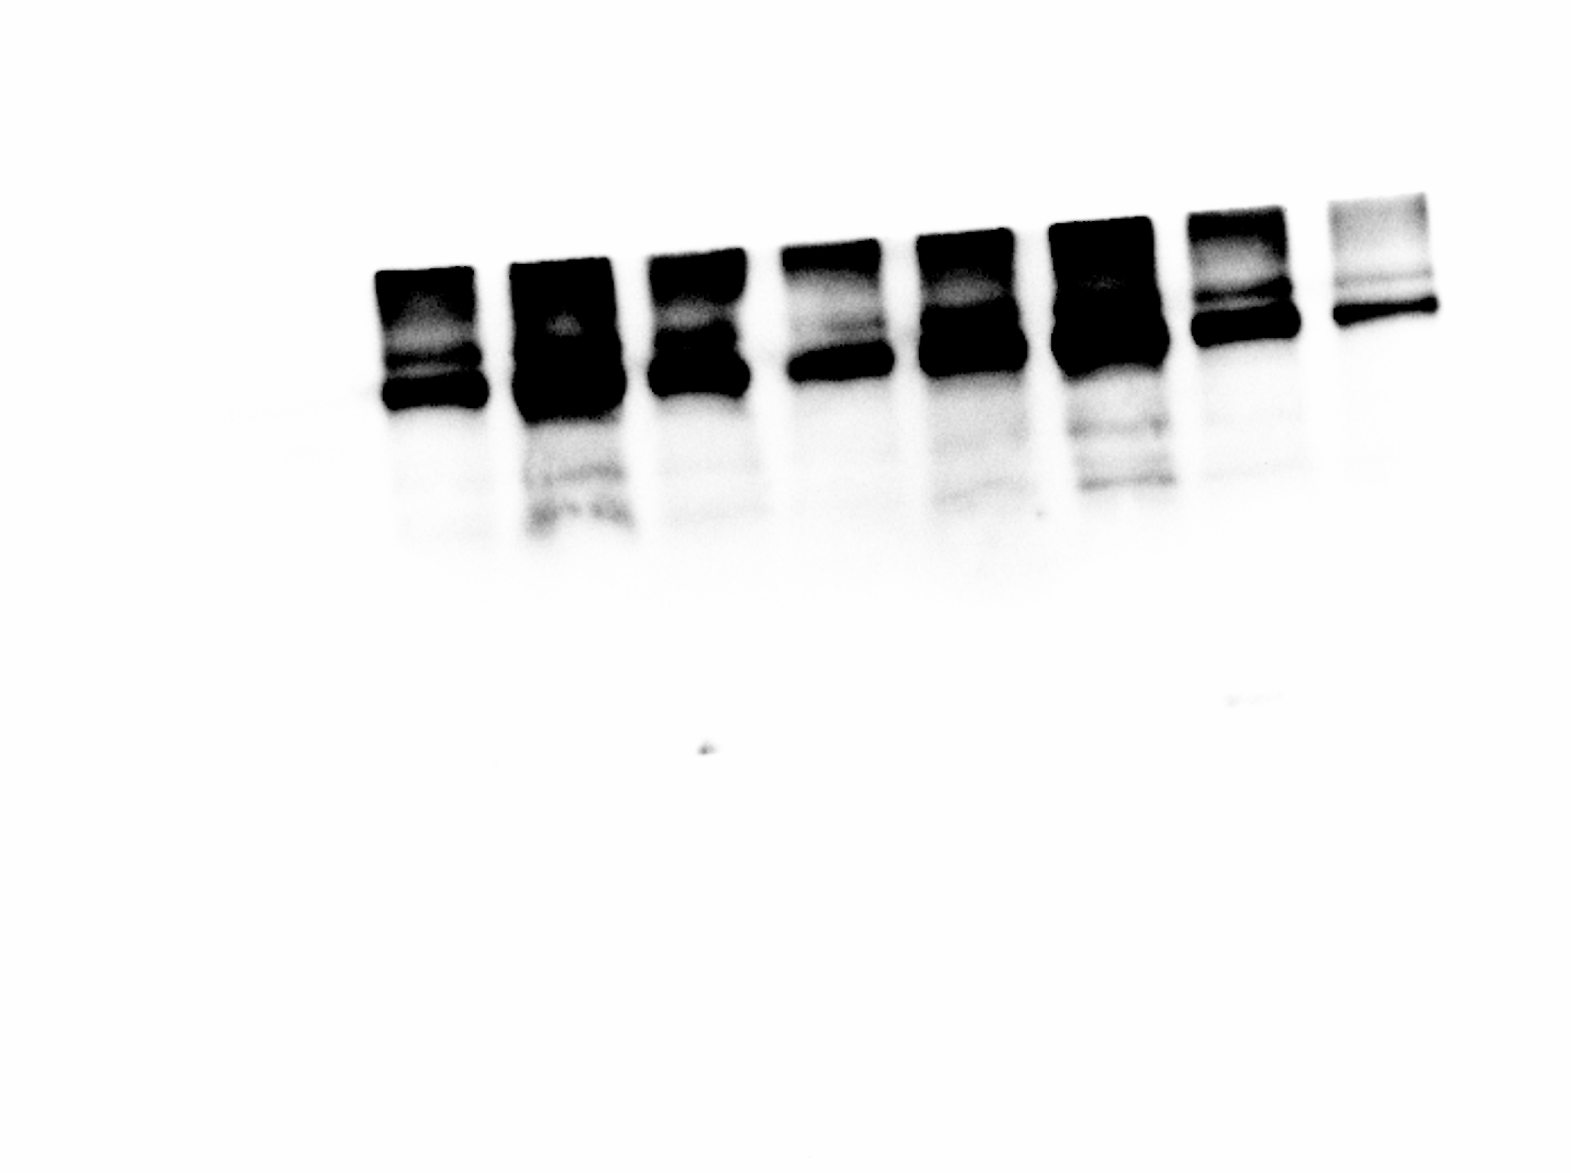
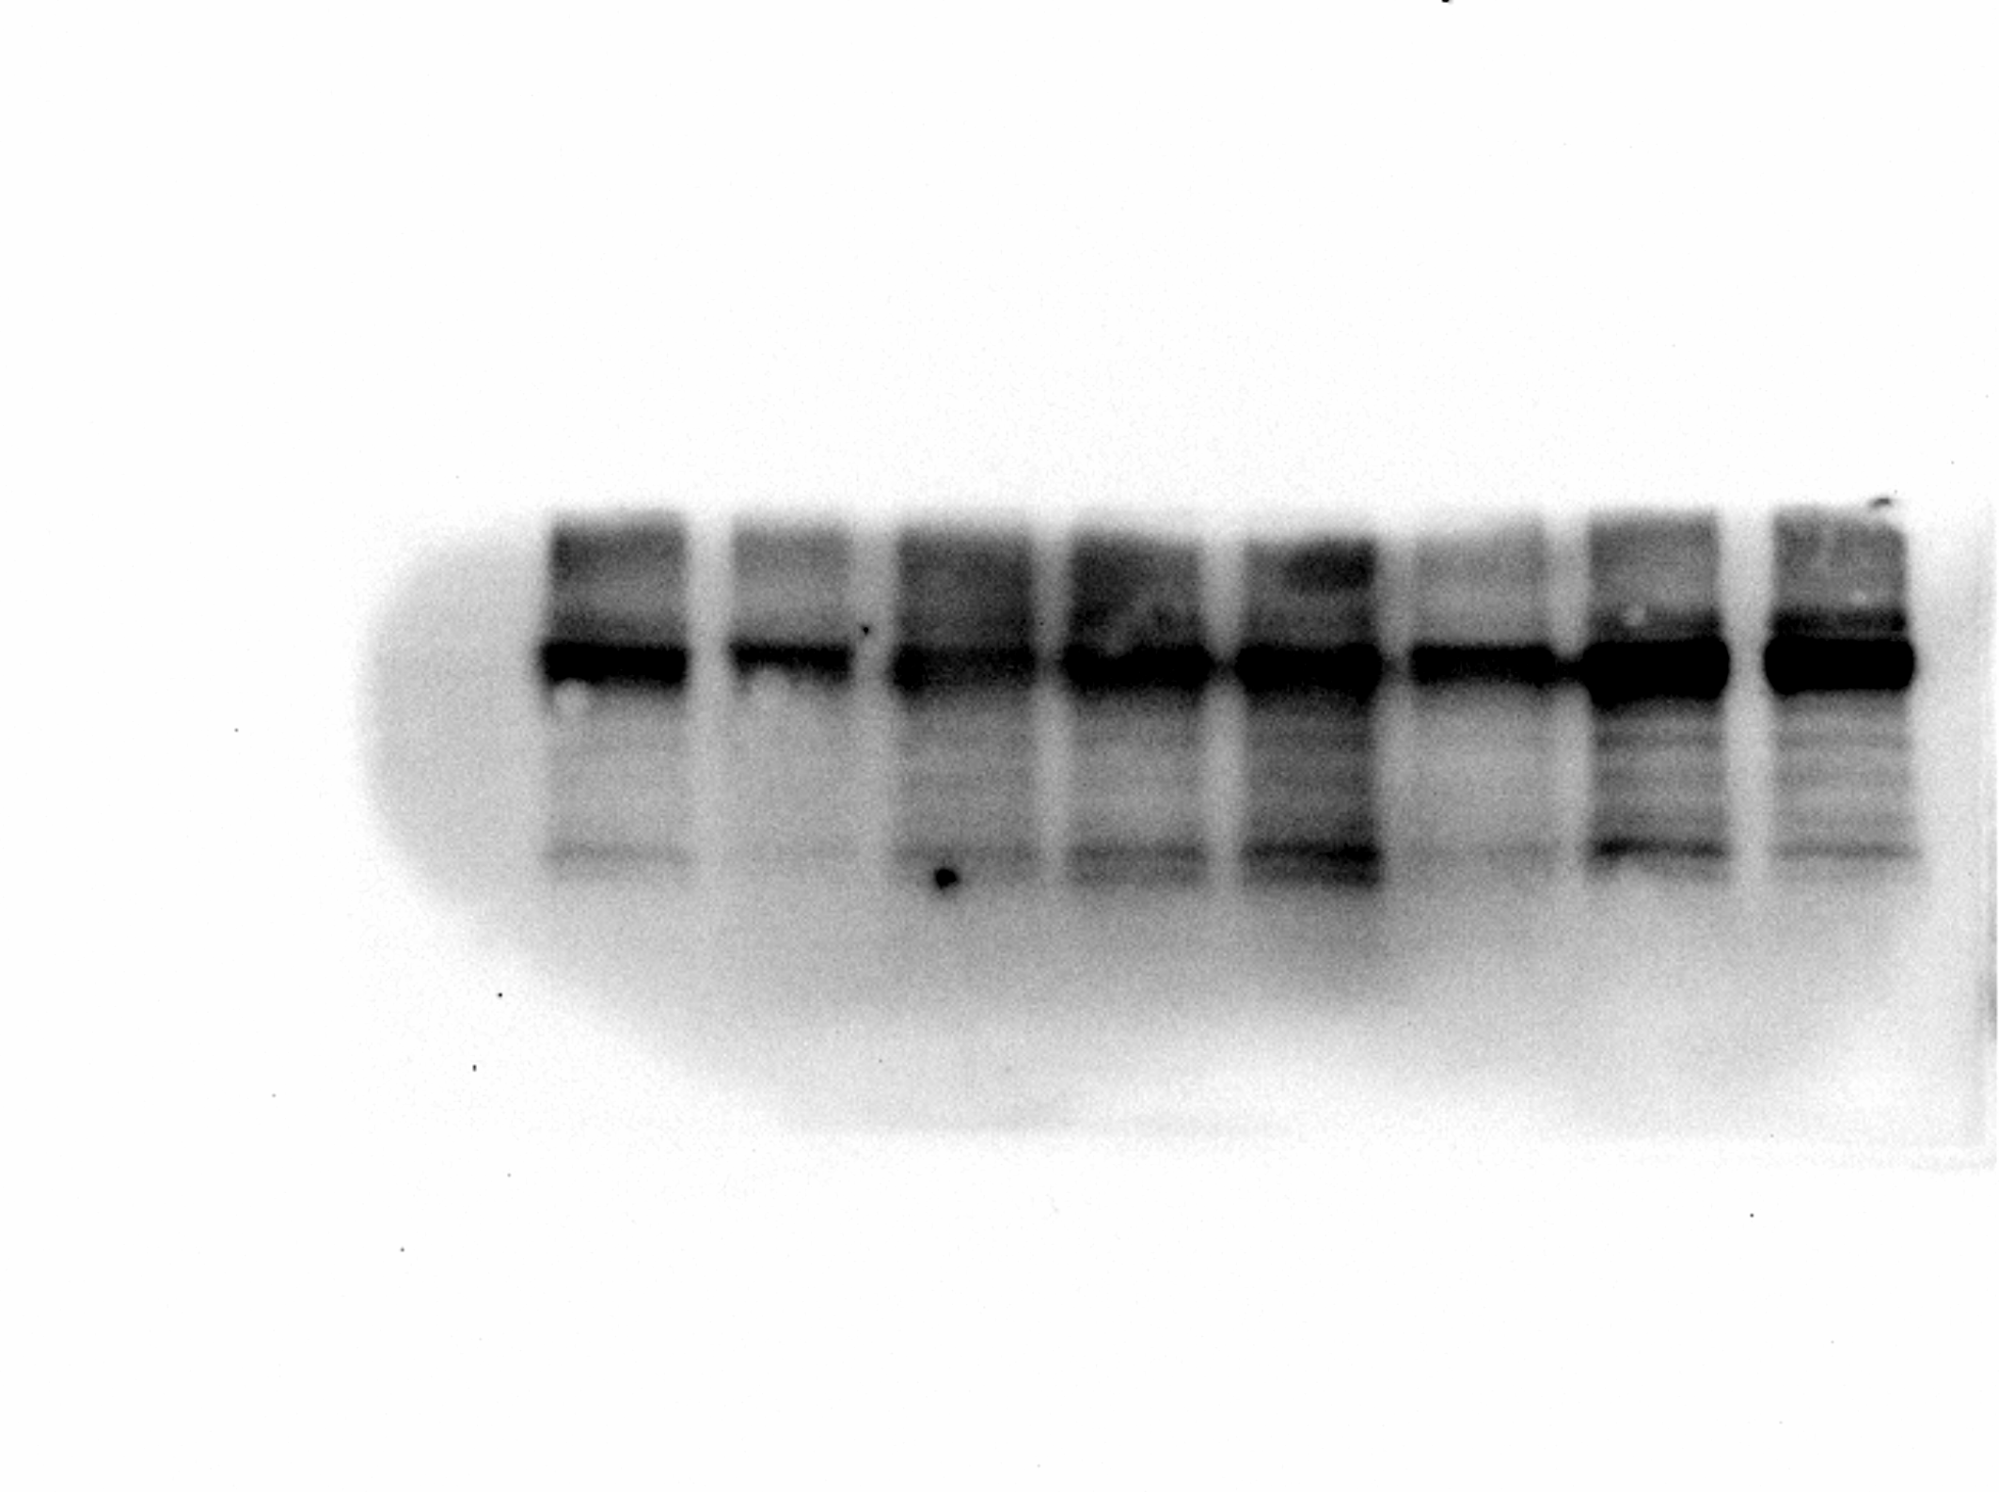
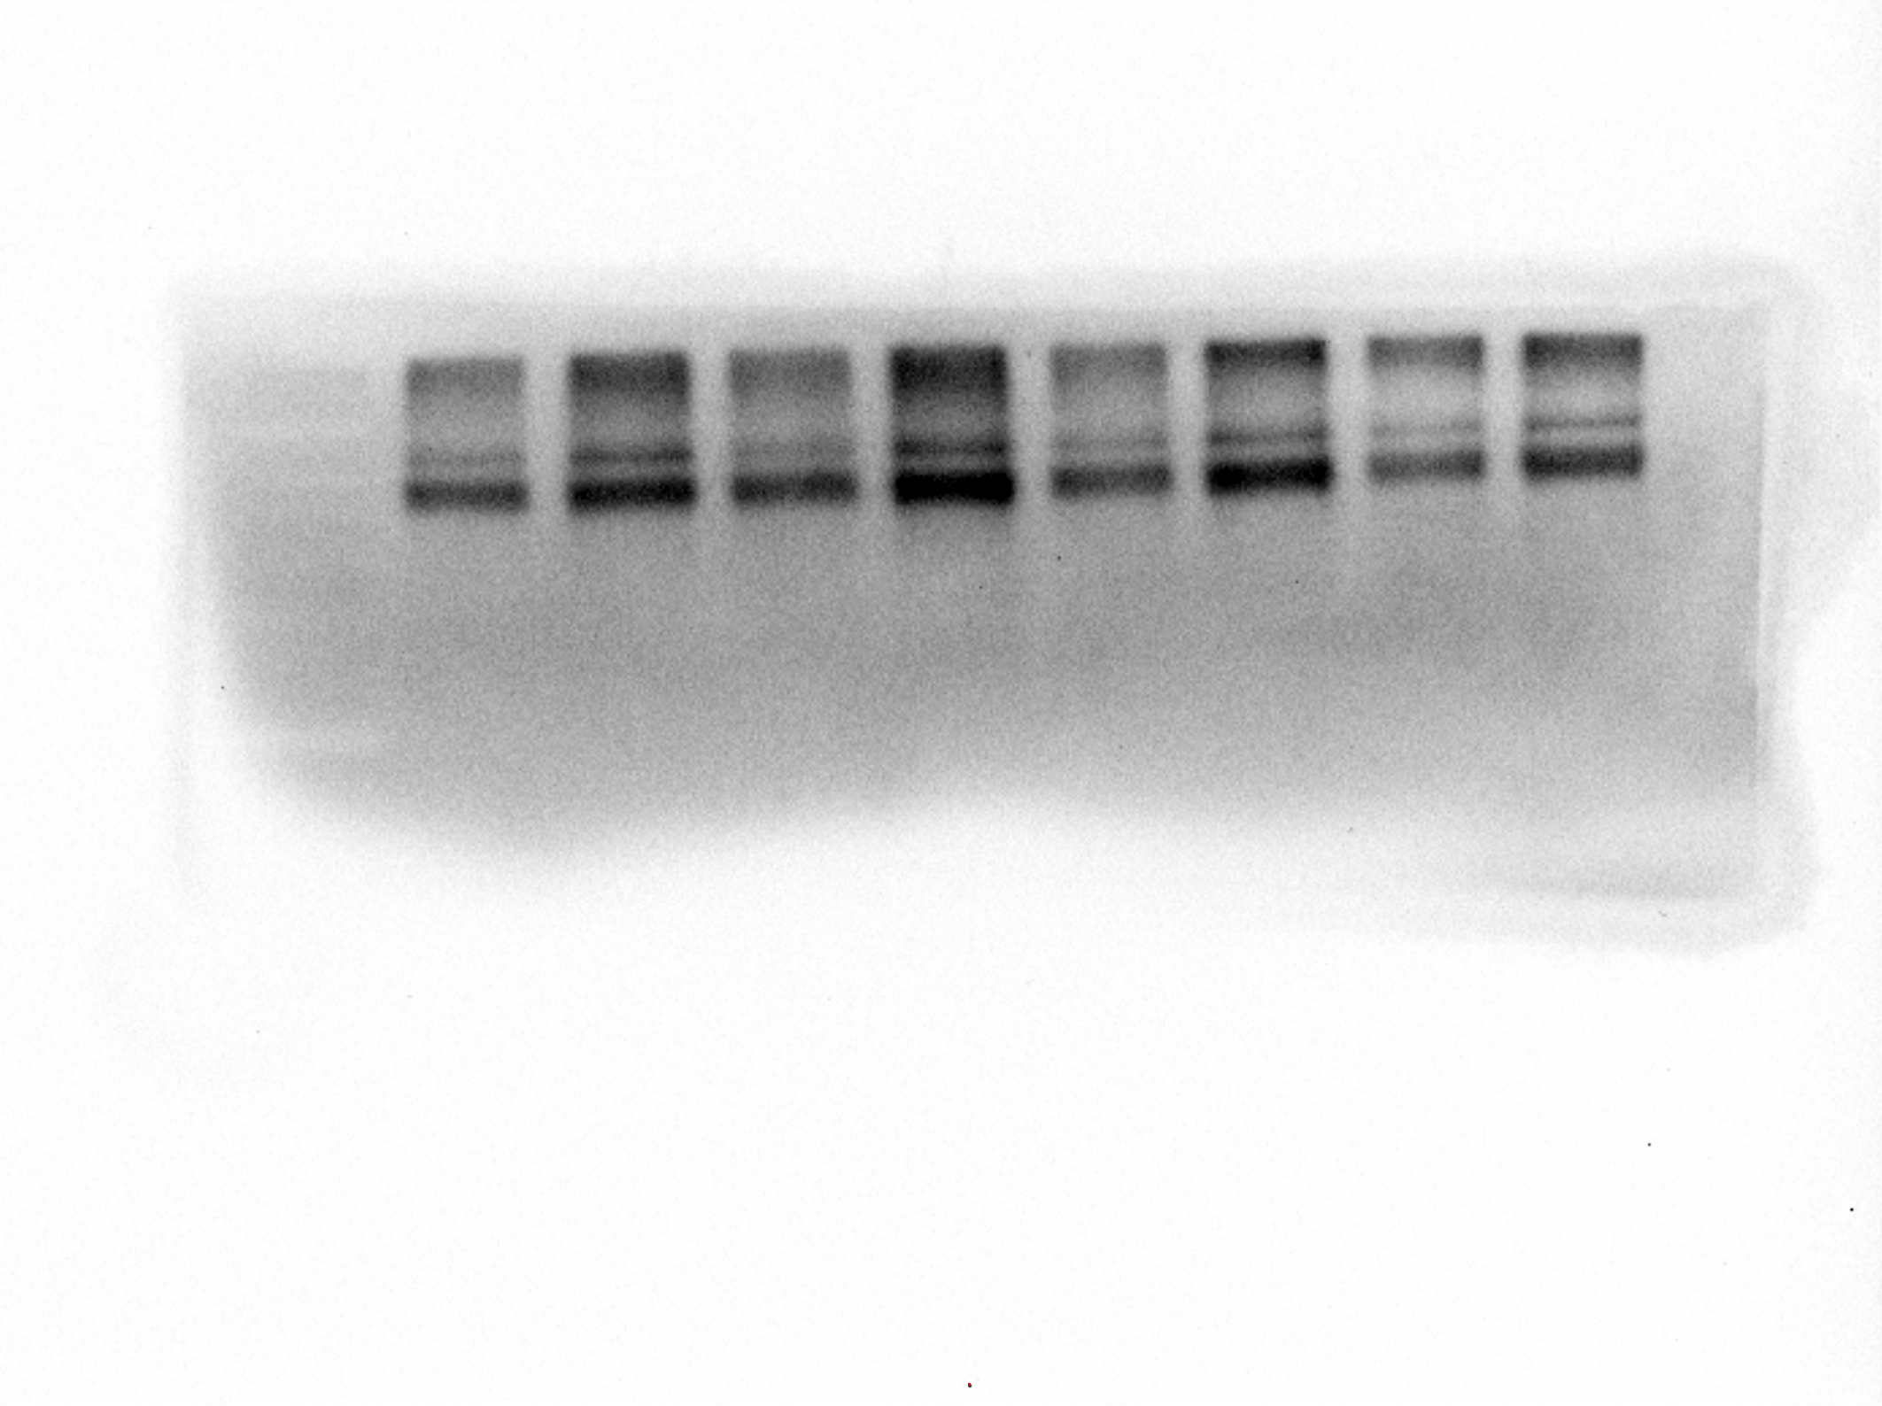
Figure 6G
GAPDH
p53
p-p53
SLC7A11
p-Ampk

