Slide 1


Supplementary 1
Control
LPS
(1 µg/mL)
Extract 50 + LPS
Extract 100 + LPS
Extract 100 alone
Il6 (152 bp)
Tnf (183 bp)
Cox2 (210 bp)
Nos2 (196 bp)
The bands shown in Supplementary Figure S1 are cropped representative bands derived from the corresponding uncropped agarose gel images presented in Supplementary Figures S2–S5; they do not represent independently generated gel images.

Slide 2
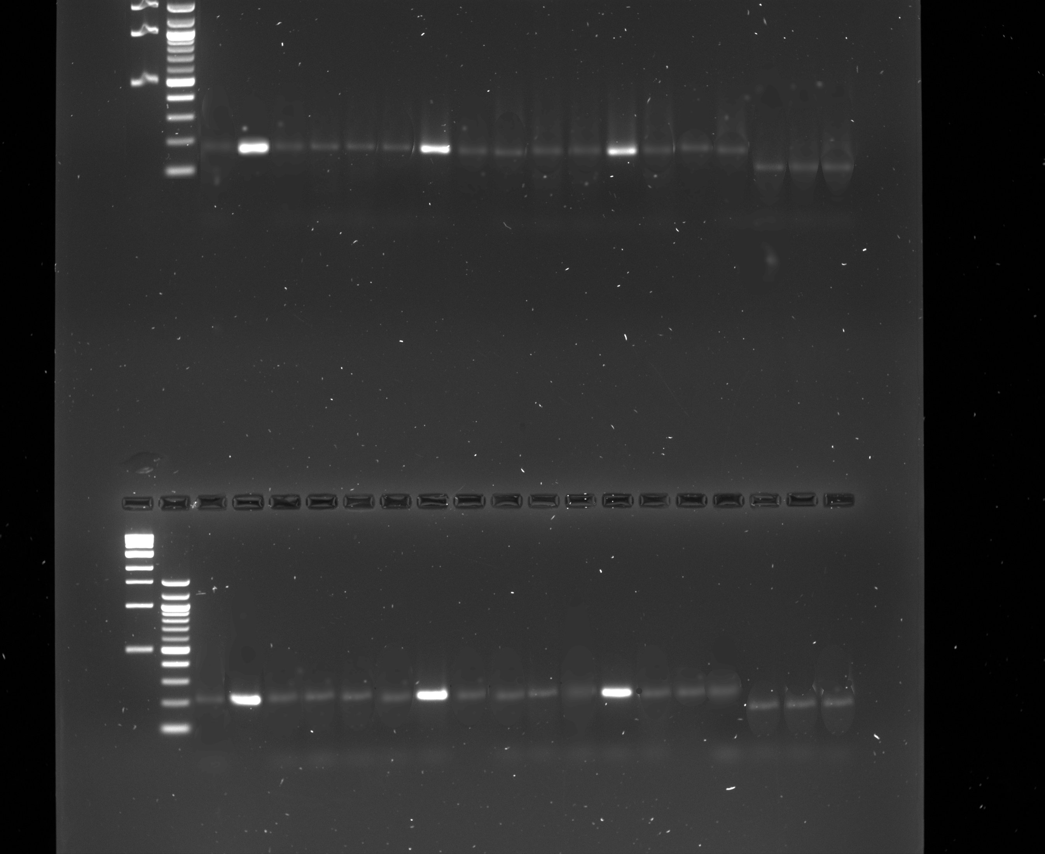
Supplementary 2
Extract 50 + LPS
Extract 100 + LPS
Extract 100 + LPS
Extract 100 alone
Extract 100 + LPS
Marker 100 bp
Extract 50 + LPS
Extract 100 alone
Extract 50 + LPS
Extract 100 alone
Marker 1 kb
LPS (1 µg/mL)
LPS (1 µg/mL)
LPS (1 µg/mL)
Control
Control
Control
Actb
Actb
Actb
1500 bp
1200 bp
1000 bp
900 bp
800 bp
700 bp
600 bp
500 bp
400 bp
300 bp
183 bp
200 bp
154 bp
100 bp
Invitrogen™ 100 bp DNA Ladder (Cat. No. 15628019)

Slide 3
Supplementary 3
Extract 50 + LPS
Extract 100 + LPS
Extract 100 + LPS
Extract 100 alone
Extract 100 + LPS
Marker 100 bp
Extract 50 + LPS
Extract 100 alone
Extract 50 + LPS
Extract 100 alone
Marker 1 kb
LPS (1 µg/mL)
LPS (1 µg/mL)
LPS (1 µg/mL)
Control
Control
Control
Actb
Actb
Actb
1500 bp
1200 bp
1000 bp
900 bp
800 bp
700 bp
600 bp
500 bp
210 bp
400 bp
300 bp
154 bp
200 bp
100 bp
Invitrogen™ 100 bp DNA Ladder (Cat. No. 15628019)

Slide 4
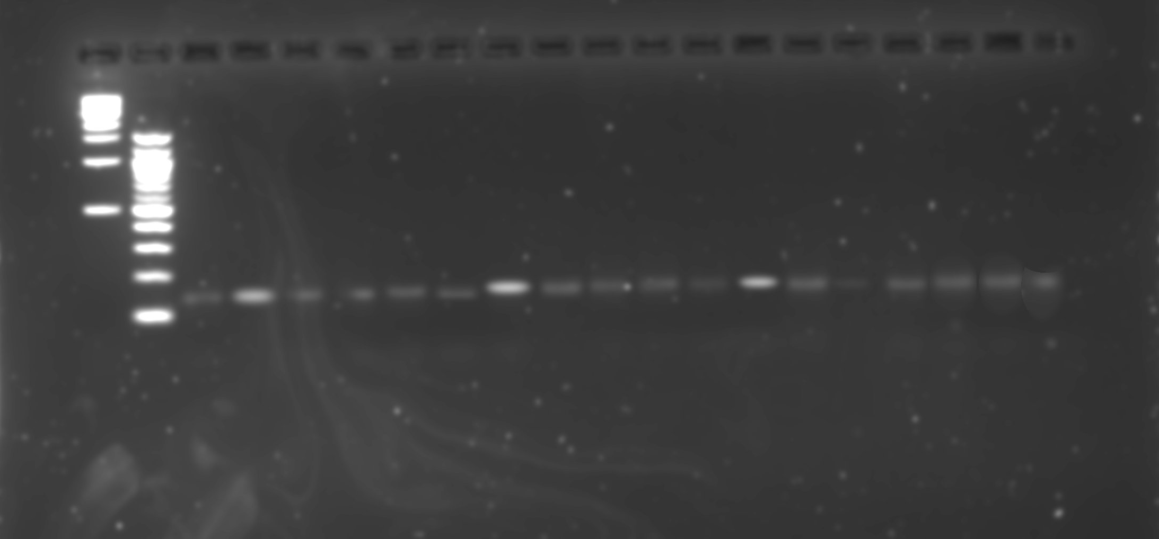
Supplementary 4
Extract 100 + LPS
Extract 100 alone
Extract 100 + LPS
LPS (1 µg/mL)
Extract 100 alone
Extract 100 + LPS
Extract 100 alone
Extract 50 + LPS
Extract 50 + LPS
Extract 50 + LPS
Marker 100 bp
LPS (1 µg/mL)
LPS (1 µg/mL)
Marker 1 kb
Control
Control
Control
Actb
Actb
Actb
1500 bp
1200 bp
600 bp
500 bp
400 bp
154 bp
300 bp
152 bp
200 bp
100 bp
Invitrogen™ 100 bp DNA Ladder (Cat. No. 15628019)

Slide 5
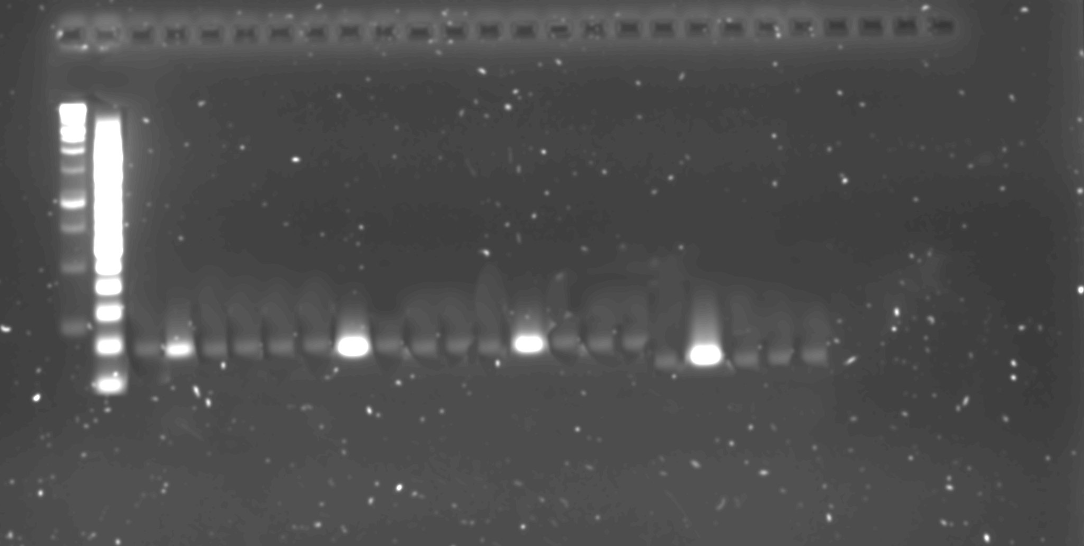
Supplementary 5
Extract 100 alone
Extract 100 alone
Extract 100 alone
Extract 100 + LPS
Loading mistake
Extract 100 + LPS
Extract 100 + LPS
Marker 100 bp
Extract 50 + LPS
Extract 50 + LPS
Extract 50 + LPS
Marker 1 kb
LPS (1 µg/mL)
LPS (1 µg/mL)
LPS (1 µg/mL)
Control
Control
Control
Actb
Actb
Actb
600 bp
500 bp
400 bp
300 bp
196 bp
200 bp
154 bp
100 bp
Invitrogen™ 100 bp DNA Ladder (Cat. No. 15628019)

