Slide 1

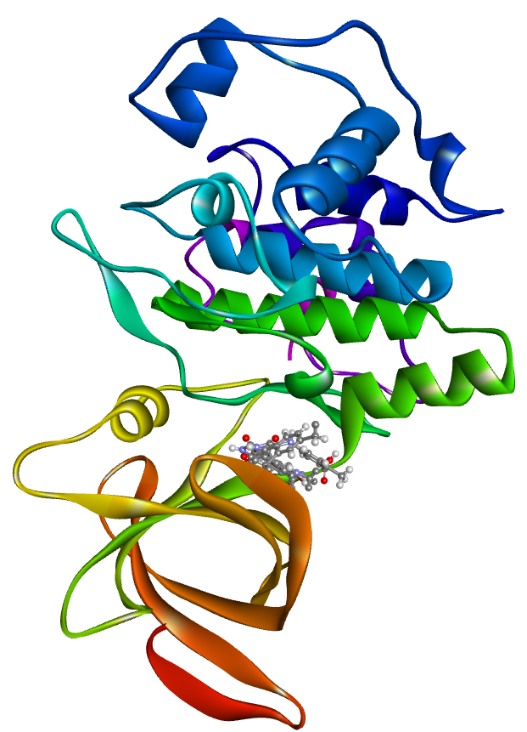
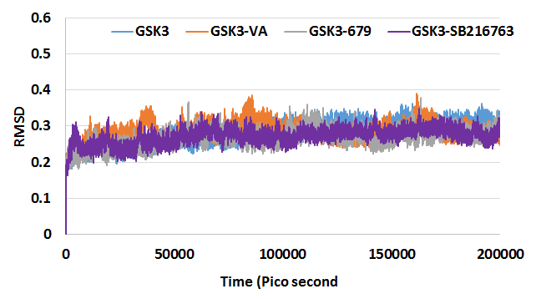
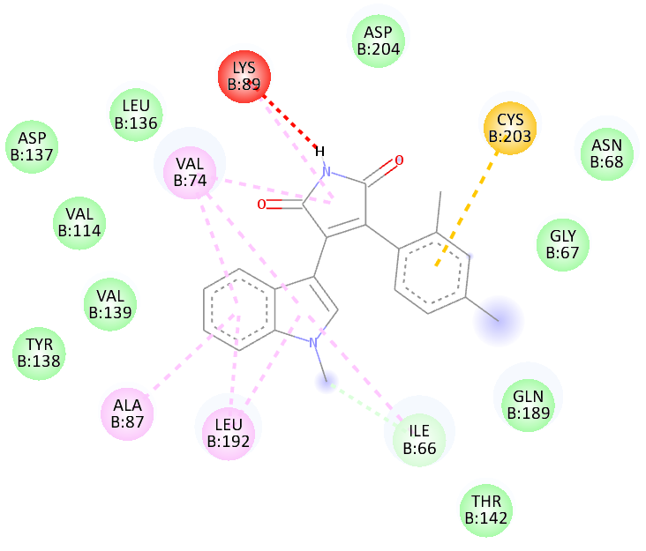
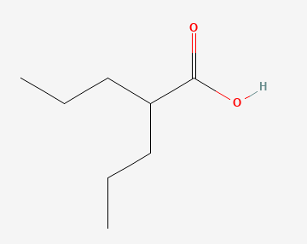

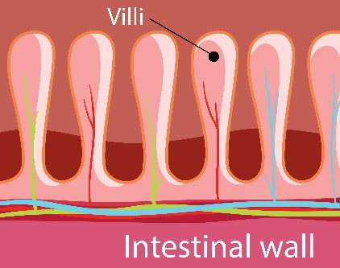






Graphical Abstract
IN SILICO ANALYSES
NETWORK ANALYSIS
Molecular Docking and MD Simulations (200 ns)
Enriched Pathways
WNT/$β$-Catenin Signaling
Inflammatory response
Cytokine signaling
Cell proliferation
Intestinal epithelial regeneration
VPA in GSK-3$β$ATP Pocket
VPA
PROPOSED MECHANISM
In-vitro and In-vivo Validations
R8.5 Gy
VPA
Survival
Colon length
$β$-Catenin
$β$-Catenin
VPA increases mice survival after radiation injury
VPA increases length of Colon
VPA MITIGATES RADIATION INDUCED GASTROINTESTINAL INJURY
GSK-3$β$
$β$-Catenin
Intestinal regeneration through
activation of WNT pathway

