Slide 1
Table 1: The animal characteristics, 16S rRNA amplicon sequence reads and OTUs of the bacterial community
Code | Animal species | Age | Gender | Sequence (raw) reads | Filtered Sequence reads | OTUs
Ech2 | Sheep | 6 months | Male | 30,020 | 106 | 51
Ech4 | Sheep | 12 months | Female | 27,972 | 2,028 | 54
Ech6 | Goat | 6 months | Male | 26,197 | 2,420 | 34
Ech7 | Goat | 12 months | Female | 30,992 | 1,384 | 27

Slide 2
Table 2: Dominant taxa in the fecal microbiota associated with sheep and goats (The percentage of abundance)
Taxon | (6 months) |  | (12 months)
 | Sheep (Ech2) | Goat (Ech6) | Sheep (Ech4) | Goat (Ech7)
phylum
Firmicutes | 93.01%* | 37.87% | 72.76% | 95.37%
Proteobacteria | 6.88% | 62.03% | 26.83% | 4.54%
Actinobacteria | 0.09% | 0.09% | 0.35% | 0.10%
Bacteroidetes | 0.00% | 0.00% | 0.06% | 0.00%
class
Gammaproteobacteria | 0.94% | 0.08% | 0.10% | 0.22%
Bacilli | 3.77% | 0.28% | 0.54% | 0.51%
Clostridia | 4.71% | 0.41% | 0.88% | 0.86%
Coriobacteriia | 0.00% | 0.00% | 0.05% | 0.00%
Tissierellia | 0.00% | 0.17% | 0.05% | 0.07%
Erysipelotrichia | 0.00% | 0.04% | 0.05% | 0.07%
Negativicutes | 0.00% | 0.04% | 0.00% | 0.00%
order
Enterobacterales | 0.00% | 0.08% | 0.05% | 0.22%
Lactobacillales | 2.83% | 0.17% | 0.05% | 0.29%
Clostridiales | 4.71% | 0.41% | 0.88% | 0.79%
Bacillales | 0.94% | 0.12% | 0.25% | 0.29%
Tissierellales | 0.00% | 0.17% | 0.05% | 0.07%
Erysipelotrichales | 0.00% | 0.04% | 0.05% | 0.07%
Bifidobacteriales | 0.00% | 0.08% | 0.05% | 0.07%
Coriobacteriales | 0.00% | 0.00% | 0.05% | 0.00%
Bacteroidales | 0.00% | 0.00% | 0.00% | 0.07%

Slide 3
Taxon | (6 months) |  | (12 months)
 | Sheep (Ech2) | Goat (Ech6) | Sheep (Ech4) | Goat (Ech7)
Family
Clostridiaceae | 3.77% | 0.00% | 0.15% | 0.00%
Enterococcaceae | 1.88% | 0.08% | 0.05% | 0.14%
Lachnospiraceae | 0.94% | 0.17% | 0.25% | 0.14%
Bacillaceae | 0.94% | 0.08% | 0.19% | 0.14%
Peptostreptococcaceae | 0.94% | 0.08% | 0.25% | 0.29%
Streptococcaceae | 0.94% | 0.00% | 0.10% | 0.07%
Enterobacteriaceae | 0.00% | 0.08% | 0.10% | 0.29%
Aerococcaceae | 0.00% | 0.00% | 0.05% | 0.00%
Ruminococcaceae | 0.00% | 0.00% | 0.05% | 0.00%
Carnobacteriaceae | 0.00% | 0.00% | 0.05% | 0.00%
Bifidobacteriaceae | 0.00% | 0.04% | 0.05% | 0.07%
Tissierellaceae | 0.00% | 0.12% | 0.05% | 0.00%
Erysipelotrichaceae | 0.00% | 0.04% | 0.05% | 0.07%
Oscillospiraceae | 0.00% | 0.00% | 0.10% | 0.07%
Rikenellaceae | 0.00% | 0.00% | 0.05% | 0.00%
Bacteroidaceae | 0.00% | 0.00% | 0.05% | 0.07%
Atopobiaceae | 0.00% | 0.00% | 0.05% | 0.00%
Paenibacillaceae | 0.00% | 0.04% | 0.00% | 0.07%
Sporomusaceae | 0.00% | 0.04% | 0.00% | 0.00%
Gottschalkiaceae | 0.00% | 0.00% | 0.00% | 0.07%

Slide 4
Taxon | (6 months) |  | (12 months)
 | Sheep (Ech2) | Goat (Ech6) | Sheep (Ech4) | Goat (Ech7)
GENUS
Escherichia | 8.49% | 40.12% | 21.99% | 5.49%
Vagococcus | 0.00% | 0.00% | 0.00% | 0.36%
Clostridium | 0.94% | 0.00% | 19.38% | 0.22%
Shigella | 0.00% | 0.00% | 0.00% | 0.07%
Enterococcus | 1.89% | 3.60% | 5.03% | 1.73%
Desnuesiella | 0.00% | 0.08% | 0.00% | 0.00%
Lysinibacillus | 76.42% | 9.88% | 7.25% | 76.95%
Terrisporobacter | 1.89% | 0.00% | 2.56% | 0.00%
Streptococcus | 2.83% | 1.20% | 2.22% | 1.88%
Sporobacter | 0.94% | 0.00% | 0.00% | 0.00%
Anaerocolumna | 0.94% | 1.07% | 1.63% | 0.00%
Paraclostridium | 0.00% | 0.00% | 0.00% | 8.67%
Romboutsia | 0.00% | 0.04% | 0.05% | 0.22%
Paeniclostridium | 0.00% | 0.00% | 0.05% | 0.07%
Bacillus | 0.00% | 0.00% | 0.39% | 0.00%
Lactonifactor | 0.00% | 0.00% | 0.35% | 0.00%
Anaerotignum | 0.00% | 35.95% | 4.93% | 0.00%
Falcatimonas | 0.00% | 0.04% | 0.00% | 0.00%
Mageeibacillus | 0.00% | 0.00% | 0.05% | 0.00%
Kroppenstedtia | 0.00% | 0.00% | 0.10% | 0.00%

Slide 5
Taxon | (6 months) |  | (12 months)
 | Sheep (Ech2) | Goat (Ech6) | Sheep (Ech4) | Goat (Ech7)
GENUS
Muricomes | 0.00% | 0.21% | 0.99% | 0.00%
Tissierella | 0.00% | 0.91% | 0.39% | 0.00%
Alistipes | 0.00% | 0.00% | 0.05% | 0.00%
Faecalicatena | 0.00% | 0.00% | 0.64% | 0.00%
Intestinimonas | 0.00% | 0.00% | 1.43% | 0.00%
Atopobium | 0.00% | 0.00% | 0.05% | 0.00%
Gracilibacter | 0.00% | 0.00% | 0.15% | 0.00%
Bacteroides | 0.00% | 0.00% | 0.05% | 0.29%
Butyricicoccus | 0.00% | 0.00% | 0.05% | 0.00%
Bifidobacterium | 0.00% | 0.21% | 0.44% | 0.51%
Turicibacter | 0.00% | 0.51% | 0.25% | 0.00%
Mogibacterium | 0.00% | 0.00% | 0.05% | 0.07%
Abiotrophia | 0.00% | 0.00% | 0.05% | 0.00%
Papillibacter | 0.00% | 0.00% | 0.05% | 0.00%
Coprococcus | 0.00% | 0.00% | 0.05% | 0.00%
Oscillibacter | 0.00% | 0.00% | 0.15% | 0.00%

Slide 6
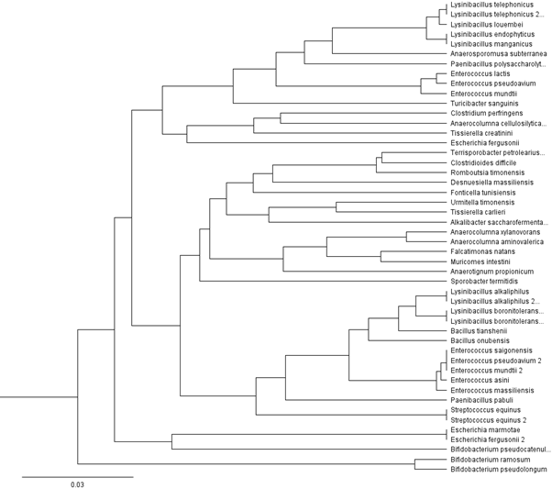
Fig.4

Slide 7
Table 3: Alpha diversity metrics among sheep and goats
Code | Chao1 | Shannon
Ech2 | 51.27 | 1.51
Ech4 | 54.48 | 3.04
Ech6 | 34.60 | 2.00
Ech7 | 27.05 | 1.36
Mean | 41.85 | 1.97

