Slide 1
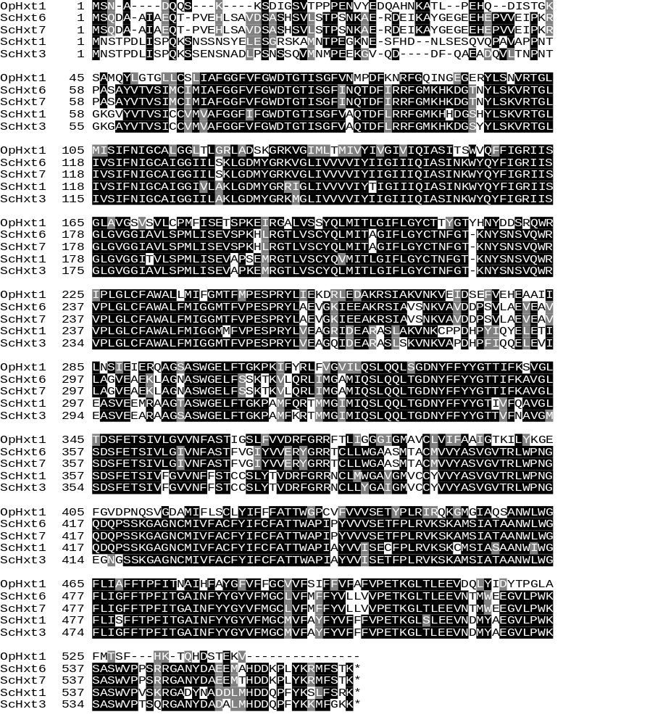
Fig. S1

Slide 2
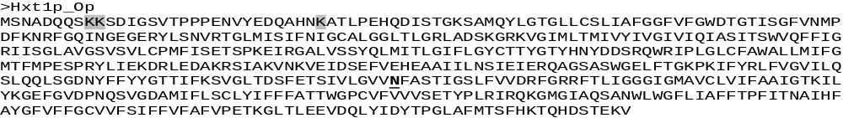
Fig. S2

Slide 3
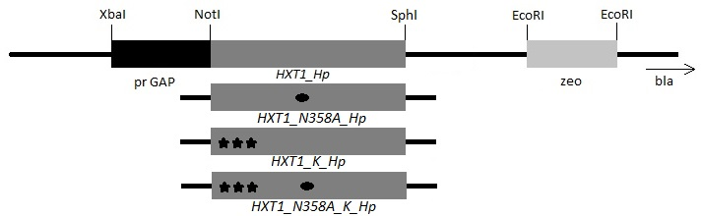

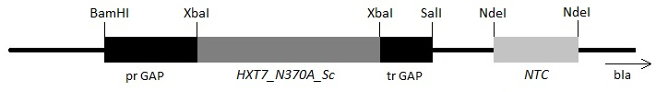

pUC19/zeo/HXT1
pUC19/zeo/HXT1_N358A
pUC19/zeo/HXT1_K
pUC19/zeo/HXT1_N358A_K
pNTC_HXT1_N358A_K
pNTC_HXT7_N370A
pNTC_GAL2_N376F
Fig. S3

