Slide 1
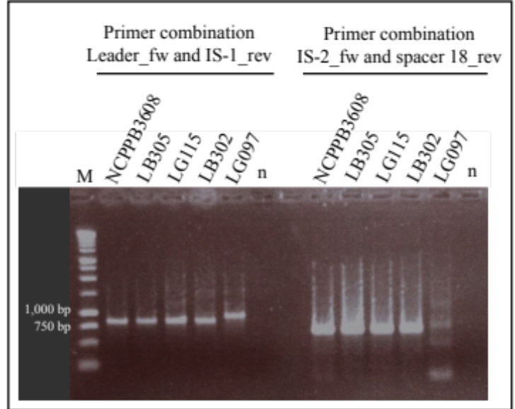
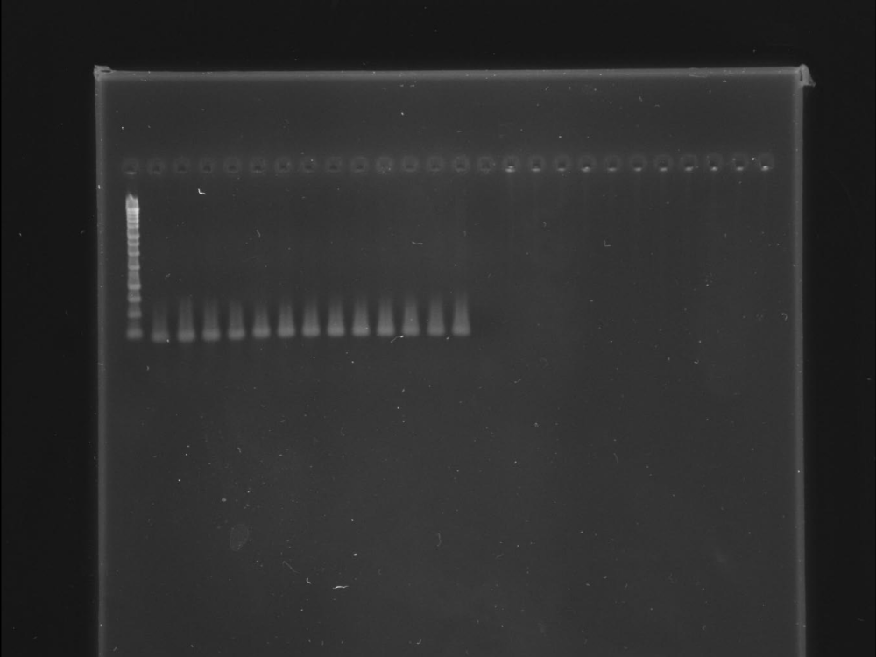
Figure S6. PCR amplification of spacer/repeat units next to the IS element of five X. citri pv. citri strains. M, molecular weight marker (1-kb ladder, Promega); n, negative control (PCR reaction without template DNA). Lanes 2-7, primer combination Leader_fw and IS-1_rev; lanes 9-14, primer combination IS-2_fw and Spacer#18_rev.

