Slide 1
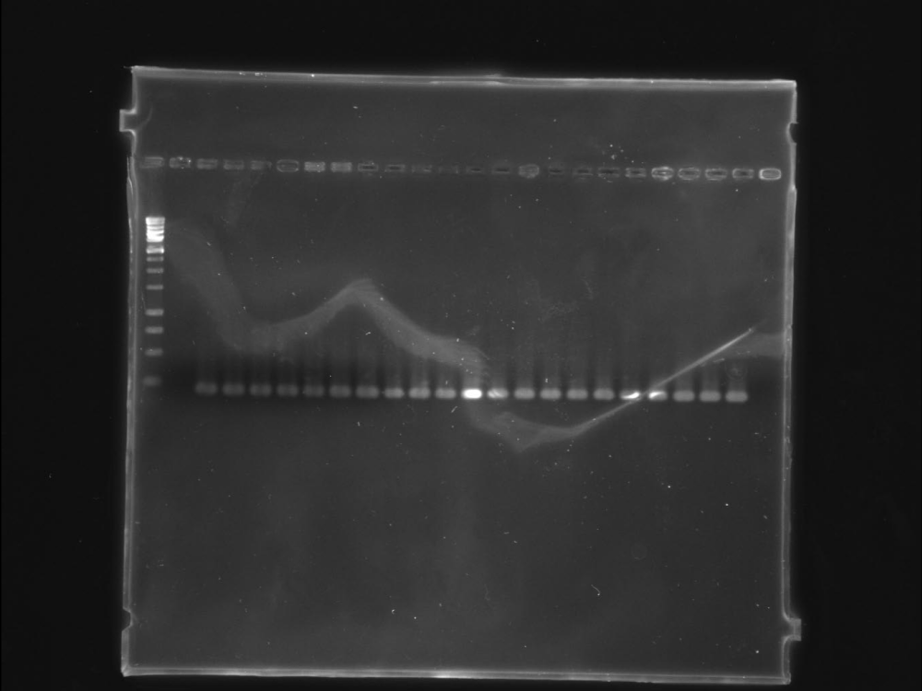
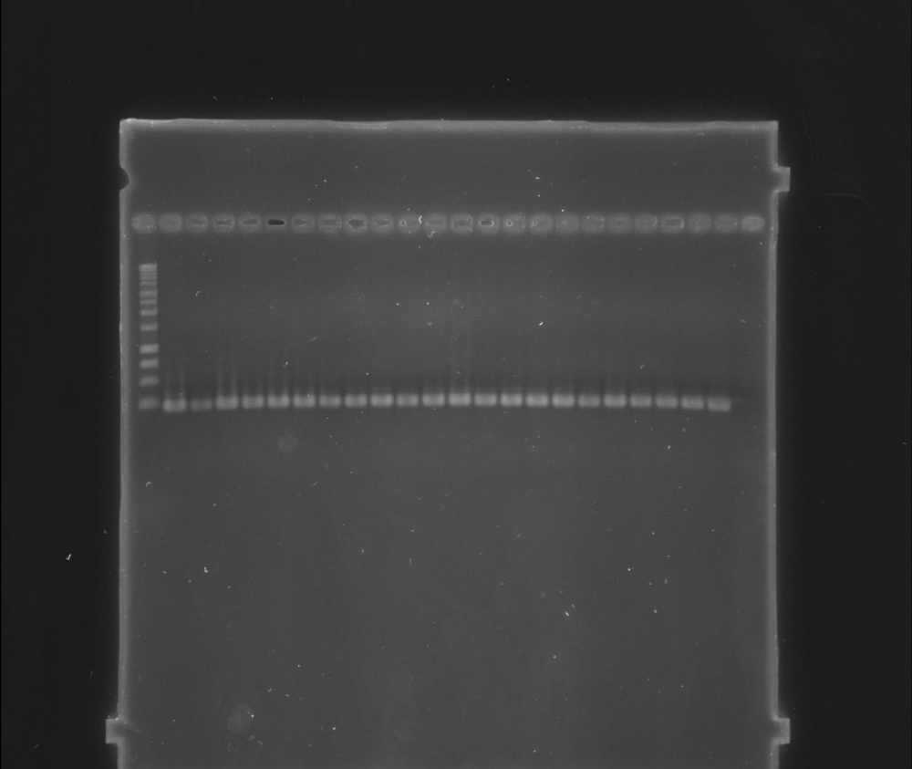
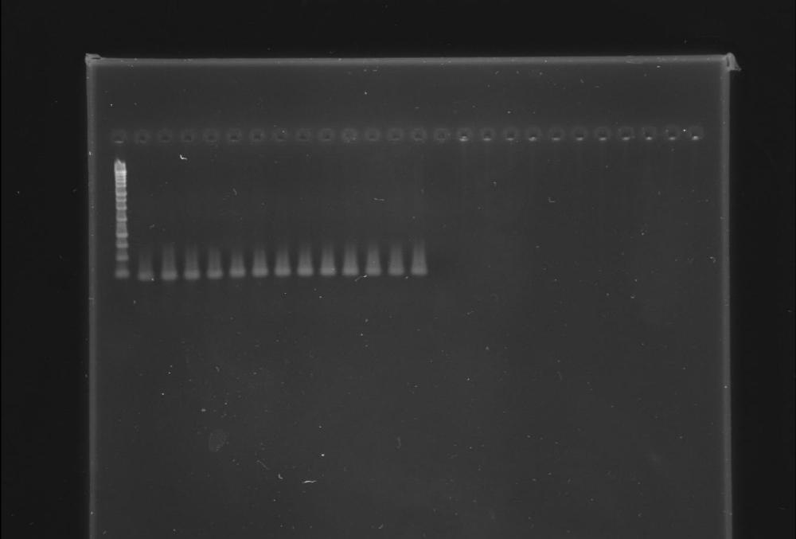
--------------------------------------------------
n
5
22
4
21
3
20
2
1
M
A
250 bp
--------------------------------------------------
n
27
44
26
43
25
42
24
23
M
B
250 bp
---------------------------
n
47
46
45
M
56
57
C
250 bp
Figure S1: PCR amplification of a 220-bp cas1 gene fragment from strains of X. citri pv. citri. M, molecular weight marker (1-kb ladder, Promega); n, negative control (PCR reaction without template DNA). A, strains no. 1-22 of Table 3; B, strains no. 23-44 of Table 3; C, strains no. 45-57 of Table 3. The red box indicates X. citri pv. bilvae strain NCPPB 3213.

