Slide 1
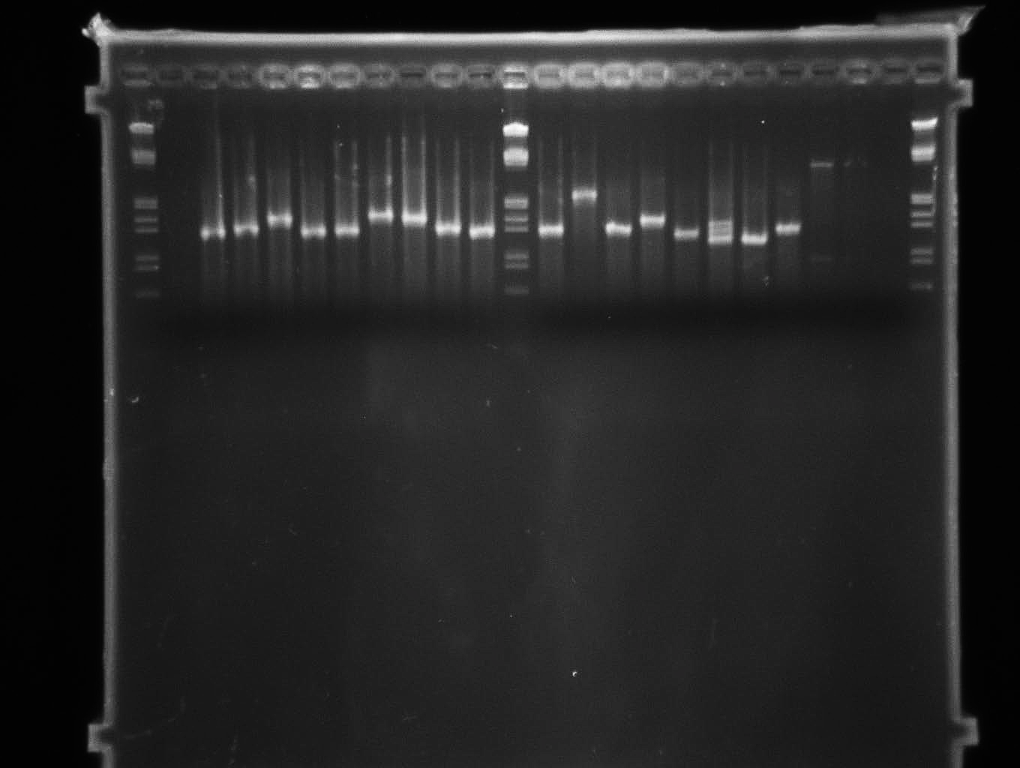
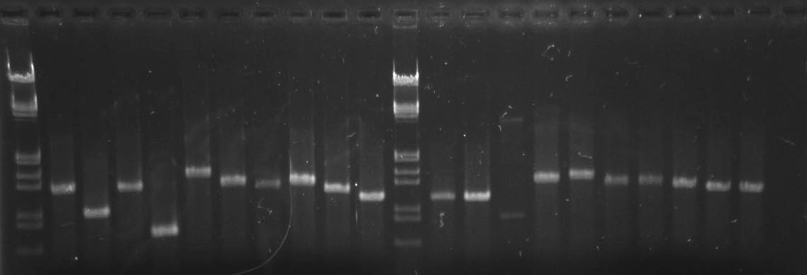
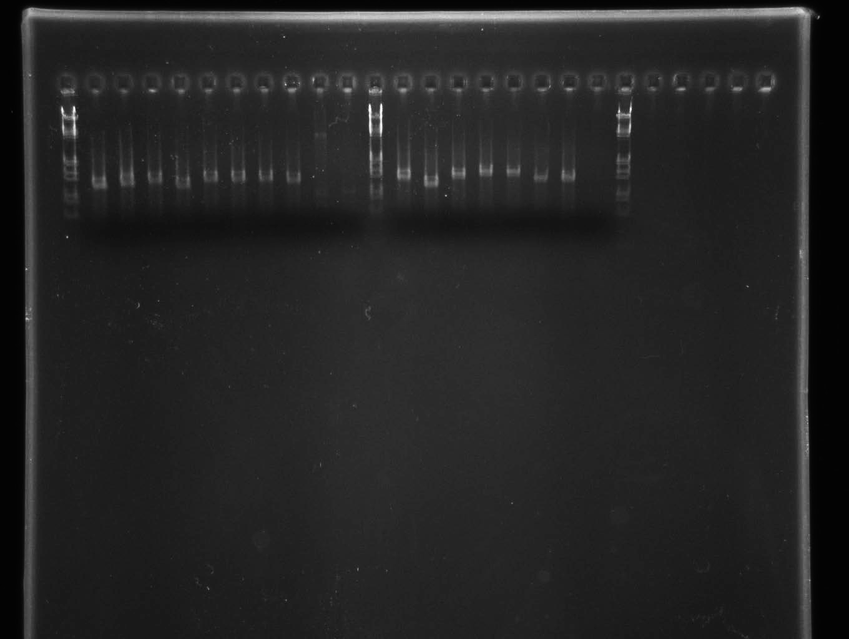
A
M
1
2
3
4
5
6
7
8
9
10
M
11
12
13
14
15
16
17
18
19
20
n
2,027 bp
1,584 bp
1,375 bp
B
M
21
22
23
24
25
26
27
28
29
30
M
31
32
33
34
35
36
37
38
39
40
n
1,584 bp
1,375 bp
831 bp
564 bp
C
M
41
42
43
44
45
46
47
48
49
50
M
51
52
53
54
55
56
57
n
1,584 bp
1,375 bp
Figure S2: PCR amplification of CRISPR arrays from X. citri pv. citri. M, molecular weight marker (λ DNA/EcoRI + HindIII, Promega); n, negative control (PCR reaction without template DNA). A, strains no. 1-20 of Table 4; B, strains no. 21-40 of Table 4; C, strains no. 41-57 of Table 4.

