Slide 1
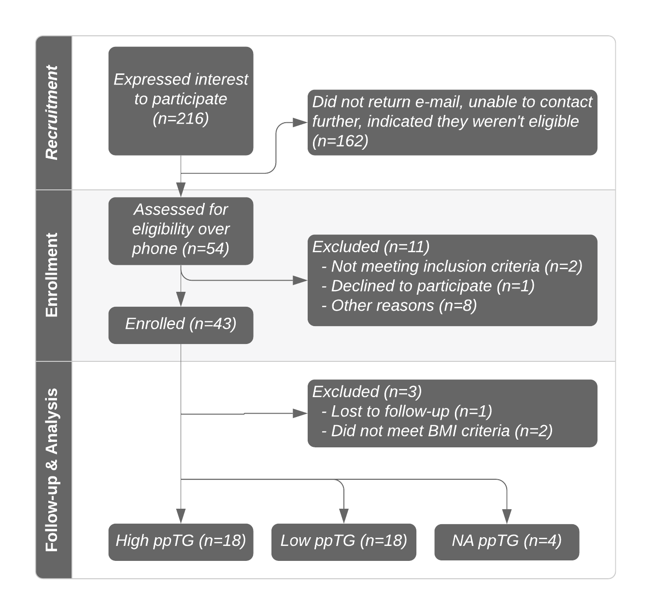
Supplementary Figure 1 | A flowchart of the study design. Flyers and e-mails were used to recruit interested individuals. Interested individuals contacted the research team, who sent additional information about the study. Fifty-four individuals completed a detailed phone screening with the same researcher with those individuals who met eligibility requirements, enrolled to participate. Abbreviations: ppTG, postprandial triglyceride response.

Slide 2
Supplementary Figure 2 | Serum triglyceride responses to high-fat meal challenge. All forty participant triglyceride responses during the four hour testing period are shown, with each color indicating one individual response. TG, triglycerides.

