Slide 1

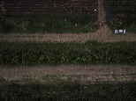
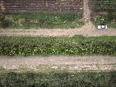
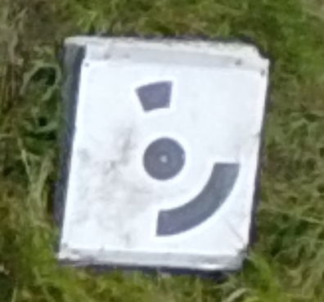
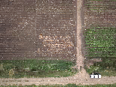
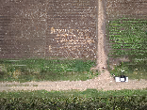
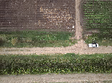
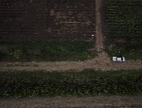
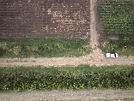
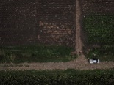
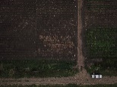
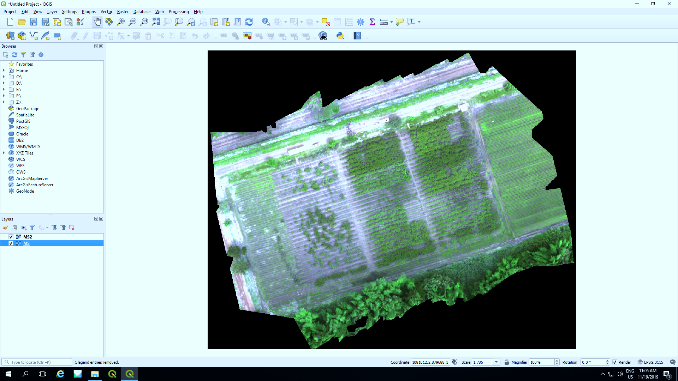
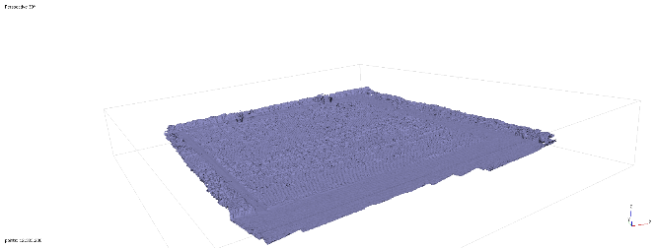
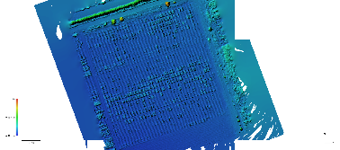
RAW Images .TIFF, .PNG
MicaSense
Reflectance Panel .CSV
Read Photos
Calibration
GCP* Detection
Photo Alignment
Camera
Optimization
Build Orthomosaic
Build DEM*
Build dense Cloud
Export image .Tiff
*GCP: Ground Control Point
*DEM: Digital Elevation Model
Figure S1. Agisoft Metashape automated orthomosaic building pipeline

Slide 2
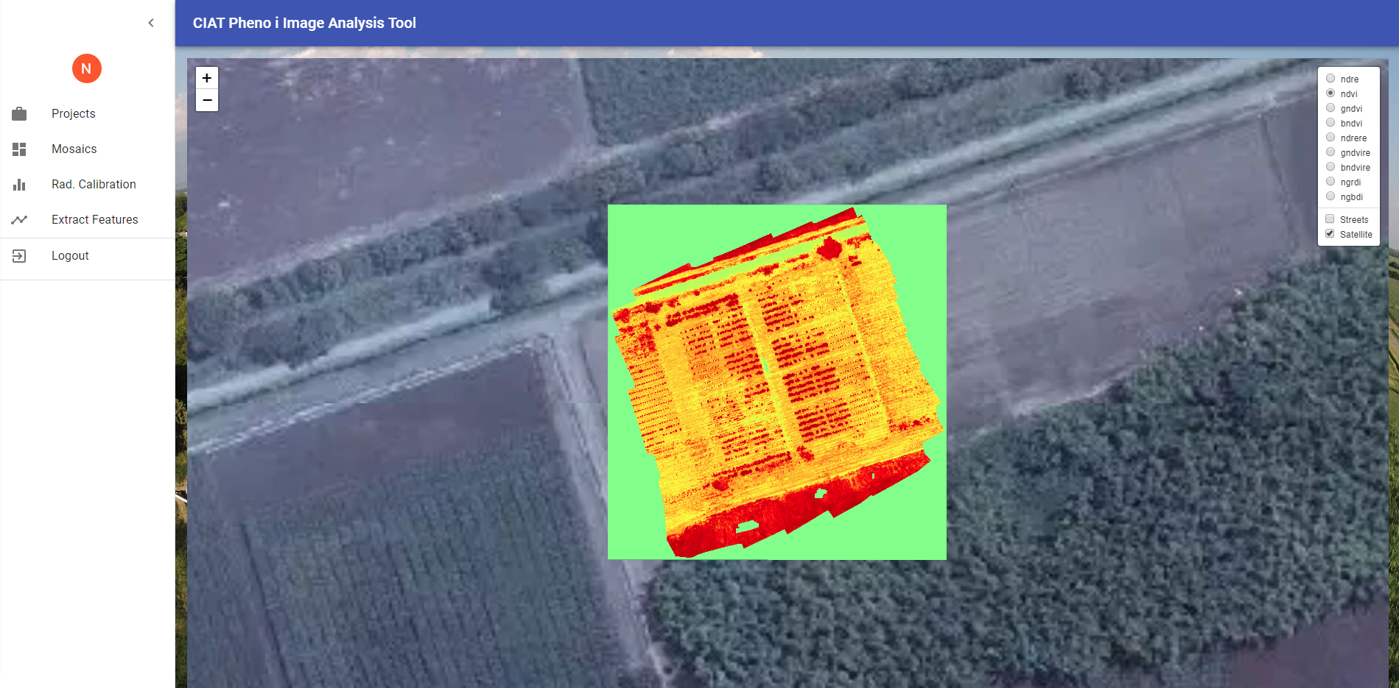
Figure S2. CIAT Pheno-i Front-en overview

Slide 3






CIAT server (Backend)
Front-end server
Browser
FLASK_API.py
Web Application
HTTP Protocol
API RESTFUL
CIAT Pheno-i
Backend.py
Internet
Figure S3. Pheno-i image analysis platform design. Back-end: Developed in Python 3 and Flask as a Web Service. Front-end: Developed using React as a single page app, it implements leaflet.js to render.

Slide 4
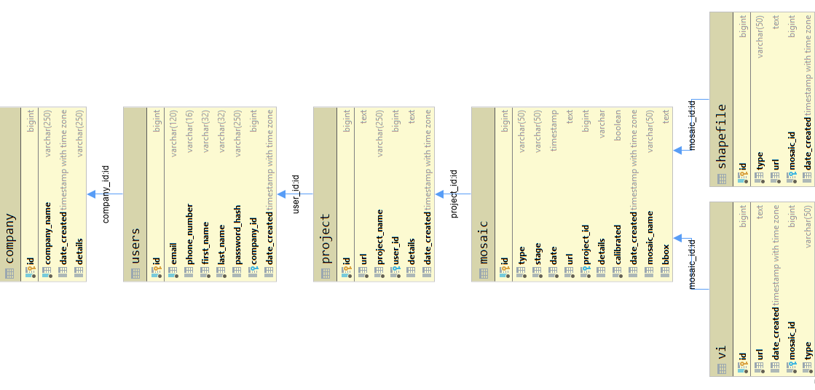
Figure S4. Schematic representation of database implemented in CIAT Pheno-i.

Slide 5
a)
b)
c)
d)
Figure S5. Comparison of time series data between manual and automatic orthomosaic generation with MS and RGB sensors. (a) MultiSpectral trial in manual mode. (b) Multispectral trial in auto mode. (c) RGB trial in manual mode. (d) RGB trial in auto mode. *M1-M8 Manual orthomosaics. *A1-A8 Automatic orthomosaics.

